Slide 1
Welcome
Alison Petch
IRISS Director

Slide 2
Minister for Children and Early Years
Adam Ingram

Slide 3
Family life and the lives they choose
Caroline Tomlinson
in Control

Slide 4
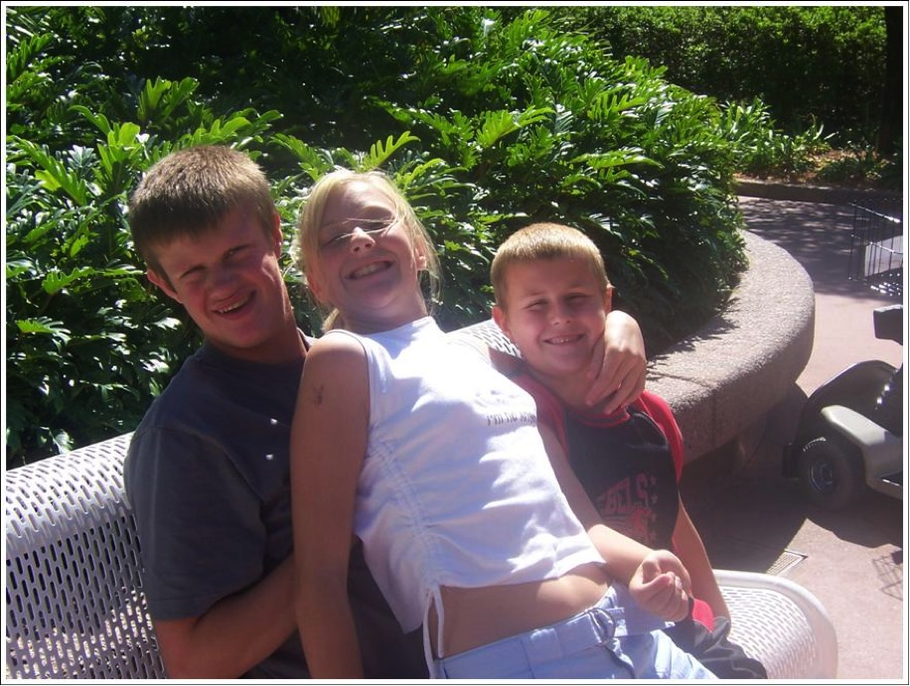
Individuals and Families Living the Life they Choose
The journey from Service Land to a GOOD LIFE
Caroline Tomlinson
Caroline.tomlinson@in-control.org.uk
07947 608 915
www.in-control.org.uk

Slide 5
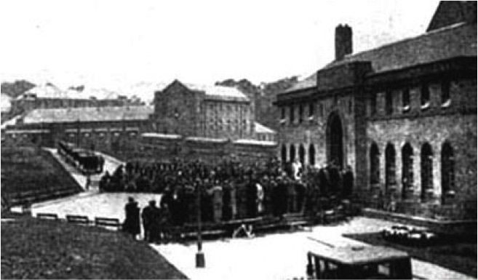
A welfare state fit for purpose
The first world war
We have a Great British welfare state to be proud of?
BUT is it fit for purpose for the next generation?

Slide 6
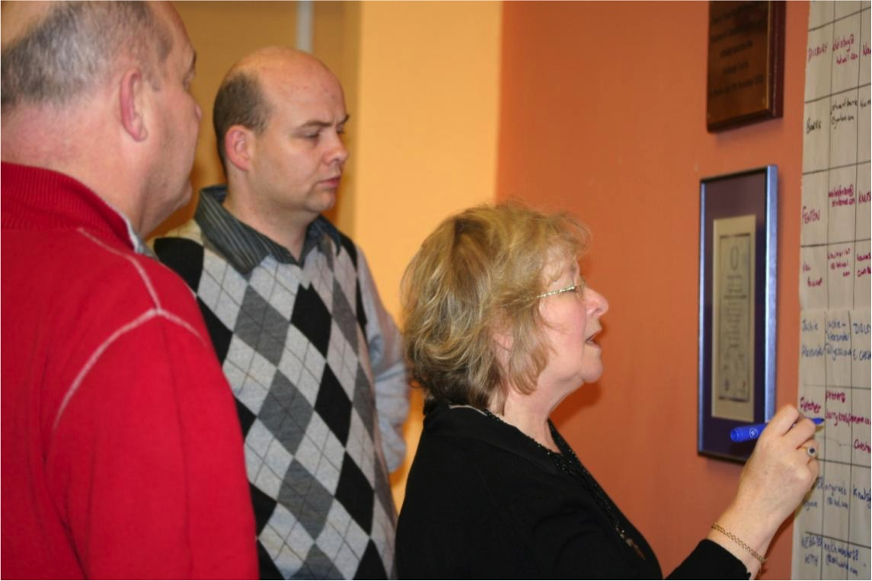
So who are the people and what do they need??

Slide 7
So how did it all happen?
The story so far for Joe
Sit back, relax and enjoy!

Slide 8
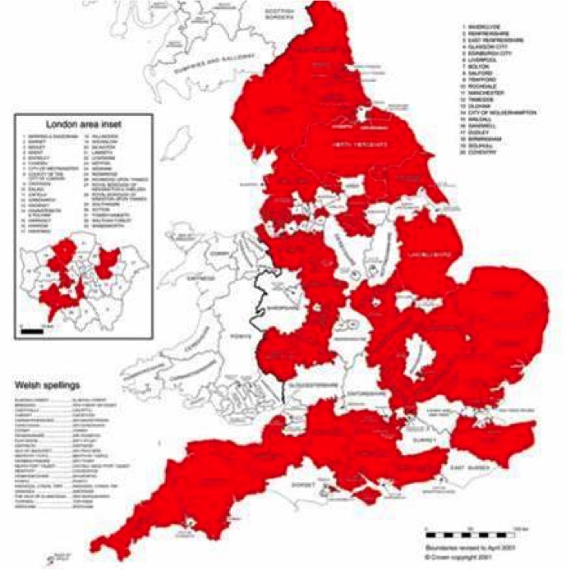
Network for Social Innovation: led reform and innovation in Social Care - founded in 2003
Membership: 122 adult departments, 36 childrens, 38 PCTs & 21 TT authorities
Independent charity - trustees: CPA, OPP, NCIL, ADASS, Together, Mencap, NAAPS
Defined concepts: Self-Directed Support, RAS, Individual Budget, Support Plan, Brokerage...
Social enterprise: www.shop4support.com PLAN, Partners in Policy Making
Policy work: social care funding, personal health budgets, community capacity
Open Source materials - www.in-control.org.uk
In Control International: Australia, Cymru,
N Ireland, Scotland, Japan, Finland, Italy

Slide 9
1996 Direct Payments Act
1996 Inclusion Glasgow
2000 Piloting of SDS in Scotland
2001 Valuing People in England
2003 in Control partnership begun
2003 Testing begins in 6 authorities
2004 Policy interest begins
2005 Initial government commitment
2006 IB Pilot Programme begins
2007 in Control Scotland & Cymru
2007 iC membership reaches 107
2007 Putting People First published
2008 Children and health work stream developed
Policy and Practice

Slide 10
PUTTING PEOPLE FIRST 10th Dec 2007 was launched
A serious message from Government that this is going to happen
Giving Local Authorities a transformational grant to help make the change

Slide 11
The Keys to Citizenship
Self-determination
Direction
Money
Home
Support
Community Life

Slide 12
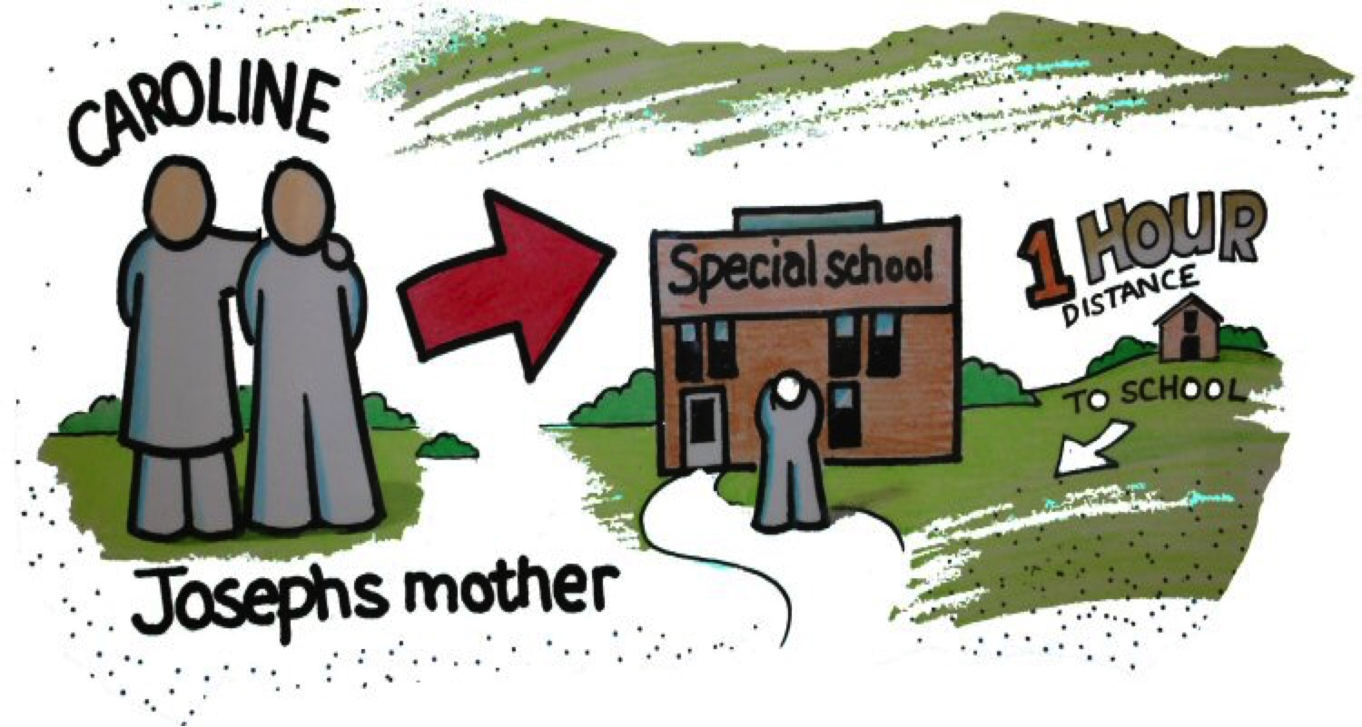
Was Joe being seen as a citizen in his community like everyone else?

Slide 13
The ‘Gift’ model

Slide 14
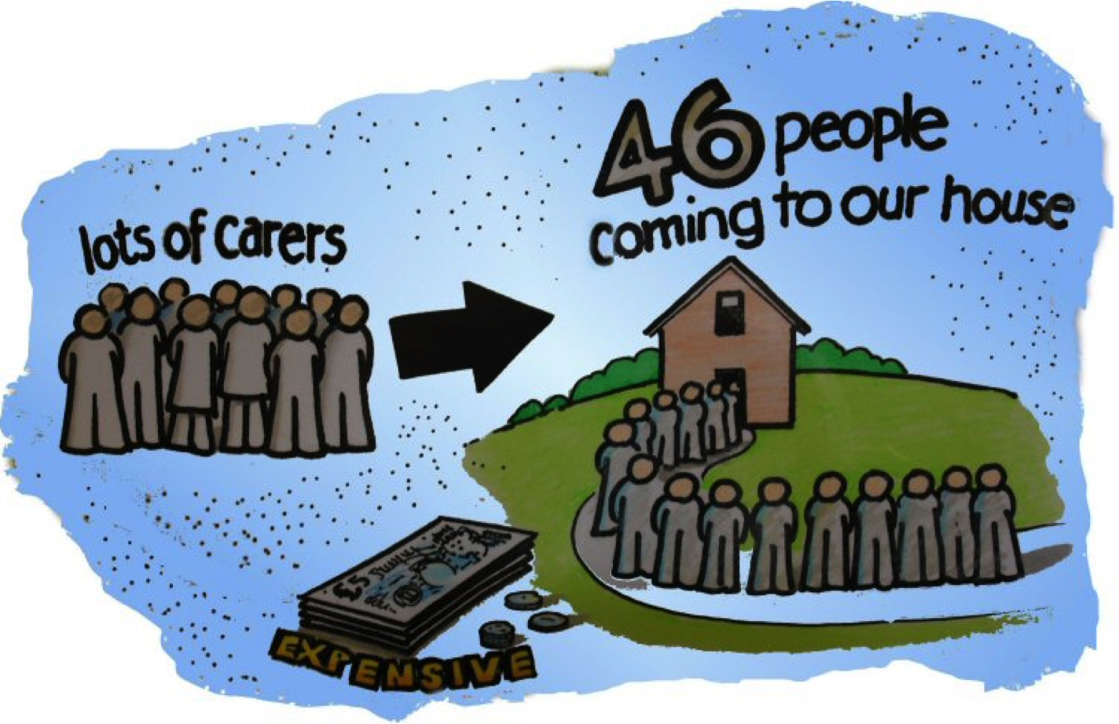
NO – we were being given the ‘gift’ of services

Slide 15
The Citizenship Model

Slide 16
The new system
Individual has maximum control (but checks)
Individual knows their budget
Planning is real
Encourages creative & community solutions
Builds partnership with professionals

Slide 17
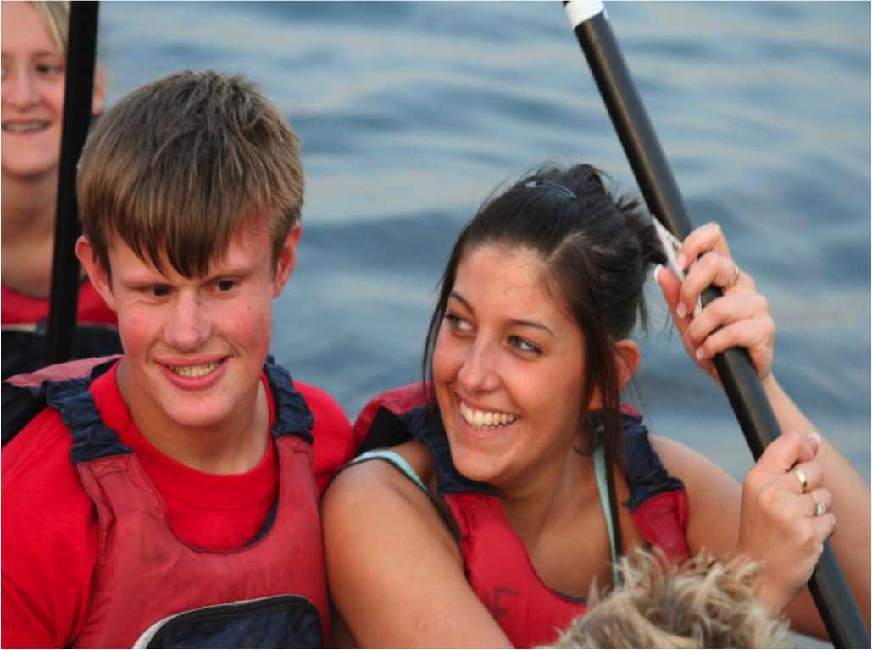
A person centred approach
Circle of friends
Assessment
Resource Allocation
Support Plan
My Skills and gifts
My plans now, next year
and in the future.
How I control my own life
Organising the help I need
The Community
So how did it work for Joe?

Slide 18
So what difference has it really made for me?

Slide 19
Joe found a great team to support him

Slide 20
He got his own car

Slide 21
He started college ...but needed more things to do

Slide 22
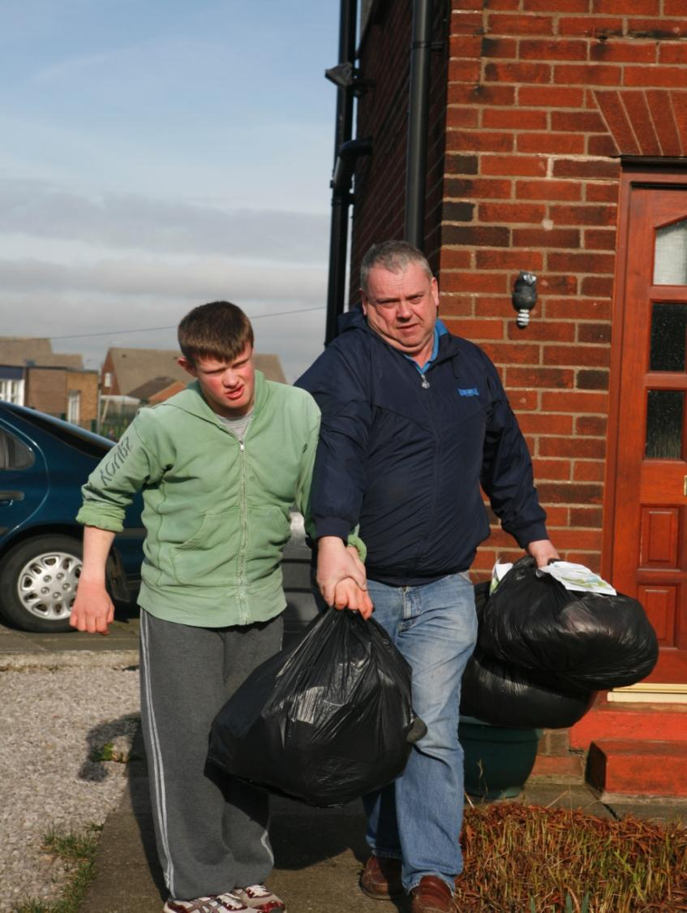
Clothes,
collecting, reusing and recycling with the ODD SOCKS ENTERPRISE
And importing fair trade goods made from recycled materials.

Slide 23
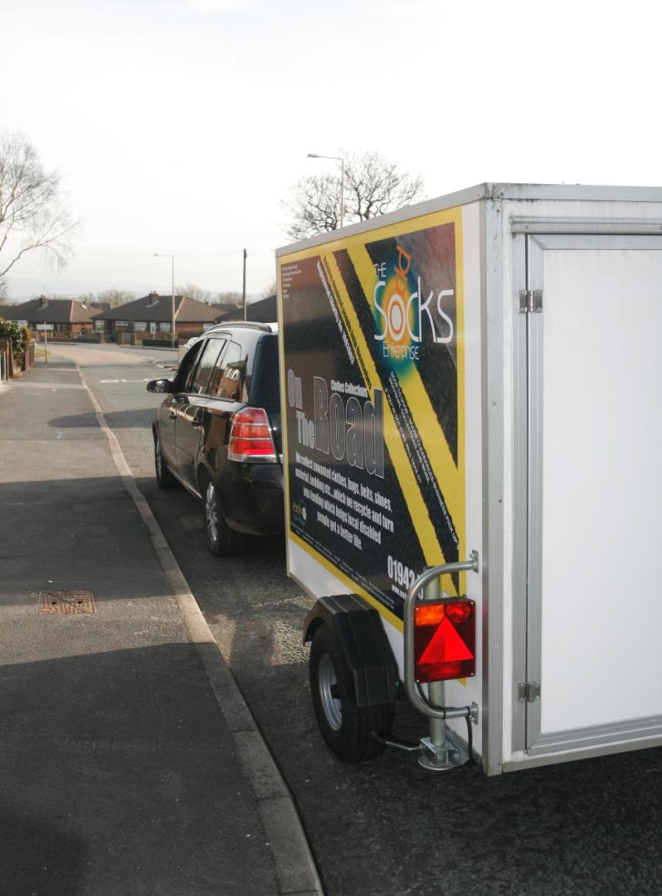
Ready for more clothes collections with my trailor

Slide 24
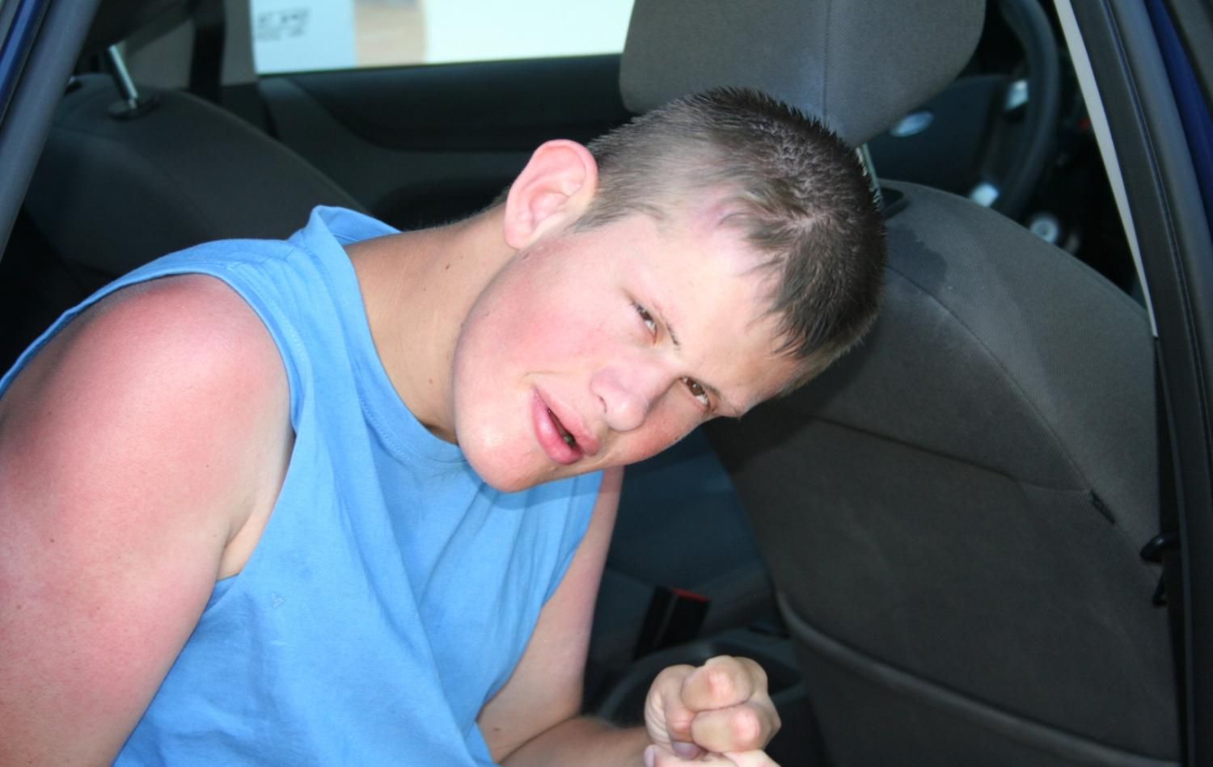
Went on holiday

Slide 25
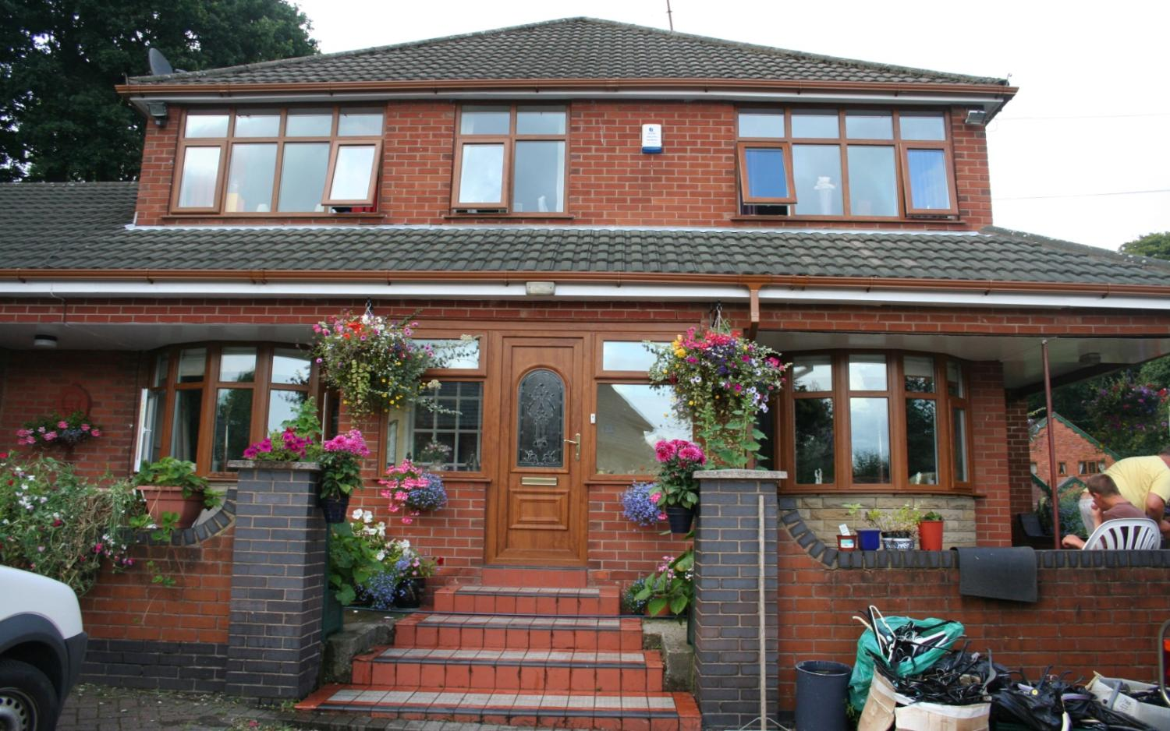
Bought my own home – “Sunnyville”

Slide 26
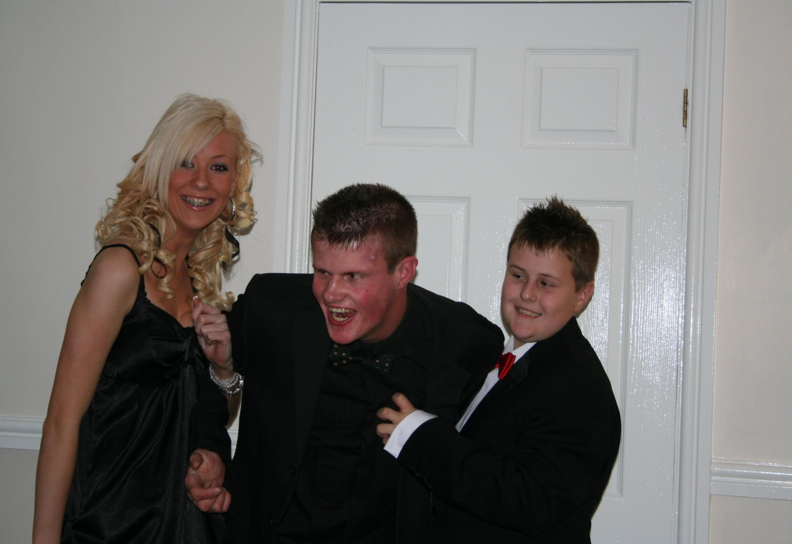
Is still part of the family with roles and responsibilities to fulfill as a brother, son, nephew etc....

Slide 27
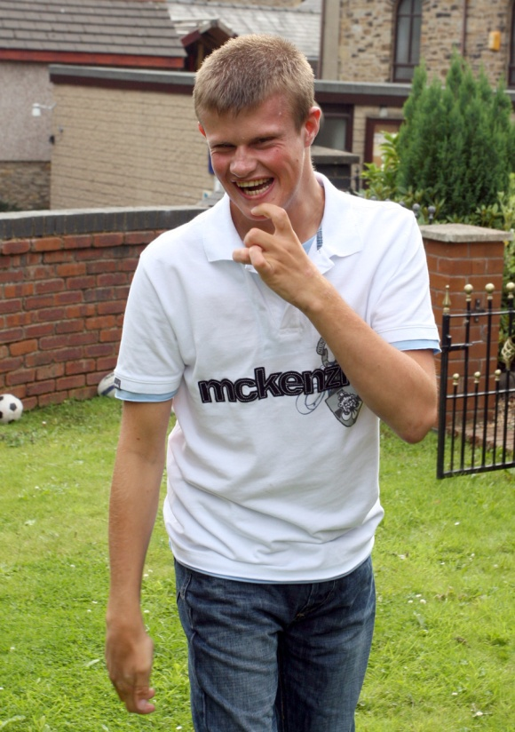
...and really started to enjoy life

Slide 28
So……
don’t STOP me now!!!!!!!!!

Slide 29
Joe - 60 feet up a tree in the Lake District at Kepplewray
A man is either free or not. There cannot be any apprenticeship for freedom.
Imamu Amiri Baraka

Slide 30
The love of liberty is the love of others, the love of power is the love of ourselves.
William Hazlett
Joe on the Nemesis at Alton Towers

Slide 31
You only have power over people so long as you don’t take everything away from them.
But when you have robbed a man of everything he’s no longer in your power - he’s free again.
Alexander Solzhenitsyn
Joe on the Standish to Southport bike ride summer 2004.

Slide 32
None of those who have been free can understand the terrible fascinating power of the ‘hope of freedom’ on those who are not free.
Pearl S. Buck
Joe being towed by a speed boat across the Mediterranean with Clare and Jonny, our friends who lived in Spain.

Slide 33
Laughing WITH not at Joe as he prepares to absail.

Slide 34
Freedom is never voluntarily given by the oppressor, it must be demanded by the oppressed.
Martin Luther King,Jr.
Joe in the Wigan Pier Theatre Company Community Production March 2005

Slide 35
A life spent in making mistakes is not only more honourable but more useful than a life spent doing nothing.
George Bernard Shaw
Joe meeting Fred Flintstone in Madame Tussauds

Slide 36
Who knows? Maybe my life belongs to God. Maybe it belongs to me. But I do know one thing: I’m damned if it belongs to the Government!
Arthur Hoppe
Joe and friends stood on the glass at the top of Blackpool Tower

Slide 37
Joy is not in things, it is in us Richard Wagner
Joe at home with his family

Slide 38
Joe waiting for the limo to pick him up for the Bronze Duke of Edinburgh Ball to receive his award.
Joe has now completed his Silver Award and is working towards his GOLD
Hold tenderly that which you cherish
Rob Albert

Slide 39
He
He achieved his GOLD duke of Edinburgh award in November 2008.

Slide 40
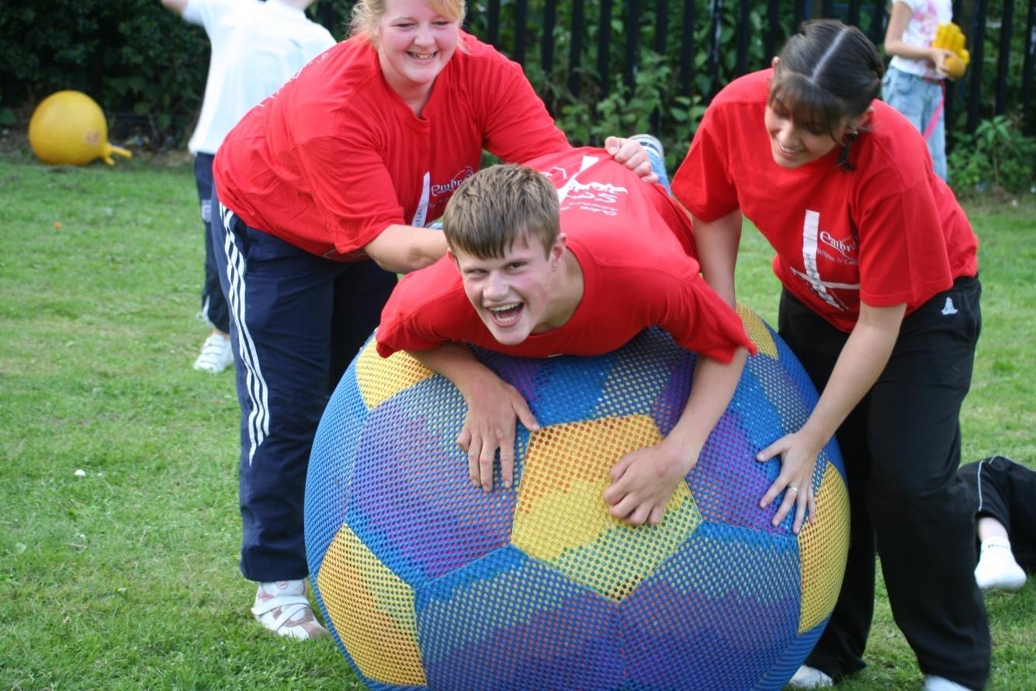
Who was it that said I don’t communicate?

Slide 41
I do not love him because he is good, but because he is my child. Rabindranath Tagore
Joe just being the usual ‘cheeky’ Joe

Slide 42
Dancing queen..........young and sweet, definately not seventeen!!!!

Slide 43
Yet another social function - going by Stretch Limo this time though!!

Slide 44
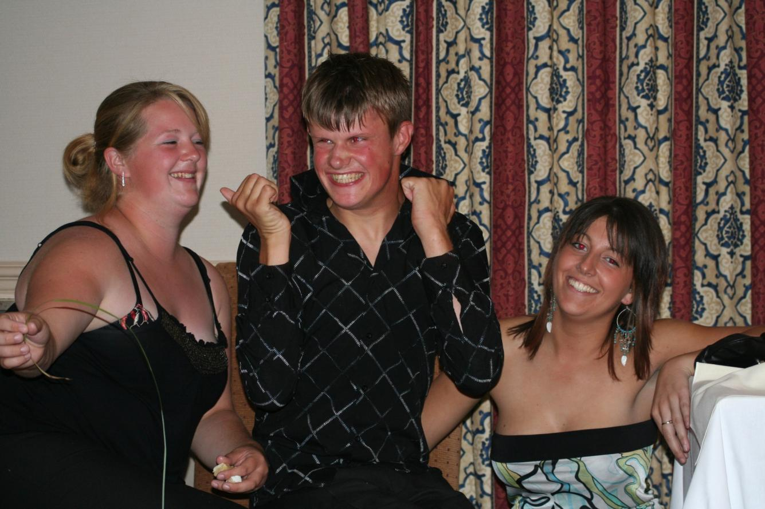
So Joe what do you think of your PA’s?

Slide 45
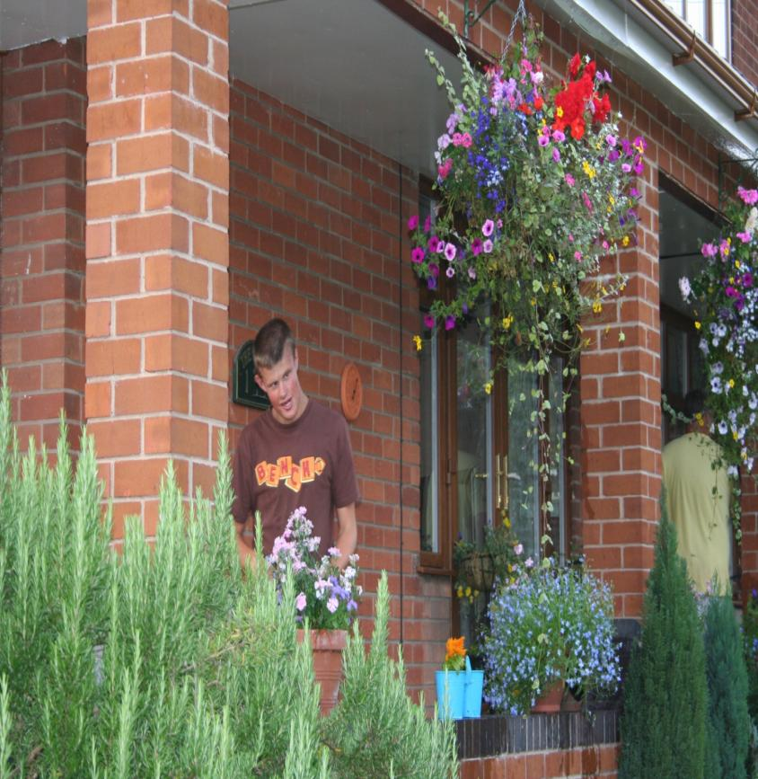
Joe at the side of “SunnyVille”

Slide 46
Chilling with Dad!!
The best and most beautiful things in the world cannot be seen or even touched.
They must be felt with the heart.
Helen Adams Keller

Slide 47
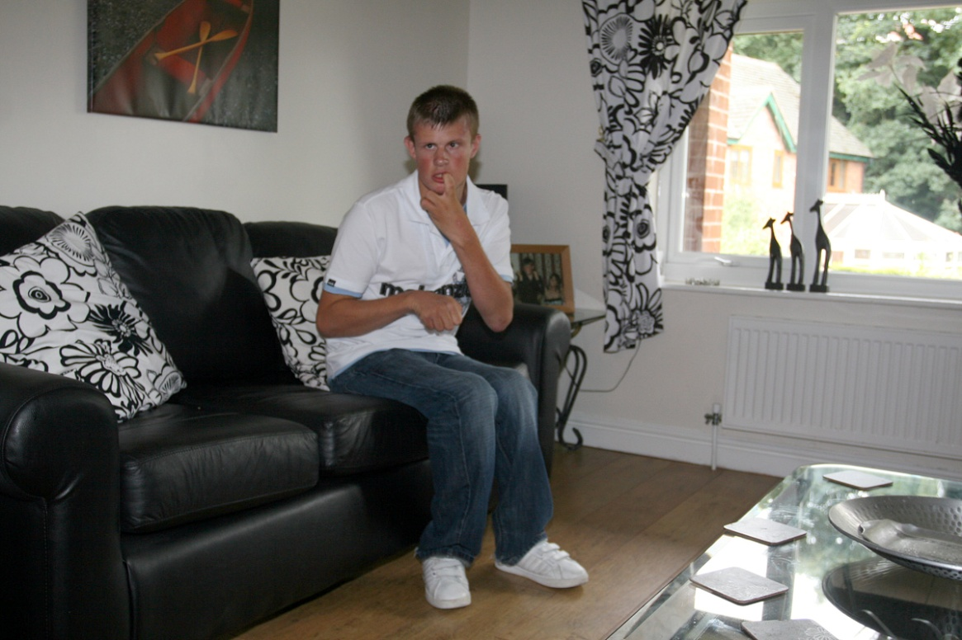
Having a minute!!
Love is but the discovery of ourselves in others, and the delight in the recognition. Alexander Smith

Slide 48
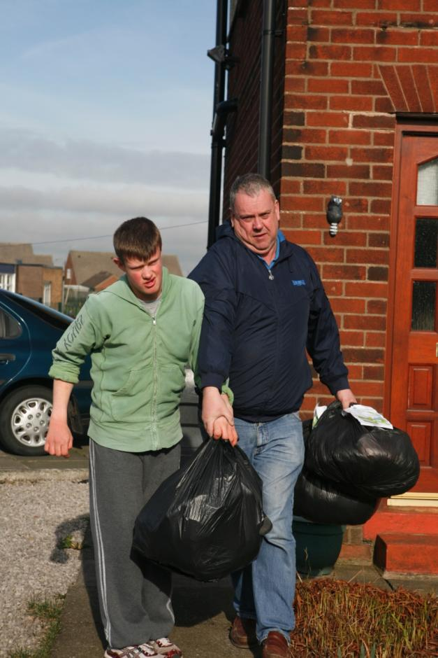
Joe and The Odd Socks Enterprise

Slide 49
Joe working at his sale

Slide 50
Feeling a little tired after the 8 mile sponsored walk

Slide 51
Joe enjoying life in his own home
So who’s in control now?

Slide 52
Jacob doing what he does best……….being a monkey!

Slide 53
Hey Rosie, watch you don’t bite your tongue!

Slide 54
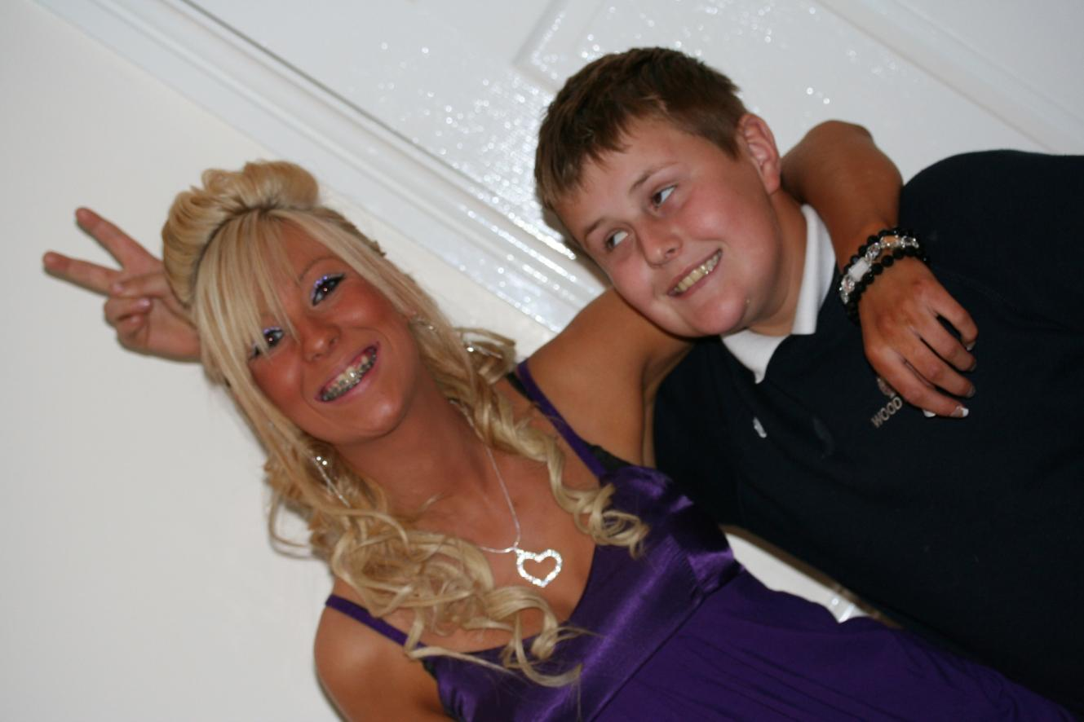
Rosie and Jacob growing up and living their life

Slide 55
So sweet and precious is family life James McBride

Slide 56
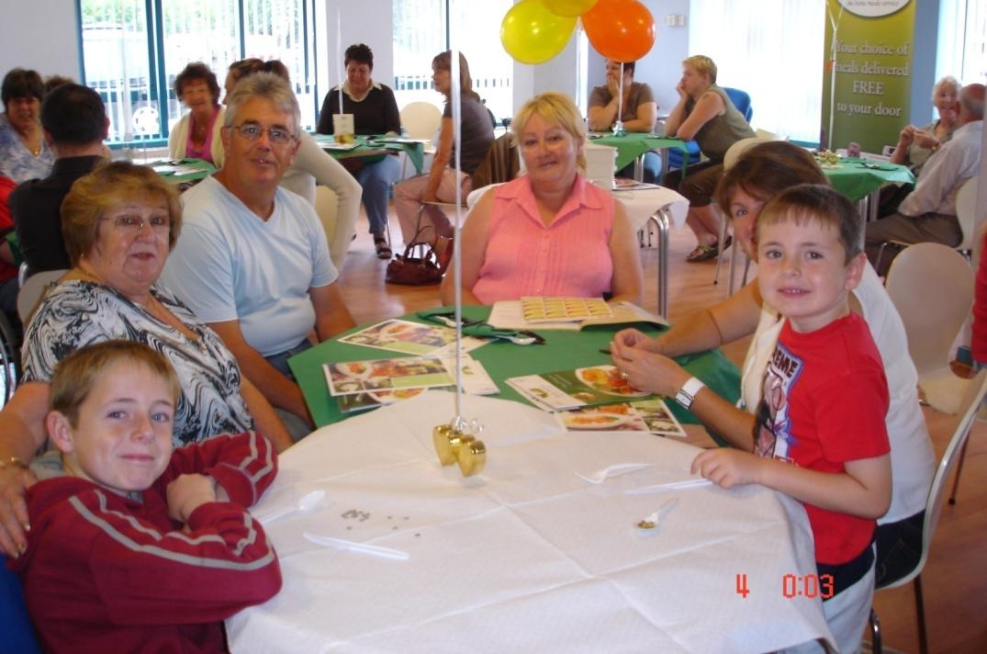
Services have promised generations of families so much, its NOW time to deliver because people who need support don’t have the time to wait to get a GOOD LIFE.

Slide 57
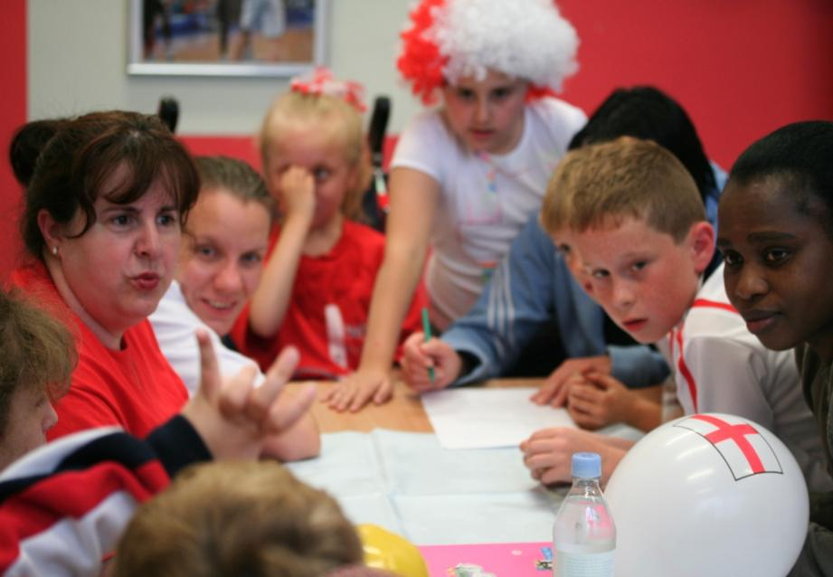
It can all be done
We know how to do it
Some are doing it well
It will be hard work
The most important work is always hard.

Slide 58
Thank you for letting me join you today
caroline.tomlinson@in-control.org.uk
07947 608 915
www.in-control.org.uk
www.shop4support.com

Slide 59
Break
North Gallery

