Slide 2
Who are carers?
Unpaid carers are individuals who care for a friend, relative or neighbour without receiving paid income other than income received through the benefits system.
About 1 in 8 of the population in Scotland (approx 657,000 people)
16,701 of carers in Scotland are young carers.

Slide 3
Short breaks
short breaks, ‘breaks from caring’ or ‘respite care’ all refer to a carer and the person they care for being supported – mainly through the provision of a service – to have a break from their normal routine and the demands of their caring situation.

Slide 4
What we did
Scotland-wide survey (approx 10,000)
5 focus groups (1 specifically for BME)
13 interviews

Slide 5
Impact of caring
Over half of the survey respondents felt that caring had negatively affected their interests and hobbies and their mental wellbeing.
Over 40% reported that caring had negatively affected their family life, friends, finances, physical wellbeing and career.
A third of respondents said that caring had a positive impact on their hobbies, family life, physical wellbeing and friendships.

Slide 7
Experience of short breaks
Over half (57%) of survey respondents had not taken a break from caring.
63% of black and minority ethnic (BME) carers had not had a break from caring.
Respondents most likely to be satisfied with the quality of the break, the choice, support to organise it and the length.
Respondents were most likely to be dissatisfied about the frequency of breaks.

Slide 8
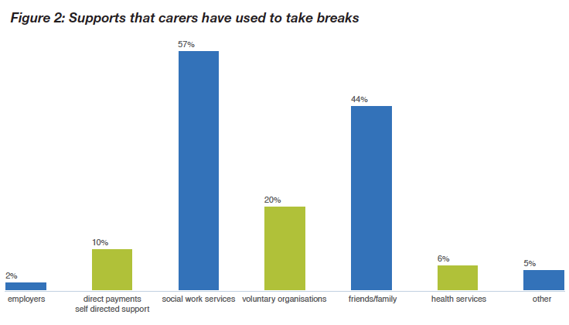

Slide 9
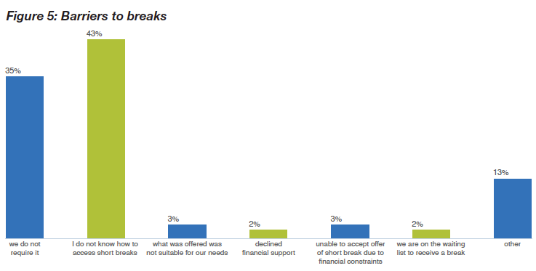

Slide 10
Other barriers
Difficulty with the planning process
A lack of appropriate and personalised provision
Guilt
Uncertainty about eligibility

Slide 11
What carers said they need
Early not crisis intervention
More choice, flexibility, frequency and length of short breaks
More information about carers’ entitlements and availability of short breaks
More appropriate and personalised short breaks, including culturally suitable services for BME carers
Better planning processes including a single point of contact and dates for short breaks secured well in advance

Slide 12
Next steps
1. Planning for improvement
2. Involving carers in decisions about the future development of short breaks
3. Extending the reach of short breaks
4. Improving information and advice about short breaks
5. Meeting the challenges and opportunities presented by Self-directed Support
6. Helping families and communities to support each other
7. Measuring the reach and impact of short breaks

Slide 13
Discussion questions
How can champions support the use of evidence to improve outcomes for people who access support and unpaid carers?
Any examples of how you already do this?
What support might you need from Ito improve the way you do this?
Notes:
Rest assured? is an example of evidence. We hope one of the objectives of the champion network is to help support the use of evidence – eg circulate insights, raise awareness, include in training sessions, get these issues on organisations’ agendas.
Current examples of how you support the use of evidence in your practice?

