Slide 1
“It takes big courage”:
Children and young people talk about living with parental alcohol problems and seeking support
SCCPN Child protection seminar
Louise Hill
1st March 2011

Slide 2
Overview
Background
Living with parental alcohol problems
The need for courage
Implications for practitioners

Slide 3
Hidden population
Issues of stigma and secrecy. Legality and broad social acceptability of alcohol. Defining harmful drinking can be difficult and relies on parental reporting.
Government figures estimate 65 000 children (under 16) are living with parental alcohol misuse in Scotland (2009).
UK population estimates (Manning et al, 2009):
  Approximately 30% of children under 16 live with at least one binge drinking parent in the UK [General Household Survey, 2004]
  22% of children live with a hazardous drinker and 6% with a dependent drinker [National Psychiatric Morbidity Study, 2000]

Slide 4
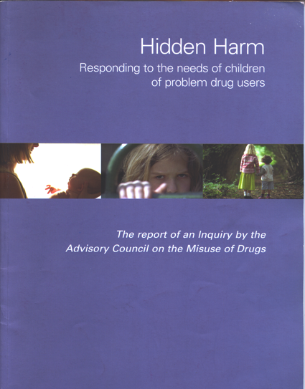
Policy context
Hidden harm
  An influential inquiry by the Advisory Council on the Misuse of Drugs published in 2003
  Focus on needs of children (foetal to eighteen years) of problem drug users
  A catalyst for action: responses from Scottish Government – extended the remit to include alcohol
Alcohol and drug policy
  Road to recovery (2008)
  Changing Scotland’s Relationship with alcohol: A Framework for Action (2009)

Slide 5
Impact on children
There is considerable variety in the experiences and outcomes for children affected by parental alcohol problems; thus, it is important to recognise that the impact on every child within every family can be different and there is no simple negative trajectory (Velleman, R & Orford, J, 1999)
Cumulative affect of multiple adversities in childhood that leads to negative outcomes (Cleaver et al. 1999)
BUT for the majority of children, parental alcohol problems have a negative affect on their childhood; ‘most of the children conveyed a clear message of deep hurt resulting from parental drinking, although a minority appeared to have taken it in their stride’ (Laybourn et al. 1996:136)

Slide 6
Impacts (Adapted from Cleaver et al., 1999)
 | Potential problems | Protective factors
Unborn child | Foetal damage – maternal alcohol consumption & maternal wellbeing Physical violence | Good antenatal care Support & safety
Children 0-4 years | Neglect; consequences of parental behaviour on attachment – consistency, warmth; possibility of physical danger Responsibilities & unable to tell | Caring adult & supportive help Good home environment Regular attendance at nursery provision
Children 5-9 years | Emotional wellbeing Impact on schooling – attendance, concentration, friendships, bullying Responsibilities at home & physical safety | Cognitive ability to make sense of parental alcohol use & separate self Positive school experience & friends Social networks incl. organised clubs
Children 10-14 | Identity, puberty, denial of own needs and feelings Isolation, young carer, hostile to outsiders | Coping strategies & information Unstigmatised support – adult as a ‘champion’
Children 15+ | Inappropriate role models Risk of school exclusion/own needs ignored Emotional problems/low self esteem | Attendance at college/employment Trusted adult

Slide 7
Children identified ‘at risk’
Audits of Child Protection Registers
  One London audit of children on Child Protection Registers (CPR) found parental substance misuse was a concern for just over half the children, with alcohol the greater concern at 24% compared to 16% heroin use (Forrester, 2000)
  English study found 75% of children on CPR had parents misusing alcohol on its own or with other substances; furthermore, social workers had the greatest concerns about these children (Hayden, 2000)
  Forrester & Harwin’s (2006) study identified a third (33%) of children on the CPR affected primarily by parental alcohol problems.
  A study across six English local authorities found a third of children in social worker case files were negatively affected by parental alcohol problems (Cleaver et al. 2007)
Small scale study of social backgrounds of children referred to the Children’s hearing system found 39% of families had one or both parents have problems with alcohol (SCRA, 2004)

Slide 8
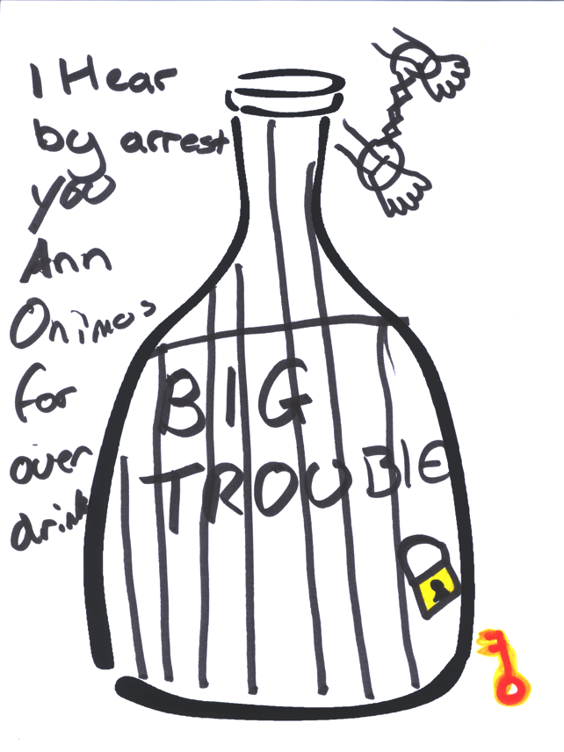
Living with parental alcohol problems
Jessica, aged ten
Drawing produced when asked ‘what comes into your head when I say the word ‘alcohol’?’
(Hill, 2011)

Slide 9
A real concern for children and young people when using ChildLine (confidential telephone support service)
  Parental alcohol misuse found to be the most frequent concern regarding parental health and well being (31%) followed by drug misuse (11%) and domestic abuse (7%) in a study of 9 000 children’s phone calls to ChildLine Scotland (CRFR/ChildLine Scotland 2005)
  Often many worries of which parental alcohol problems are a part – family conflict and violence, domestic abuse, parental mental health, bereavement, financial hardships, caring responsibilities, school difficulties (especially bullying/attendance) (Gillan et al 2009)

Slide 10
The need for courage
Factors affecting talking about parental alcohol problems and seeking support
  (Often) love and loyalty for a parent and family
  Fear of being removed
  Fear of reprisals (in some cases)
  Fear of being bullied/associated stigma if known
  Do not want to be ‘treated differently’
  Not being taken seriously
  Being able to trust
  Optimism – it will get better soon!
  Finding the right words….

Slide 11
Implications for practitioners
Need to recognise the possible anxieties in talking about parental alcohol problems – will take time and trust
Provide non-judgemental and non-stigmatising support
Find different ways to communicate
  Use stories – ‘Good to start the conversation’
  Talk through the third person or abstract
  Open methods (e.g. alcohol bottle)
  Be sensitive in using alcohol education resources
  Be open to the ways in which children may engage in different methods and choose to communicate in different ways
Challenges of understanding multiple problems - children, parents and professionals views may all differ
Parents may be reluctant to accept alcohol use has an impact on children or engage with services

Slide 12
References
Advisory Council on the Misuse of Drugs (ACMD) (2003) Hidden Harm: responding to the needs of children of problem drug users London: Home office
Cleaver, H, Unell, I, Aldgate, J (1999) Children’s needs – parenting capacity: The impact of parental mental illness, problem alcohol and drug use and domestic violence on children’ London: TSO
CRFR/ChildLine (2005) Children’s concerns about the health and wellbeing of parents and significant others Edinburgh: CRFR
Forrester, D. (2000) Parental substance misuse and child protection in a British sample A survey of children on the child protection register in an inner London district office. Child Abuse Review, 9(4):235-246.
Forrester, D & Harwin, J (2006) Parental substance misuse and child care social work: findings from the first stage of a study of 100 families, Child & Family Social Work, 11(4): 325-335.
Gillan, E, Wales, A, with Hill, L, & Robertson, F (2009) Untold damage: children living with parents who drink harmfully Glasgow: ChildLine Scotland/SHAAP
Hayden, C (2004) Parental substance misuse and child care social work: research in a city social work department in England, Child Abuse Review 13(1):18-30

Slide 13
Laybourn, A., Brown, J and Hill, M (1996) Hurting on the inside: Children’s experiences of parental alcohol misuse Aldershot: Avebury
Manning, V, Best, D, Faulkner, N & Titherington, E (2009) New estimates of the number of children living with substance misusing parents: results from UK national household surveys BMC Public Health 9:377-388
Scottish Government (2008) The road to recovery: a new approach to tackling Scotland’s drug problem Edinburgh: Scottish Government
Scottish Government (2009) Changing Scotland’s relationship with alcohol: a framework for action Edinburgh: Scottish Government
SCRA (2004) Social backgrounds of children referred to the Reporter: a pilot study Stirling: Scottish Children’s Reporters Administration
Velleman, R & Orford, J (1999) Risk and resilience: Adults who were children of problem drinkers Amsterdam: Harwood Academic

Slide 14
Contact details
Centre for Learning in Child Protection
University of Edinburgh and NSPCC
Moray House School of Education,
Paterson's Land, Holyrood Road,
Edinburgh, EH8 8AQ
Tel: 0131 651 6443
Email: Louise.Hill@ed.ac.uk
Thank you for listening! ☺

