Slide 1


Young people’s research:
Who Cares? Scotland’s advocacy services
Sharon Smith
Jimmy Paton
Laura Dooley
Kourtney Stewart
David Miller

Slide 2
Introduction
We evaluated Who Cares? Scotland advocacy service on how they support young people
  We wanted to help Who Cares? improve the way they support young people.
We got involved because we have all been in care and have previous experience with Who Cares? Scotland.
We learned about doing research, decided on the research methods, carried out the research analysed the results.

Slide 3
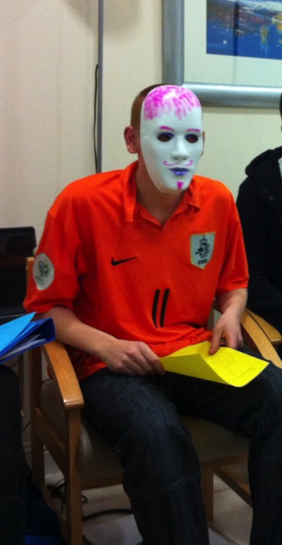
What was the research about ?
We decided to look at how Who Cares? was performing
on 3 different outcomes:
People know what Who Cares? is for
Young people get support from Who Cares?
when they need it
Young people have a voice
(because of Who Cares?)
We decided that the 3 points above were
most important because they would show
that Who Cares? was providing a really
good advocacy service.

Slide 4
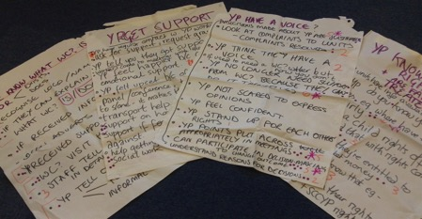
How we did the research
Online questionnaire with professionals (27 responses)
Paper questionnaire with residential staff (28 responses)
One focus group with young people in children’s houses.
7 one to one interviews with young people in children’s houses.

Slide 5

Why we chose these methods
Surveys
  We wanted to get the views of a wide variety of adults
Young people
  Focus groups to get lots of information
  One to one interviews to capture personal views and experiences

Slide 6

Limitations
Lack of time
Small numbers of people consulted
Young people consulted were already involved with Who Cares? Scotland
Young people in the focus group felt uncomfortable talking in front of their Who Cares? worker
Young researchers all involved with Who Cares? – bias?

Slide 7
Findings: Knowledge of Who Cares?
All residential staff and 90% of professionals had heard of Who Cares? and could say what they did
The majority were also very or quite confident that they could explain about Who Cares? to a young person
However, young people were not always sure what Who Cares? did

Slide 8
Findings: Support from Who Cares?
Both young people and adults consulted were mainly aware of the support that Who Cares? offers in meetings
Young people thought that the support they received from Who Cares? was really good
They felt that they had a good relationship with their Who Cares? worker

Slide 9
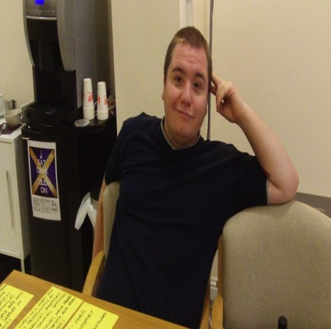
Findings: Support from Who Cares?
Who Cares? workers helped young people with their confidence and self esteem and to get their point across
The young people felt that they could trust their Who Cares? workers
Young people also believed that
Who Cares? generally made a
difference to young people’s
lives

Slide 10
Findings: Getting in contact with Who Cares?
Although the support from Who Cares? is seen as good, it can be really hard for young people to access the support.
  Lack of access to phones in children's houses or not having money to make phone calls
  When young people phone their Who Cares? worker they don’t always answer or return calls quickly
  Other options for contact are limited, for example email or internet

Slide 11

Findings:
Residential staff
Residential staff were unsure of the difference made by Who Cares?
Only 39% thought young people were happier and more confident most of the time after receiving support from Who Cares?
Some staff thought that Who Cares? didn’t give young people the answers they wanted to hear and were unlikely to provide a different point of view from the residential staff

Slide 12
Conclusions and recommendations
Outcome 1: People know what Who Cares? is for
Rating: Amber
Build better relationships with residential staff and help them understand why you are important
Show residential staff why you are important from a young person’s point of view
Expand your promotion so people are aware of your full range of services

Slide 13
Conclusions and recommendations
Outcome 2: Young people get support from Who Cares? when they need it
Rating: Amber
Can you make a rule or policy that staff will reply in a few hours and tell the young people what they can expect
Have another number or member of staff available as an alternative contact
Consider a free phone number

Slide 14
Conclusions and recommendations
Outcome 2: recommendations continued
There is some interest in an out of hours service
You could consider increasing internet contact like social networking or email
Young people sometimes don’t feel like there are enough staff for some areas, would it be possible to increase the numbers?

Slide 15
Conclusions and recommendations
Outcome 3: Young people have a voice
Rating: Green
Keep your services active as they help young people feel confident and make a difference to their lives.
You are really strong at helping young people speak up and giving practical support.
Young people feel comfortable with their Who Cares? workers and really trust them.

