Slide 1
The Canadian “Home Children”
a case study in the digitization of social work heritage material
Neil Ballantyne
Scottish Institute for Excellence in Social Work Education
&
Ellen Daly
Scottish Institute for Excellence in Social Work Education.

Slide 2
Social work history
Emerged from the crucible of massive societal changes and dislocations associated with the industrial revolution.
Historical traces inscribed in books, documents, images, artifacts, leaflets, newsletters and ephemera.
Many documents & artifacts remain out of public view, buried deep within the archives of modern day governmental & not-for-profit organizations, often maintained in sub-optimal conditions.

Slide 3
Does it matter today?
Literature search using Social Care Online database
642 records of books and articles published 1997 to 2006 classified with the phrase “social work history”.
516 were articles, 126 were books.
Mean of 64.2 social work history articles each year.
Just over one publication each week of the last ten years.
Historians make sense of the present by tracing its roots and resonances with the past.
Social amnesia is not healthy.

Slide 4
Heatherbank
Museum of Social Work
Opened to the public from his home in Glasgow by Colin Harvey in 1975.
Moved to Glasgow Caledonian University in 1994.
Aims to:
  help educate & challenge society to understand the caring professions and those needing care;
  act as a resource for the study of the history of social work and welfare; increase awareness of social welfare needs by presenting interesting, challenging exhibitions;
  and rescue, collect & preserve artifacts and documents from discontinued social work institutions.
Archived in 2004 by Glasgow Caledonian University.
Plans proposed to create a virtual Heatherbank.
Notes:
Founded in 1975 by Colin and Rosemary Harvey, and originally located within their family home, the museum was founded to increase public awareness of the social welfare needs of society.

Slide 5
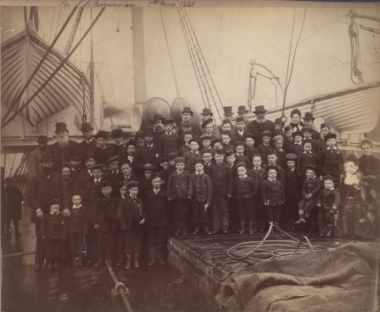
The Golden Bridge
"We who labour here are tired of relieving misery from hand to mouth, and also heartsick of seeing hundreds of families pining for want of work, when over on the shores of Ontario the cry is heard ‘Come over and we will help you’.
…give us the power to make a: Golden Bridge across the Atlantic.”
Annie MacPherson (1869)
Cited in Birt (1913)
Copyright © Quarriers 2007

Slide 6
The historical ‘facts’
Between 1869 and 1939 over 100,000 children were migrated from the United Kingdom to Canada.
10,000 were migrated from Scotland (7,000 from Quarriers Orphan Homes).
Two-thirds had at least one surviving parent and most were from families experiencing extreme poverty.
The children were placed with families to work as farm labourers or domestic servants.
Canadian historians have uncovered harrowing stories of abuse & exploitation; as well as stories of compassion & humanity (Kohli, 2003; Harrison, 1979; Parr, 1994; Bagnell, 2001).

Slide 7
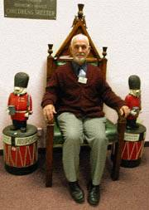
Original Golden Bridge exhibition
Eight large display boards.
Replica child migrants trunk.
Testimony tree (42 maple leaves).
Living Histories video.
Historic images & ‘Narrative of Facts’ on on loan from Quarriers.
The curator: Rev Alastair Ramage

Slide 8
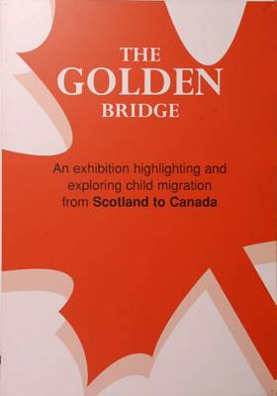
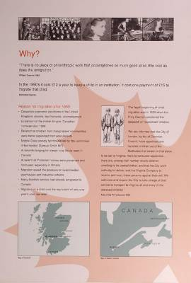
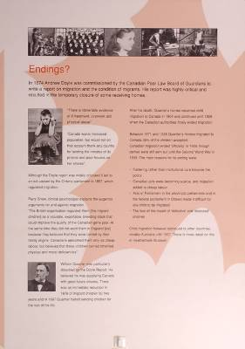
Original display boards

Slide 9
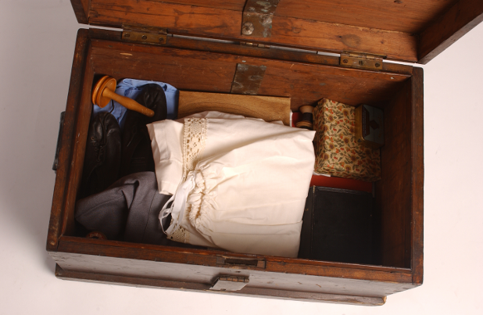
Replica migrant’s trunk
Replica trunk with
contents typical
of those with which a
female migrant would
depart.

Slide 10
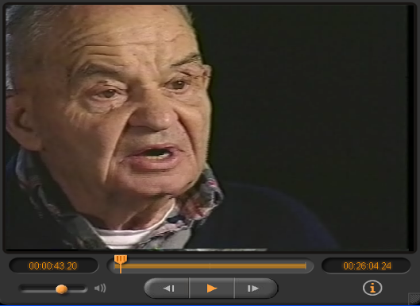
Living Histories video
Four former ‘Home Children’ ,
migrated from the
‘Orphan Homes of Scotland’
in the 1920s, reflect on the
stages in their journey from
family of origin, to orphanage,
to Canada.

Slide 11
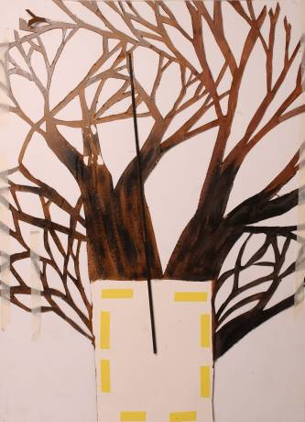
Testimony tree
Covered with 42 maple leaves each
one of which was inscribed with a
Short statement derived from the work of
historians collecting data from former
‘Home Children’. (e.g. Harrison, 1979)

Slide 12
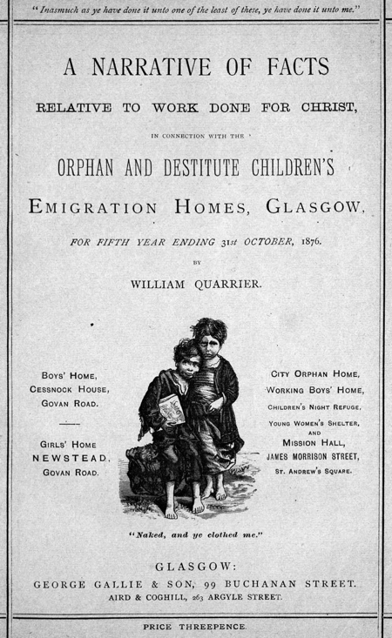
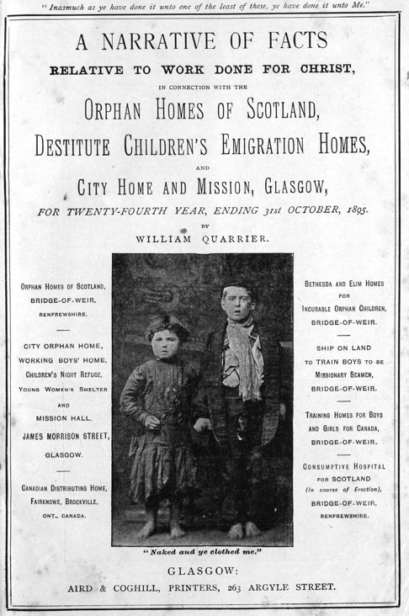
Narrative of Facts 1872-1910
Copyright © Quarriers 2007
Copyright © Quarriers 2007

Slide 13
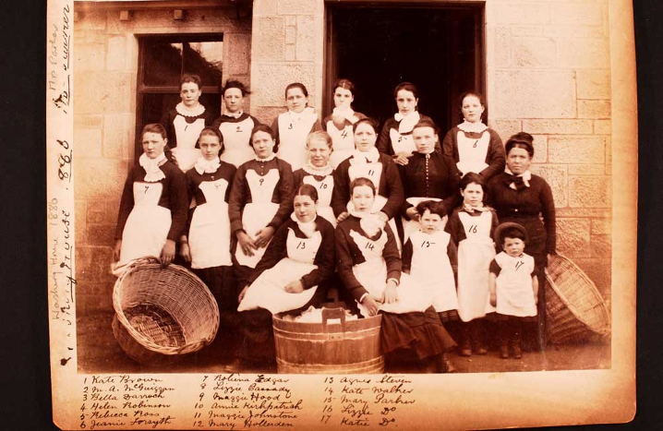
Photo album (circa 1880s)
Copyright © Quarriers 2007

Slide 14
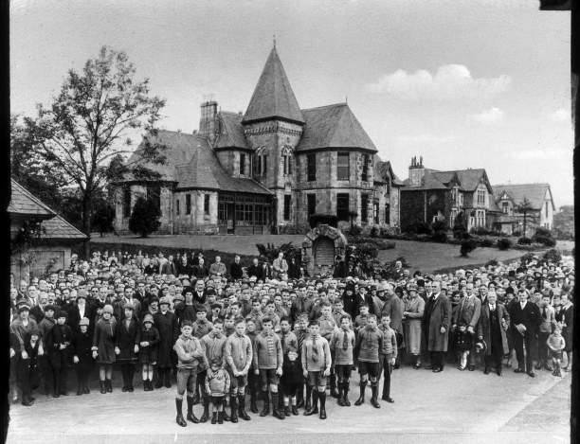
Glass slides (circa 1922)
Copyright © Quarriers 2007

Slide 15
Project objectives
Preserve the Quarriers historical assets;
Repurpose the Heatherbank exhibition material;
Provide access for researchers, educators, & the public.

Slide 16
Digital preservation
Source materials handled less and can be preserved for longer (Hughes, 2004).
But digitization brings new preservation problems (Webb, 1996; Muir, 2004).
  May deflect attention away from the original objects leading to neglect of their proper storage and maintenance (Webb, 1996)
  Digital surrogates are likely to endure technological obsolescence & physical deterioration (Hedstrom and Montgomery, 1998).
Risks can be managed by establishing a long-term migration strategy
  The Quarriers images and NoFs are likely to be deposited in a secure underground vault;
  digital surrogates contributed to a ‘trusted repository’ such as the National Library of Scotland.

Slide 17
Repurposing the exhibition
Visitors to Web museums are looking for exhibits that provide rich narratives and deeper contextual information (Nickerson, 2002; Hermann, 1999).
Web-based exhibitions need to do more than offer online public access to digital surrogates of a collection but must add value by wrapping objects in “…layers of interpretation” - need to “…move away from list making to storytelling” (Donovan, 1997)

Slide 18
Intellectual property rights
Bring lawyers, guns and money!
Complex, many layered issue
  From VHS video to the world wide web
  New IP can emerge through the process of digitization
Need to be clear about ownership & avoid fudging issues
Clarify with partners what you want to achieve before letting the lawyers loose
Reach agreement and record agreement
As much a ‘social process’ as a ‘legal process’ (Dunning, 2005)

Slide 19
References
Bagnell, K. (2001). The little immigrants: The orphans who came to Canada: New Edition: Toronto: The Dundurn Group.
Birt, L. M. (1913). The children's home finder. London: J. Nisbit.
Brown, C. (2006). Digitisation projects at the University of Dundee archive services. Program: electronic library and information systems, 40(2).
Donovan, K. (1997). The best of intentions: Public access, the web & the evolution of museum automation, Museums and the Web. Los Angeles, California: Archives & Museum Informatics. Retrieved 19th July, 2007, from http://www.archimuse.com/mw97/speak/donovan.htm
Dunning, A. (2005) Tracing Help with Copyright: New AHDS Case Studies on Copyright Issues. Ariadne. 42, January. Retrieved 19th July, 2007, from http://www.ariadne.ac.uk/issue42/dunning/
Harrison, P. (1979). The home children: their personal stories: J. Gordon Shillingford Publishing Inc.
Heatherbank Museum of Social Work. Retrieved 19th July, 2007, from http://www.gcal.ac.uk/heatherbank/
Hedstrom, M., & Montgomery, S. (1998). Digital preservation needs and requirements in RLG member institutions: Mountain View, California: Research Libraries Group.

Slide 20
References (continued)
Hermann, G. (1999). Exploring narrative: Telling stories and making connections, Museums and the Web. New Orleans, Louisiana: Archives & Museum Informatics. Retrieved 19th July, 2007, from http://www.archimuse.com/mw99/papers/hermann/hermann.html
Hughes, L. M. (2004). Digitizing collections: Strategic issues for the information manager: London: Facet Publishing.
Kohli, M. (2003). The golden bridge: Young immigrants to Canada, 1833-1939. Toronto: Natural Heritage / Natural History Inc.
Muir, A. (2004). Digital preservation: Awareness, responsibility and rights issues. Journal of Information Science, 30(1), 73-92.
Nickerson, M. (2002). Voices: Bringing multimedia museum exhibits to the World Wide Web. First Monday, 7(5). Retrieved 19th July, 2007, from http://www.firstmonday.org/issues/issue7_5/nickerson/index.html
Parr, J. (1994). Labouring children: British immigrant apprentices to Canada, 1869-1924: University of Toronto Press.
Webb, C. (1996). Future directions in access and preservation technologies and new electronic formats. National Conservations and Preservations Strategy Public Forum, National Library of Australia Online.

Slide 21

For further information
neil.ballantyne@strath.ac.uk
&
e.daly@strath.ac.uk
Slides
http://www.sieswe.org/HUSITAgoldenbridge
The Golden Bridge
http://www.sieswe.org/opencontent/goldenbridge
Forthcoming article
http://fsw.ucalgary.ca/currents/
Images in slides 5, 12, 13 & 14
Copyright © Quarriers 2007

