Slide 1
Systems Leadership
Imagining the Future
Zaid Tariq, Strategic Planning Lead
East Renfrewshire Health and Social Care Partnership
What does good leadership look like in Scotland’s social services? An event for managers & strategic leaders.
1 June 2017, Renfield Conference Centre

Slide 2

Today
What does systems leadership mean?
How does working in this way make a difference?
Practical, tangible examples
Relevant risk / enablers to systems leadership

Slide 3
1.
What does systems leadership mean?

Slide 4

Your world
Notes:
Hands up whose world is simple
Hands up whose world is complex

Slide 5

A system?
services
supports
systems
people

Slide 6

A system!

Slide 7
opinions
expectations
Re-designs
targets
experiences
understanding
variation
personalities
protocols

Slide 8


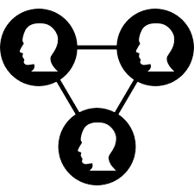
Some of the behaviours
Notes:
1.Ability to work across boundaries both personal/interpersonal and sector boundaries.
2.Participation – able to engage in collaborative relationships and processes as well as hierarchical “telling” relationships and processes.
3. Knowledge brokers- able to pass information, connect ideas and generate new knowledge. This is characterised by the response “we must tell XYZ about ABC

Slide 9



Some more of the behaviours
Notes:
1.Able to build trust in groups and communities and able to model, give and enact trust.
2. Maintain and restore humanity to services which can become de-sensitised to human needs and mechanistic
3. reflective - Good at delaying, reflecting, holding questions for exploration rather than always rushing to action.

Slide 10
2.
How does working in this way make a difference?

Slide 11





My Journey

Slide 12


My Journey
Notes:
IRISS ITF systems leadership residency - A different type of learning opportunity, experiential learning – not what we do but how we do it

Slide 13
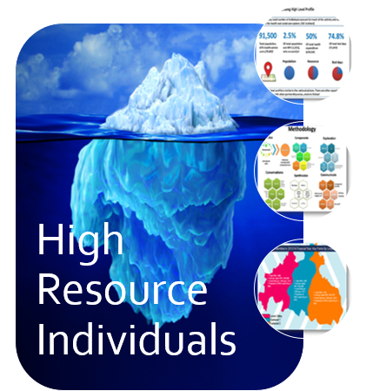
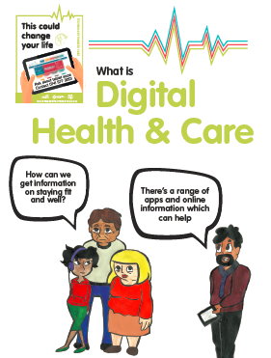


Portfolio

Slide 14



The difference working in this way
Interesting, new conversations
Wider, meaningful impact
Slower, more time invested

Slide 15
3.
Practical, tangible examples

Slide 16
High Resource Individuals
New approaches
Story board cross sector drop-ins
Iterative
Operational – system triggers
Recognised & applied
Notes:
Recognised – intelligence as an asset board, shortlisted data insight award, pharmacy development plan

Slide 17
Digital Participation
Council links
National E-health
Digital Forum
Integrated Strategy

Slide 18
4.
Relevant risk / enablers to systems leadership

Slide 19
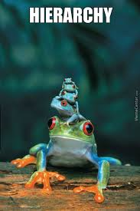

Risks
Notes:
Doesn’t sit well with people who work in traditional hierarchies
Challenging, Requires resilience

Slide 20
Enablers

Slide 21

Enablers
Thank you for listening. LinkedIn: https://uk.linkedin.com/in/zaid-tariq-66250b34
Notes:
We started talking about people and we’ll end with people, your strongest asset and enabler.

