Slide 1
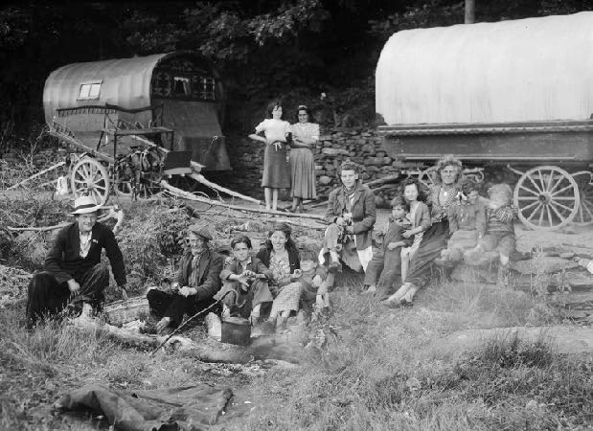


Co-producing Cultural Competency: Working With Scottish Gypsy Traveller & Roma Communities
Stories of Health and Wellness
Gypsy, Roma & Traveller Communities in Wales

Slide 2
Gypsies, Roma, Travellers in Wales
Co-producing Cultural Competency: Working With Scottish Gypsy Traveller & Roma Communities
Currently in Wales, there are some 3,000 families of Gypsies (Welsh Romani or Kalé) and Travellers (mostly of Irish origins). Families are usually quite large, with 3 or 4 children and 2 or sometimes 3 generations living together or very close to each other. Most families remain commercially nomadic, travelling for work and business, wedding, baptisms, funerals and to comfort relatives during illness. During winter months, families stop on caravan sites, many of which are provided by local authorities (municipalities). There are not enough spaces on these sites though, and ‘stopping places’ (aitchin than) are fewer than needed. Unauthorised encampments, forced evictions and confrontations with local, settled communities are frequent.
Discrimination against Gypsies and Travellers is very widespread in Wales (as across the UK), with abuse, violent attacks and harassment being very frequent. The former competence in Rromani-chib or Romani language is rapidly being lost. Irish Travellers speak Gammon. There are now some 1,750 Roma families mostly from Slovakia (Kosice, Lunik IX) in the south of Wales, with a few Rumanian, Bulgarian and Hungarian Roma present. Many survive by selling a newspaper that supports homeless people, “The Big Issue” on the streets, begging and washing car windscreens at traﬃc lights. These Roma face discrimination as beggars and EU migrants, particularly since the Brexit referendum. Many of the Roma retain their Romani language, though are not commercially nomadic like Welsh Gypsies and Travellers.

Slide 3
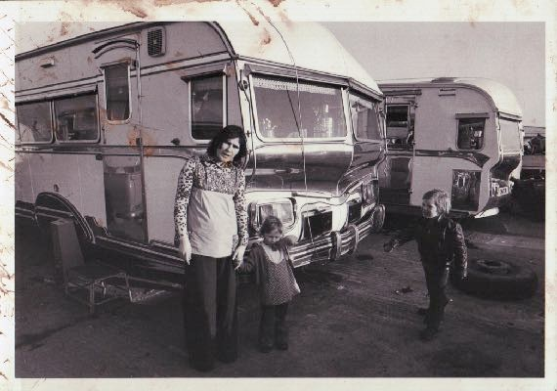
The Romani Cultural and Arts Company
Co-producing Cultural Competency: Working With Scottish Gypsy Traveller & Roma Communities
The Romani Cultural & Arts Company is the leading Romani and Traveller organisation in Wales, working on advocacy and rights through education, arts, culture and heritage. RCAC is managed and run by Roma, Travellers and Gypsies.
www.romaniarts.co.uk
www.twitter.com/Romaniarts

Slide 4
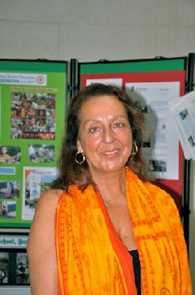
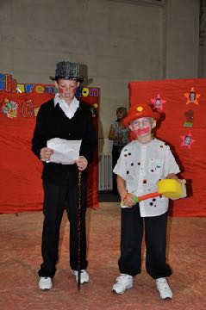
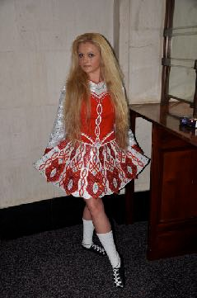
The History Month in Wales
Co-producing Cultural Competency: Working With Scottish Gypsy Traveller & Roma Communities

Slide 5


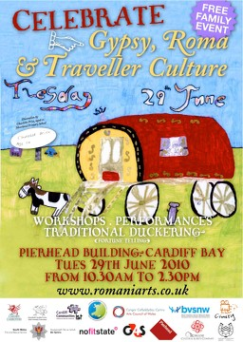
Schools Competition
Co-producing Cultural Competency: Working With Scottish Gypsy Traveller & Roma Communities

Slide 6
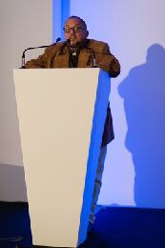
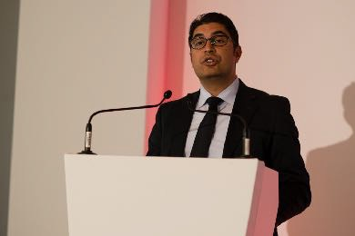
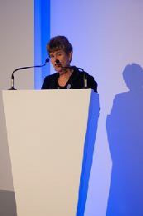
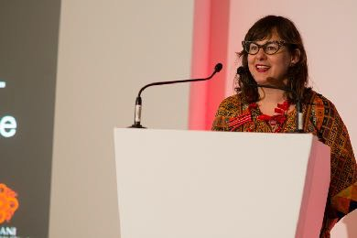
National Symposium
Co-producing Cultural Competency: Working With Scottish Gypsy Traveller & Roma Communities
Dr Ian Hancock
- Professor of Linguistics - University of Texas at Austin
Costel Bercus - Chair - Roma Education Fund Board
Jane Hutt - Minister for Finance and Leader of the House
- Welsh Government
Dr. Ethel Brooks - Rutgers University

Slide 7
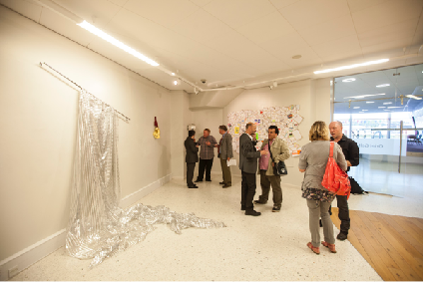
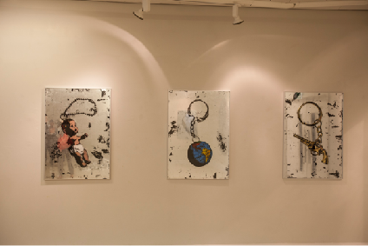
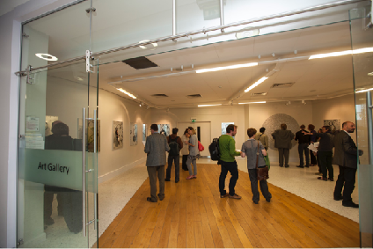
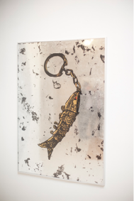
Gypsy Maker
Co-producing Cultural Competency: Working With Scottish Gypsy Traveller & Roma Communities

Slide 8

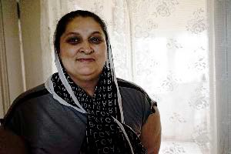
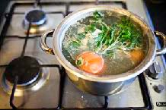
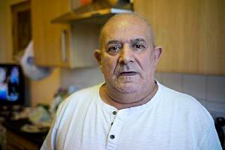

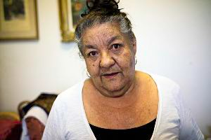
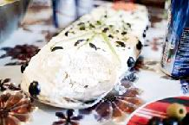
ARTUR CONKA is one of the few Roma to have documented his own community from behind the lens

Slide 9
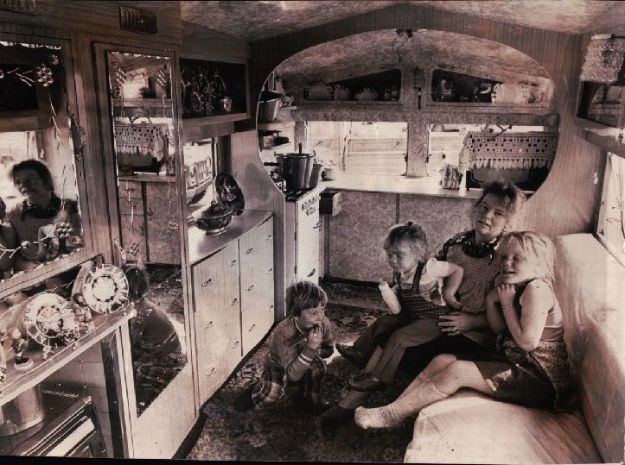
Family Lines, Family Trails
Co-producing Cultural Competency: Working With Scottish Gypsy Traveller & Roma Communities

Slide 10
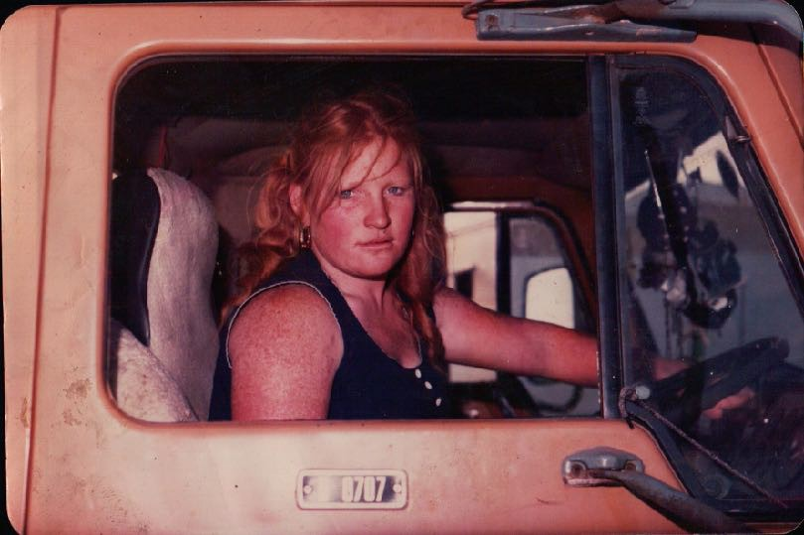
Family Lines, Family Trails
Co-producing Cultural Competency: Working With Scottish Gypsy Traveller & Roma Communities

Slide 11
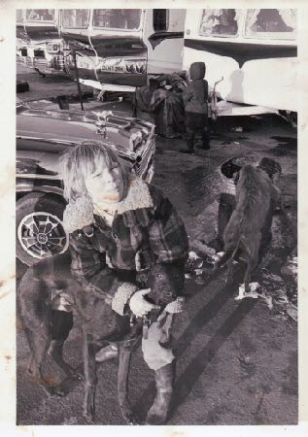
Promoting Gypsy, Roma, Traveller rights
Co-producing Cultural Competency: Working With Scottish Gypsy Traveller & Roma Communities
The RCAC promotes the rights of Romani and Traveller people through all its activities and works in schools, homes, community centres, on caravan sites and in the communities across Wales.
Contact: isaacblake@romaniarts.co.uk

Slide 12
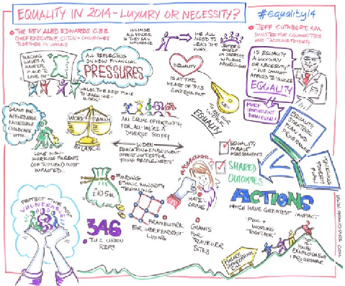
Centre for Equality & Human Rights, NHS Wales
Co-producing Cultural Competency: Working With Scottish Gypsy Traveller & Roma Communities
We know it's not fair We believe it matters
Together we can change things
http:// www.equalityhumanright s.wal es.nhs.uk/home

Slide 13
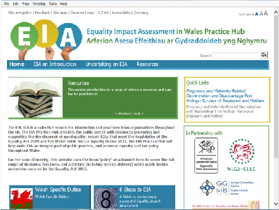
Centre for Equality & Human Rights, NHS Wales
Co-producing Cultural Competency: Working With Scottish Gypsy Traveller & Roma Communities
Supporting NHS Wales to provide quality healthcare services that meet the different needs of people and tackle inequality
Through developing ‘Standards’ for equality in health service delivery across Wales
Through reporting, such as the “Review of the Use of Equality Assessments in the Public Health Sector” and the Equality Impact Assessment Toolkit (2012)
Developing on-line, e-learning programmes, such as “Treat Me Fairly”, for health practitioners and professionals

Slide 14
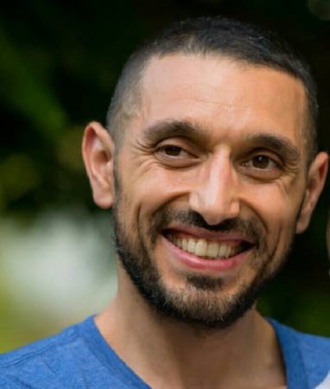
Co-producing Cultural Competency: Working With Scottish Gypsy Traveller & Roma Communities
In our project, the terms “Romani” and “Traveller” are used alongside “Gypsy”, “Roma” and “Traveller” as inclusive of Gypsy, Romani, Irish Traveller, Scottish Gypsy- Traveller, east and central European Roma (including Kalderash, Lovari, Ghurbeti, Rudari, Beyash, Romungro, Vlachi, Xoraxane) and south- east European Ashkali and Egyptians, Turkish Romanlar, Domlar, Lomlar and Syrian Domari, all of whom are present in the UK. The ‘lumping together’ of all Roma as an undiﬀerentiated group, with Gypsies and Travellers, in the acronym “GRT”, is avoided, as this is rapidly creating an elision of cultural and linguistic diversity amongst Romani and Traveller groups, which is ultimately discriminatory in its impact, reducing as it does, complex ethnicities to a formula. The analogy would be to describe UK populations as ‘ESWI’ - English, Scottish, Welsh, Irish -
no-one suggests this reduction and erasure of diversity in modern Britain.
Aleksandar G. Marinov, Ph.D., post- doctorate, research fellow at the School of History, University of St Andrews, Scotland

Slide 15
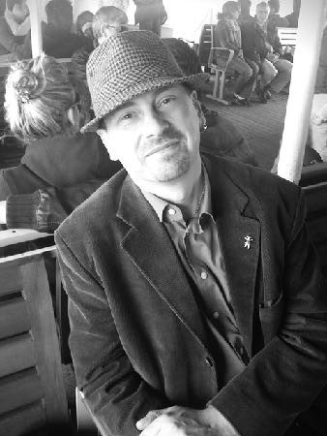
Stories of Health and Wellness
Co-producing Cultural Competency: Working With Scottish Gypsy Traveller & Roma Communities
The project was developed from a concept paper in November 2015, finalised in January 2016 and launched in April.
The NHS Wales team and the RCAC Consultant worked closely together to produce a feasible and strategic project proposal that would secure funding from health service finance and management.
The 6 researchers recruited for the project are all from Gypsy, Roma, Traveller backgrounds and have been trained in preparation to undertake the project by the RCAC.
Dr Adrian Marsh, Researcher in Romani Studies & Romani Early Years, is of Romany-Traveller origins, who works with Roma, Gypsy, and Traveller communities in the UK, Sweden, Turkey, Egypt and Central, Eastern and South-Eastern Europe

Slide 16
Stories of Health and Wellness
Co-producing Cultural Competency: Working With Scottish Gypsy Traveller & Roma Communities
The project has a number of intended outcomes, to be achieved by the close of the pilot (March 2017):
to explore the health experiences of Gypsy, Roma, Traveller people, specifically in relation to early childhood and young parents, in order to improve their understanding of health services and provision, increase their knowledge about access and availability to such services and provision, through experiences of storytelling and using digital media;
to inform future actions of health services and professionals that appropriately and in a culturally sensitive manner, meet the needs of these communities;
strengthen the relationships between Romani and Traveller communities and health • services’ professionals across Wales;
improved access to health services and quality of provision for Gypsy, Roma, Traveller young families with young children;
6. to establish a basis for developing a national strategy with NHS Wales, for the training and support of health practitioners and professionals working with Romani and Traveller communities in the early years environment;

Slide 17
Stories of Health and Wellness
Co-producing Cultural Competency: Working With Scottish Gypsy Traveller & Roma Communities
To identify themes that the Romani and Traveller participants wish to develop into short digital stories (2 minutes) around the central topics of early years health, happiness, wellness and well-being.
To develop and extend the understanding of health services and provision available, with the aim of improving access, quality and child development outcomes, amongst Gypsy, Roma, Traveller communities for parents, carers, infants and young children.
To explore issues that arise for the Romani and Traveller people around these topics and seek to address them in order to help strengthen the relationships between health professionals and the communities.
To improve the knowledge and understanding of primary health practitioners, health professionals and service managers about the needs of Gypsy, Roma, Traveller communities in Wales through gathering of material to develop an e-learning module for NHS Wales Staﬀ, informed by the interviews
(100) and digital stories (50), through training and awareness days (2) and through participation in focus groups (10) with GRT parents and carers.

Slide 18
Stories of Health and Wellness
Co-producing Cultural Competency: Working With Scottish Gypsy Traveller & Roma Communities
Improving notions of self-determination, agency, social and emotional well- being are also central to this project’s aims. The project participants are all drawn from young Gypsy, Roma, Traveller people. Parents and some members of the community who will be interviewees have been recruited from the “Family Lines, Family Trails” Heritage Lottery Project, that has successfully concluded with a major exhibition and book at the St Fagan's Museum of Welsh Life, co-created with the RCAC.
The inter-weaving of narratives that recall community experiences of health and well-being, or that describe community practice related to health and wellness, early childhood, children’s development and parenting have been gathered, capturing ‘lost’ competences amongst Gypsy Roma, Traveller communities.
‘Recovering’ health and wellness, will strengthen self-identities and confidence whilst re-asserting communities’ based narratives of skills and knowledge that have existed and have been eﬀectively ‘co- opted’ by majority societies (herb lore, traditional remedies), rebuilding a sense of Gypsy, Roma, Traveller ownership and agency.

Slide 19
Stories of Health and Wellness
Co-producing Cultural Competency: Working With Scottish Gypsy Traveller & Roma Communities
Themes
Our research has highlighted a number of very important themes and raised diﬀering issues.
Good practice exists Examples of positive experiences in accessing health services from north and west Wales tell us that, there is good practice for Romani and Traveller people.
GP’s are trusted Local doctors are generally trusted and appreciated by Romani and Traveller families. A number of our interviewees preferred to visit their GP, even in emergency situations.
Receptionists Many Romani and Traveller people have told us that receptionists in GP surgeries behave negatively towards them. Registering was a diﬃcult process for all our interviewees, sometimes as they were rejected by receptionists.
Hospitals Visiting hospitals is one area of potential conflict and misunderstanding, when large family groups come to see sick relatives. Health staﬀ find it diﬃcult to accommodate these visits.
Dentists Dentists and dentistry are viewed warily, in comparison to doctors and hospitals. Many avoid visits altogether.

Slide 20
Stories of Health and Wellness
Co-producing Cultural Competency: Working With Scottish Gypsy Traveller & Roma Communities
Romani and Traveller diet
Hunting rabbits, pheasants and other animals (hedgehog for example), foraging for roots, berries, mushrooms and herbs, picking vegetables and fruits on farms have all featured as part of the eﬀorts to source nourishment in the past. This is very rarely the case now. The impact on wellness has been negative, with what seems to be a greater reliance upon ready meals and take-away foods, high in saturated fats and sugars. This is leading to poor nutrition for babies and young children, increasing dental and health problems

Slide 21
Stories of Health and Wellness
Co-producing Cultural Competency: Working With Scottish Gypsy Traveller & Roma Communities
Issues
There are some serious issues that need addressing related to health and wellness for young Romani and Traveller families.
Reading and writing
Almost all Gypsies and Travellers interviewed had a low, or no level of literacy, across the age ranges 7-70.This causes real diﬃculties in reading instructions for taking medicine, filling out registration forms at GP’s surgeries, understanding signs in hospitals, following diet sheets or advice on inoculations for babies.The Welsh education system has consistently failed Gypsies and Travellers for the past fifty years in delivering literacy to these communities – why is this the case?
Diet
Living on sites for Gypsies and Travellers in Wales has fundamentally changed the kind of diet that families have relied upon. Childhood dental problems (some of our youngest interviewees told us of having 14 to 20 teeth removed, due to decay), overweight (even obesity), early onset diabetes, blood pressure and heart problems in adult life are all a consequence of these changes.
Women
Romani and Traveller women were, in previous generations, engaged in selling (hawking), fortune-telling, working in agriculture and trading. Presently, restrictions to mobility and street trading or door-to-door selling has concentrated women’s roles to the children, caravan and home, with much less engagement outside of the domestic sphere. Agricultural work has become dominated by cheap labour from the EU or Asia. Well-being amongst Romani and Traveller women, has suﬀered as a result and gender inequality has worsened.
Early years support
In terms of access to preschool and nursery places, this is non-existent for Gypsy and Traveller communities in Wales, with almost no take-up by the community and no outreach from early years programmes (the Welsh government’s ‘Flying Start’ initiative), to reach Gypsy, Traveller or Roma families. Very little monitoring of Romani and Traveller children’s development is being done by health practitioners or professionals, in Wa

Slide 22
Stories of Health and Wellness
Co-producing Cultural Competency: Working With Scottish Gypsy Traveller & Roma Communities
The final report from this pilot project will be presented to the donors (NHS Wales) and the Welsh government at the Senned (Senate) in Cardiﬀ in March 2017. Our advocacy strategy will be to promote the delivery of primary health care for families, through Romani and Traveller health mediators, using the experience from Slovakia (Way of Hope, Wide Open School Foundation), the Roma Health Mediators programme (OSF Budapest) and the highly successful Primary Health Care team of Irish Travellers, developed at Pavee Point (Dublin). Advocacy will also promote the development of an on-line training course for health practitioners and professionals in Wales, a national strategy for improving health and wellness amongst Romani and Traveller communities in Wales from government and NHS, particularly targeting the early years, through improving skills and knowledge amongst health visitors.
Crucially, the advocacy from the pilot project report will seek to directly impact upon government policy, through invoking the Well-being of Future Generations (Wales) Act, 2015, which requires the improvement of the social, economic, environmental and cultural well-being of all groups in the Welsh population, to achieve the “Wales We Want by 2050”. Our advocacy around developing early years services and provision for the Gypsy, Roma, Traveller communities in Wales directly feeds into this public duty.
Using the recommendations from the “Is Wales Fairer?” report, from the UK Human Rights Commission (2015) that demonstrated the declining equality outcomes for Gypsy, Roma, Traveller communities in Wales since the 2010 Act, we also intend to advocate for early childhood education and care services, to improve health and wellness outcomes amongst our communities.

Slide 23
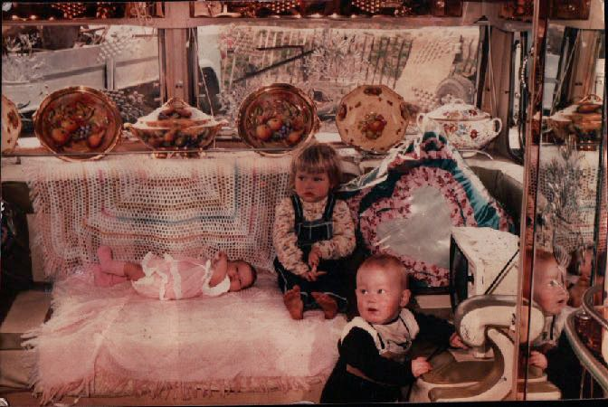
Thank you
Co-producing Cultural Competency: Working With Scottish Gypsy Traveller & Roma Communities
We would like to ask you, what could we do to further improve our advocacy, our future work that builds upon this project or to strengthen partnerships?

