Slide 1

ASP and the ‘T.I.L.S.’ Approach
Types of Harm;
Imminence of Harm;
Likelihood of Harm;
Severity of Impact of Harm.

Slide 2
Facilitator
Alan Laughland
Adult Support and Protection Lead Officer for East Lothian and Midlothian
✉️ East Lothian & Midlothian Public Protection Office, Room F28, Brunton Hall, Musselburgh, EH21 6AF
East Lothian and Midlothian Public Protection (@EMPPC1) / Twitter
☎️ 07969838549
alaughland@elothianmail.net

Slide 3
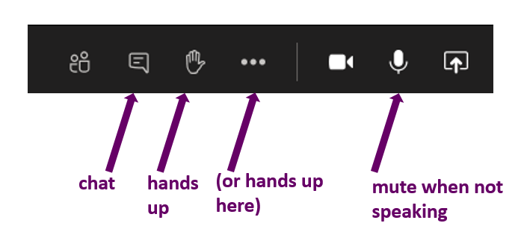
Welcome
Good morning everyone and welcome
Please close your e-mails, messaging tools (skype or lync) and switch your phone off
MS Teams Etiquette

Slide 4

Thanks for being here
Notes:
Thank the participants for their attendance. Acknowledge work pressures are great and we are all living through difficult times and it’s great to have everyone here. Hopefully with your attendance and active participation, this will be an investment of your time. Making you more confident and competent at your adult protection work. Making it easier and more rewarding.

Slide 5

Public Protection in East Lothian and Midlothian
Look beyond the individual:
If I work with children and young people, think: are there any adults who might be at risk of harm in this situation?
If I work with adults think: are there any children or young people who might be at risk of harm in this situation?
Notes:
Key messages:
In East Lothian and Midlothian Public Protection comes under one umbrella, recognising the interconnectedness between different aspects of protection – safety, protection and support for children and adults across the lifespan, and the multi-faceted nature of needs and risks.
Public protection is about the prevention of harm to children, young people and adults wherever and whenever possible
Public protection is about us all working together to keep vulnerable young and older people safe
There are common themes and knowledge in how we assess and manage risk, intervene and support families, recognising and responding to the impact of trauma, and it is therefore important to have a wide lens in our work.
Important message for your work is to look beyond the individual.

Slide 6
Strategic Structure for Public Protection in East Lothian and Midlothian
Critical Services Oversight Group
Offender Management Sub-group
Violence Against Women and Girls Delivery Group
East Lothian and Midlothian Public Protection Committee
Learning and Practice Development Sub-group
Performance and Quality Improvement Sub-group
Notes:
Here is brief structure for ASP protection across East Lothian and Midlothian –
We have a joint PPC – each local authority area is required to have a CPC and an APC – as laid out in national guidance for CPC and the Adult Support and Protection (Scotland) Act 2007. Each area also has a national Violence against women and girls partnership and an offender management group – across EL and ML we have brought those different aspects of Public Protection under one Committee. A lot of the same people would sit around the table of these groups if they were separate committees and there are a number of key overlaps between the different subject matter, hence we brought them under one umbrella.
The governance oversight group is the CSOG which is made up of the Chief Executives from the Councils, Health and Social Care Partnerships, NHS and Area Commander of Police Scotland. The EMPPC has four sub-groups, with the Learning and Development Sub-group being the key group that would develop and deliver multi-agency training on Child Protection.

Slide 7
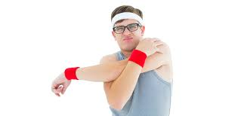
Warm-Up

Slide 8
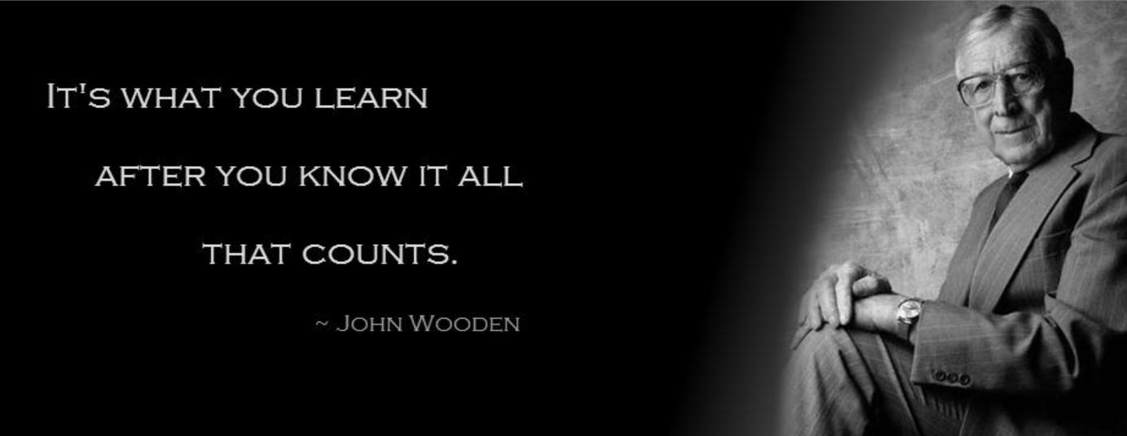

Openness To Learning
Notes:
Acknowledge the range of experience and skills the trainees bring
This training will build on current knowledge, skills and values
Give example of where I have learned something new. MHO to ASP.
John Wooden was Harry S Truman’s basketball coach
John Wooden - Wikipedia

Slide 9
ASP and the ‘T.I.L.S.’ Approach
Types of Harm
Imminence of Harm
Likelihood of Harm
Severity of Impact of Harm
TILS- The Grammar of Risk: Analytical recording, risk assessment and risk management.

Slide 10
T.I.L.S.
Types
Imminence
Likelihood &
Severity
Informing…
SMART actions

Slide 11

Putting the Adult at Risk at The Centre of Everything We Do
Notes:
Analysis of risk with the TILS approach allows purposeful recording that facilitates an understanding of the types of harm, their imminence, their likelihood & how severe the impact. We need to have analysed the interaction between these factors. Then we can devise informed SMART actions that are based on TILS, that are the least restrictive option that provide proportionate benefit, that take into account the past & present wishes of the adult etc that protect & support the adult at risk. We’ll talk about where this hasn’t happened to the cost of the vulnerable person.

Slide 12
Miss X
“Formal assessments were rare and of a very poor standard, when recorded. The level of recorded service input fell far short of that required to address the individuals' high degree of need. There was a lack ....of focused monitoring of decisions taken.”
“The lack of comprehensive assessments and of care and protection plans resulted in unfocused contacts with service users, with no clarity of purpose for intervention, and no opportunity for effective monitoring of progress. This is both the reason for, and the outcome of, little or no effective intervention at critical times.”
https://www.gov.scot/Publications/2004/05/19280/36168#3

Slide 13
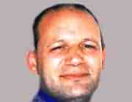

Steven Hoskins
“As with all catastrophic events, the context has to be taken into account in understanding the chronology and the circumstances. The Serious Case Review Panel acknowledged that the origins and even solutions were foreshadowed in the facts of the murder and in the events leading up to this.”
“...not entirely without merit” Margaret Flynn.
https://www.cornwall.gov.uk/media/3633936/Steven-Hoskin-Serious-Case-Review-Exec-Summary.pdf

Slide 14
Foreshadowed?
“the origins and even solutions were foreshadowed in the facts of the murder and in the events leading up to this.”
There was sufficient evidence to justify a likelihood that Steven would come to harm.
However, a lack of information sharing and analysis of the evidence prevented an assessment of the types of harm, their imminence, their likelihood and the severity of the impact of that harm.
I.e. T.I.L.S.

Slide 15
Accuracy...
Fact, opinion or professional judgement
Fact – ‘a thing that is known or proved to be true’
Opinion – ‘A view or judgement formed about something, not necessarily based on fact or knowledge’
Judgement – ‘the ability to make considered decisions or come to sensible conclusions’ (TILS leading to SMART)

Slide 16
Adult Protection & Analysis?
Assessments need to be analytical, not descriptive.
analysis
/əˈnalɪsɪs/
noun
“detailed examination of the elements or structure of something”
Risk assessment is the analysis of Types of Harm; Imminence of Harm; Likelihood of Harm and the Severity of Impact of Harm.
That is, T.I.L.S. are the elements or structure of risk analysis.

Slide 17
Analysis
“Analysis is the collation of evidence based arguments...(and) goes beyond describing ideas...this means pulling the information apart to see what the component parts are and how they relate to each other. This will help practitioners reach an understanding of what is actually happening with a case i.e. causes, key factors and possible outcomes. The practitioner needs to work out the ‘how’ and ‘why’, not merely describe the ‘what’ ”
(Professional Writing: Guidance Booklet for Social Work Practitioners. Aberdeen City Council and Robert Gordon University, 2010

Slide 18
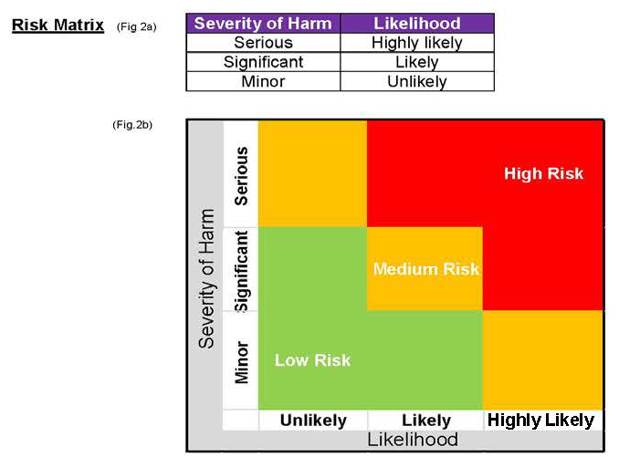
Risk Matrix and TILS

Slide 19
Analysis and Articulation of Risk
Articulate your awareness of TILS in all risk recording & verbal discussions- case notes; chronologies; duty to inquires; risk assessments; protection plans; contributions at ASPCC etc:
T- Type of harm
I- Imminence of Harm
L- Likelihood of Harm
S- Severity of the Impact of that Harm

Slide 20
What is T.I.L.S.?
Q: Is T.I.L.S. an assessment tool?
A: No. Just as language has grammar to help you to use it, T.I.L.S. is a tool that helps you to:
frame your thinking (analysis) of risk &
structure your articulation of risk assessment- whether written or verbal

Slide 21
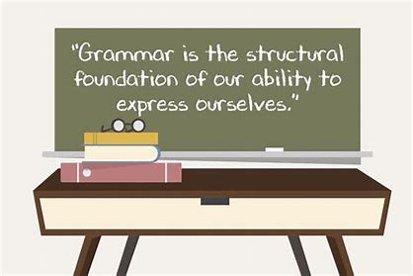
What is T.I.L.S.?
T.I.L.S. is the structural foundation of your ability to express an analysis of risk.

Slide 22



Why Use T.I.L.S.?
With exams & interviews we are often advised to restate the question in our answer. Why?
Notes:
Shout Out Exercise: Ask the teams to answer the question. The answer is that is we re-state the question we are more likely to answer it. Ask trainees what relevance could this have to how TILS could be used to analyse & articulate risk assessment?

Slide 23
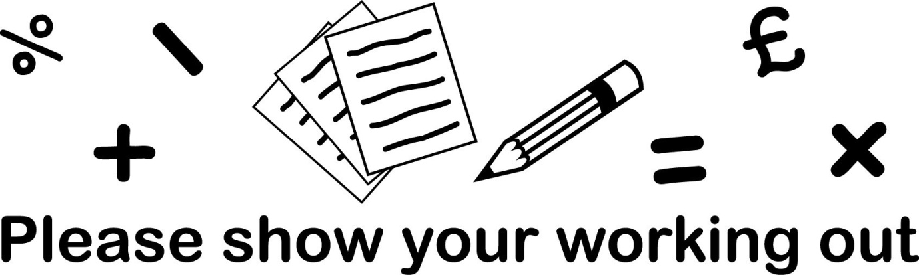
How to Use T.I.L.S.?
When analysing risk or articulating risk assessment, whether in verbal or written form explicitly state:
the T.I.L.S. Factors (Types, Imminence, Likelihood & Severity)
How you know the types of harm; imminence of harm; likelihood of harm & severity of impact (Articulation of your ANALYSIS)
state what you still need to know & how you plan to find this out

Slide 24
How to Use T.I.L.S.?
With other professionals encourage them to frame their analysis by explicitly asking about T.I.L.S.
E.G. “So, we’re concerned about the situation with Jean. I need to find out what the types of harm are, how imminent the types of harm are; how likely they are to happen and the severity of the impact on Jean of those types of harm. What’s your view of the types of harm she’s at risk from and their imminence, likelihood & severity of impact?”
You may need to bring them back to T.I.L.S. To ensure you have the information.

Slide 25
T.I.L.S. Recording Examples
G.P. Report
“You say that the analysis at the case conference will focus on T.I.L.S.:
Type of Harm- At risk of recurrent overdose from medication
Imminence of that Harm- XXXXX remains at ongoing risk of overdose
Likelihood of that Harm- It can be anticipated that there will be other overdoses in the foreseeable future
Severity of the impact of that harm- overdosing on certain medications including paracetamol carries the risk of death”
Advantages?

Slide 26
T.I.L.S. Recording Examples
Duty to Inquire
“The harm being alleged is neglect, emotional and financial harm. This appears to have been occurring over the past year as xxxxxxx’s dementia has worsened and he has ceased working. The likelihood of this continuing is high if there is no intervention from social work. The imminence of xxxxxxxx experiencing serious harm is moderate.”
Advantages?

Slide 27
T.I.L.S. in Practice
Read John Case Example
Examine the Filled Out ‘TILS Risk Clarification Tool’
Your Reflections?

Slide 28
T.I.L.S. and S.M.A.R.T. Actions
Types
Imminence
Likelihood
Severity of Impact
TILS informs SMART actions
E.g.
Types will inform the choice of action
Imminence will inform timing and frequency of review
Likelihood will inform how necessary an action is
Severity will inform how restrictive the action needs to be

Slide 29
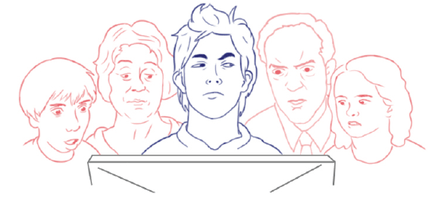
Record for the Next Person to Read Your Work
Can the next person see your T.I.L.S. based analysis & S.M.A.R.T. Actions?

Slide 30
T.I.L.S. and Case Conferences
Council Officers:
Make contributions focussed on an analysis of TILS
Say what they still need to know to complete their TILS analysis & back this up with questions to elicit the information
Articulate the link between their TILS analysis & their recommendations for SMART action points

Slide 31
T.I.L.S. and Case Conferences
Chairs who:
Encourage & focus TILS based analysis from all
Through the above ensure that the SMART Safety Plan addresses the TILS risk analysis

Slide 32
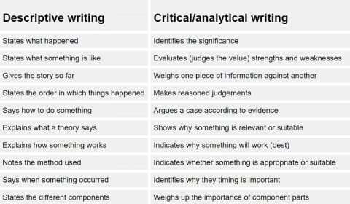
T.I.L.S; Descriptive Writing and Critical/analytical Writing

Slide 33
T.I.L.S; Descriptive Writing and Analytical Writing
Restate the question?
Question: Jean is being visited by R.S.O.s. What Types of Harm; Imminence of Harm; Likelihood of Harm and Severity of Impact of Harm is Jean at risk of?
Answer: T.I.L.S. based analysis
Types of harm? Jean has a mild learning disability which leaves her unable to protect herself from financial and sexual harm.
Likelihood of harm is high as the adult lives alone and does not have any friends. The harmers are R.S.O.s with a track record of such behaviour.
Imminence is high as the harmers visit daily and there is evidence of harm each visit.
Severity of impact of harm is currently high as the adult has attempted suicide in the past when stressed.

Slide 34
T.I.L.S. Impact?
“Before T.I.L.S. I knew what the risks were at the end of the APCC. Since T.I.L.S. I know what they are before the APCC.”
Council Officer.
“I really like T.I.L.S.”
Council Officer Trainee
TILS allow you to write less and say more.
AND
TILS allow you to talk less and say more.

Slide 35
T.I.L.S. Impact?
Transfer of learning into practice is necessary for maximum impact
Reflection:
Do current templates sufficiently support the use of T.I.L.S.?
Would you like them to?

Slide 36

Transfer of learning into practice
Use T.I.L.S. in your analysis, recording and articulation of risk
Complete a case study based TILS analysis
Bring a completed T.I.L.S. Risk Analysis tool to 03/08/22 CO Meeting
(TILS Transfer of Learning to Practice)
Any support required: Ask me

Slide 37

Notes:
Any questions?

Slide 38

Public Protection is a shared responsibility
Notes:
Key messages to sum up:
Hopefully given a sense of the different roles and responsibilities in ASP
Different people will hold different parts of the jigsaw – the key message is that people have a responsibility to bring these together to build the picture of risk – to inform the assessment, planning and action
And a message that it is only by working together and sharing the responsibility that we will deliver effective ASP services

