Slide 1
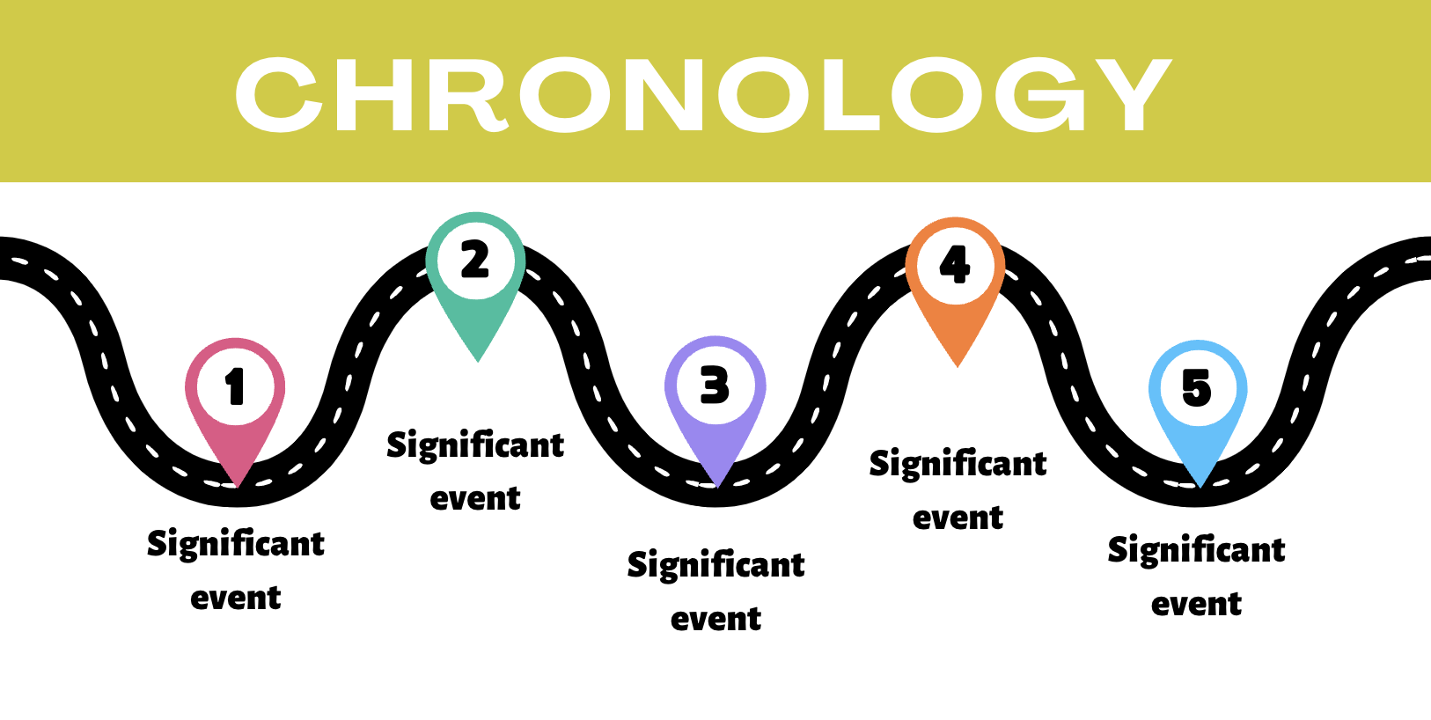

17th April 2024

Slide 2
Iriss role and support
  ASP Workstream
    data and evidence use
    learning and development
  Member / co-facilitator of the ASP National Implementation Subgroup for Chronologies
  Commissioned by Scottish Government to undertake scoping research on chronologies in 2022/23

Slide 3


Slide 4
Challenges
TIME & CAPACITY
RECORDING PROCESS
LACK OF CLARITY
IT LIMITATIONS
INFO ACCESS
MULTI-AGENCY ISSUES

Slide 5
Suggestions for Improvement
  Enhanced guidance
  Improved IT systems and recording tools
  Increased consistency
  More training / focus on the value of chronologies
  Leadership and management support, including supervision
  Addressing broader workforce issues
  Culture change - this is wider than ASP!

Slide 6
Iriss draft tools
Leadership in Chronologies: Reflection and self-assessment tool
Assess current understanding and practices
Supports and barriers specific to leadership role
Prompts from recent research, ideas for activities
Effective Chronologies: Practice support tool
Reflective questions, messages on key concepts
Mindset - clear on purpose, connected to values.
Ready, Reflect, Review

Slide 7
Scope - this is wider than ASP
Early feedback: the tools could apply to other areas of practice
Promote consistency of approach, oversight, and quality assurance
Extend subgroup membership & remit - Child Protection, Children’s Services and Justice.
Engagement across Justice, Education, Public Protection and Child Protection

Slide 8
What’s next? (2024/25)
  Subgroup - formalise new ToR / membership (new co-facilitator)
  Evidence good practice
  Revise tools
  Partner testing and feedback

Slide 9
Thank you
Get in touch: ellen.daly@iriss.org.uk
Find out more: iriss.org.uk

