Slide 1
Adult Support and Protection Day
20 February 2025
Theme - Financial Harm

Slide 2
Introduction
20 February 2025 will be National Adult Support and Protection day, and the theme is financial harm. We invite any persons or organisations to help spread awareness of financial harm, and to promote www.actagainstharm.org/getting-help/find-your-local-contact as a tool to help people make referrals where appropriate, or to direct them to call Crimestoppers (0800 555 111).
In this pack are resources for spreading awareness across social media, and other digital networks.
Press Release Examples and further information on Financial Harm found in attached word documents

Slide 3
Social Media - post ideas
If you are concerned that an adult you know (or you yourself) are being subjected to financial harm, you can make a referral at www.actagainstharm.org/getting-help/find-your-local-contact
We all have a part to play in Adult Support and protection. If you think somebody needs help, make a referral.
For information see: www.actagainstharm.org/getting-help or call Crimestoppers on 0800 555 111
Hourglass Scotland reported more than two million pounds been stolen or defrauded from older people over the last 3 years. If you suspect someone is experiencing financial harm see: www.actagainstharm.org/getting-help

Slide 4
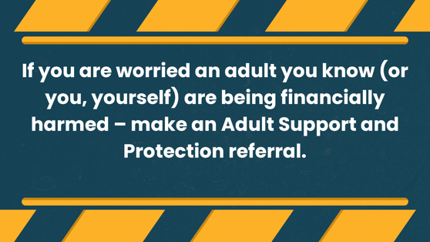



Images 16:9
See attached graphics folder
Or use a template on Canva to add your own text and logo here

Slide 5




Images 1:1
See attached graphics folder
Or use a template on Canva to add your
own text and logo here

Slide 6
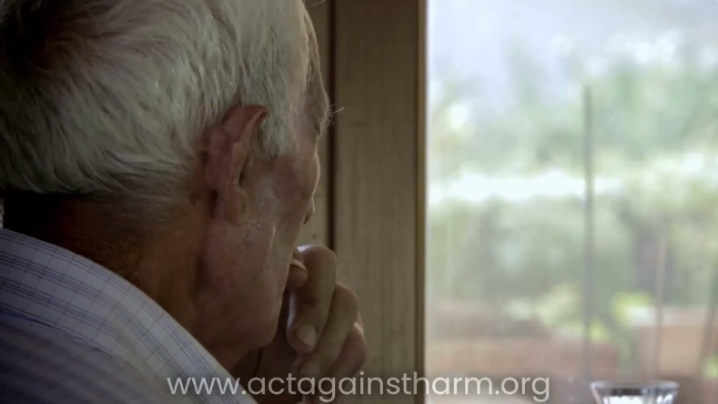
Financial Harm Video
We have a video with 2 versions, a short version and a long version.
Available on Vimeo
Notes:
USE THIS ONE

Slide 7


Zoom/Teams backgrounds
See attached graphics folder

