Slide 1
Multi-Agency Briefing: Adult Support and Protection Committee (ASPC)
Notes:
Welcome, introductions and housekeeping
Committee campaign re getting to know your governance

Slide 2
Aims & Objectives
By the end of this session, you will be able to:
Describe the role and functions of Adult Protection Committees (APCs)
Explain the interface between Adult Protection Committees and operational practice
Identify the structure and membership of Glasgow City Adult Support and Protection Committee
Summarise the aims and objectives of Glasgow City Adult Support and Protection Committee

Slide 3
Adult Protection Committees (APCs)
Legally mandated, local, multi-agency strategic partnerships
Lead on the development of local adult protection policy and practice
Develop, implement and improve adult protection strategy across and between agencies and the local community
APCs are made up of senior reps from all local services that contribute to the protection of adults at risk of harm.
Notes:
Adult Support and Protection (Scotland) Act 2007 (implemented in 2008) requires councils and a range of public bodies to work together to support and protect adults who are unable to safeguard themselves, their property and their rights.
Under the act, SW is the lead agency for operational practice in ASP; however, there is a collect responsibility to recognise and respond to ASP.
Section 42 of the Adult Support and Protection (Scotland) Act 2007 places a duty on local authorities to establish an APC.
See slides

Slide 4
Chief Officers Group (COG)
Police, NHS & councils have the overall responsibility for adult support & protection
Ensure their agencies work to effectively protect adults at risk of harm
Provide individual and collective responsibility for their agency’s leadership, direction and scrutiny of ASP
Have oversight of Adult Protection Committees
Notes:
Police, NHS and councils - key agencies which have the overall responsibility for adult support & protection
Chief Constable (Police Scotland), the Chief Executive of NHSGCC and the Chief Executive for council form what is known as the Chief Officers Group
In Glasgow - wider representation from the HSCP, education & SCRA
The Chief Officers Group are responsible for ensuring their agency provides leadership, direction and scrutiny of ASP and public protection more widely.
Oversight of the ASPC:
review updates from ASPC
appropriate membership of APCs
joint funding arrangements and dedicated finances.
Appoint Chair (Vice-Chair) - role, remit and term
Agree reporting mechanisms to elected members
Monitor ASP data and self evaluation activity
Overseeing and authorising publication of LRs and improvement plans
updates from ASPC chair on a quarterly basis

Slide 5
Functions of APCs
Review procedures and practices
Give information or advice relating to safeguarding of adults at risk
Improving the skills and knowledge of officers or employees who have responsibility for safeguarding adults at risk of harm
Improve co-operation between organisations
Any other function specified by Scottish Ministers
Notes:
Functions are written into the legislation.
Written into the Act that the functions apply to public bodies/office holders, which means:
the council
the Care Inspectorate
Healthcare Improvement Scotland (HIS)
the relevant Health Board
Police Scotland
any other public body or office-holder as the Scottish Ministers may by order specify.
Review the procedures and practices of relevant organisations relating to the safeguarding of risk in the council area.
Give information or advice, or make proposals, to organisation on the exercise of functions relating to the safeguarding of adults at risk.
Improving the skills and knowledge of officers or employees of organisations who have responsibilities relating to the safeguarding of adults at risk.
The ASP act is rooted in cooperation and extends to APCs who should improve cooperation between organisations to assist in the safeguarding of adults at risk of harm.
Any other function relating to the safeguarding of adults at risk as the Scottish Ministers may by order specify.

Slide 6
Procedures and Practices
Ensure local ASP policies, procedures and guidance are informed by the Act and Codes of Practice
Develop, disseminate and review the effectiveness of inter-agency policies, procedures and guidance
Ensure policies, procedures and guidance are developed around current and emerging issues
Notes:
Ensure local ASP policies, procedures and guidance are informed by the Act and Codes of Practice
Develop, disseminate and review the effectiveness of inter-agency policies, procedures and guidance. Ensure cooperation between relevant organisations.
Ensure policies, procedures and guidance are developed around current and emerging issues where there is agreement that this is required

Slide 7
Giving Information or Advice
Understand local practice and performance
Data collection & analysis from:
National Minimum Dataset
Audit and quality assurance activity
Learning Reviews
Large Scale Investigations
Public awareness
Notes:
Oversight of local practice and performance - identify areas for improvement.
Data collated is shared with APC members to promote single agency improvement & practice development.
Sources of data are:
NMD
Dataset developed by Iriss designed to provide a clearer picture of Adult Support and Protection in Scotland, informing planning and supporting service improvements at both local and national levels.
Reported to SG on quarterly basis to drive improvement, support forward planning, inform policy and shared agendas.
Provides an opportunity for local and national monitoring of ASP activity.
Audit and QA activity
regular programme of multi-agency audit, self-evaluation and review should be routine work of APCs -> strategic development and practice improvement.
Learning Reviews
not referenced in the Act but accepted practice that LRs are commissioned by APCs across Scotland.
purpose is to gain a multi-agency understanding of the circumstances of a particular case
and to identify what can be learnt in order to best inform future policy, practice and procedure.
APCs agree recommendations from LRs and devise improvement plans (signed off by COG).
In line with Scottish Government published national guidance for APCs undertaking LRs in 2022 (on Scot Gov website).
LSIs
the Act makes no reference to LSIs but they have become increasingly prevalent across Scotland.
may be required when there’s reason to believe agencies/organisations are placing more than one adult who receives a service from them at risk of harm.
APCs should be kept informed of progress of LSIs and provided completed reports once concluded
ensuring improvement plans are actioned accordingly.
Public awareness
not referenced in the Act but accepted that APCs ensure there are strategies to raise public awareness of ASP in the community.

Slide 8
Improving Skills and Knowledge
Learning and development
Local training strategy required which recognises the roles and responsibilities of staff and office holders
Communication and engagement strategy
Notes:
APCs have a duty to support the improvement of skills and knowledge of ASP for those who have responsibilities for safeguarding adults at risk of harm (everyone employed in the organisations named in the Act)
L&D Activity
Should be undertaken at a single and multi-agency level.
National ASP L&D framework being developed and will inform multi-agency L&D activity.
Local Training Strategy
APCs responsible for multi-agency ASP L&D strategy and evaluating the impact of L&D activity.
Should ensure there are L&D provisions for:
Staff across agencies are able to recognise the signs of harm, neglect and exploitation and know how to respond, including reporting concerns.
understand of the importance of working with people in a supportive way which promotes wellbeing and health.
Staff who are involved in ASP assessment, decision making and protection plans to receive appropriate training to enable them to carry out their duties, including those who line manage staff involved in ASP processes.
Communication & Engagement Strategy
Good practice - APCs develop a communication strategy encompassing general awareness raising and appropriate training for service users, carers and members of the public to help people who use services to understanding their rights and services available to them.
Consider asking service users to act as co-workers in delivering those programmes.

Slide 9
Interface Between APC & Operational Practice
Discussion point:
Thinking about your own role/
organisation, can you give an
example of how the Adult Protection
Committee impacts day to day adult
Support and protection practice?
Notes:
How does this affect operational practice? APC responsible for: ​
Ensuring ASP practice/performance is carried out to a high standard – multi-agency oversight through functions detailed in previous slides (audit, NMD, inspection reports etc.). Directly affects operational practice. ​
Local multi-agency policies, procedures and guidance which provide the frameworks for CP practice – hoarding protocol
Multi-agency and oversight of single-agency continuous improvement, quality assurance and self-improvement activity to identify and implement changes to improve the quality of services. Annual tripartite multi-agency audit -> generates an improvement plan. Development of chronology training course, changes to recording systems for SW. Local management reviews - multi agency events to help support practice improvement linked to safeguarding themes.
Strategic planning where organisations outline their long term priorities, allocate resources, and set a clear direction to achieve their vision and aims - achieved through everyday operation actions (practice) on a daily basis. ​Essentially, strategic planning provides the vision, and operational activity makes that vision a reality. Without a clear connection between the two, an organization may struggle to achieve its goals.​
Multi-agency training – ASP online training, spotlight events, PP conference

Slide 10
Structure of Glasgow ASPC
Chief Officers Group via Committee Chair
Elected Members
Integrated Joint Board (IJB) via ACO Public Protection & Complex Needs
Community Planning Partnership via ACO Public Protection & Complex Needs
Adult Support and Protection Committee
Child Protection Committee
ASPC Subgroups: Financial Harm
SURG
L&D
Data Working Group
ASPC Quality Assurance Subgroup
Learning Review Panel
CPC Quality Assurance Subgroup
CPC Subgroups:
Neglect
L&D
Comm & Engage
Data Working Group
Locality ASP Steering Group
Locality CP Forums
Notes:
In Glasgow the APC was changed to ASPC to reflect the role of supporting individuals at risk of harm as well as protecting them.
Integrated Joint Board
Public Bodies (Joint Working) (Scotland) Act 2014 - The Act puts in place arrangements for integrating health and social care, in order to improve outcomes for patients, service users, carers and their families.
Requires Health Boards and Local Authorities to work together effectively to agree a model of integration to deliver quality, sustainable care services.
The Integration Joint Board directs the Council and Health Board to deliver community health and social care services in line with its Strategic Plan, and this is being done under the banner of the ‘Glasgow City Health and Social Care Partnership.’
The Integration Joint Board also has responsibility for some services that are delivered across the entire NHS Greater Glasgow and Clyde Health Board area.
Community Planning Partnership
Glasgow Community Planning Partnership (GCPP) is a collective of public bodies, local communities, third sector organisations and others who work together to design and deliver services locally that make a difference and improve people's lives.
The Glasgow Community Plan acts as the Local Outcomes Improvement Plan as required by the Community Empowerment (Scotland) Act.

Slide 11
Membership of Glasgow ASPC
Independent convener/chair
Public Bodies and Office Holders
Glasgow HSCP
Care Inspectorate
Healthcare Improvement Scotland
NHS Greater Glasgow and Clyde
Police Scotland
Any other appropriate member nominated by the Council
Notes:
Independent chair
S43(1) and 6 of the Act - council must nominate a committee convener and they must not be a member of the council.
CoP - good practice to ensure that the convener is independent of all organisations represented on the committee.
Responsible for:
Chairing meetings & are multi-agency
leading the work of the ASPC to effectively fulfil its functions
reporting and being accountable to the Chief Officers Group - reporting progress and issues regularly​
ensuring collaboration across other local and national forums
negotiating committee resources
ensuring ASP issues are raised and accounted for in local adult services planning processes
Preparing a biennial report (S46 of ASP Act) detailing how the committee has fulfilled its functions in the preceding 2 years and identify areas for improvement for the next 2 years.
Copy goes to APC committee members, Scottish Ministers, MWC, the Office of the Public Guardian, the Care Commission, any other relevant public bodies.
Public Bodies and Office Holders
See slide
The Act specifies that the council can nominate other members who have the necessary skills and knowledge relevant to ASP functions.
Glasgow’s ASPC has wider representation and membership is regularly reviewed. Allows for alignment with the CoP’s and supports wider multi-agency working with ASP as “everyone’s business”.
The CI, MWC and OPG nominate a representative to attend ASPC meetings, although there is no requirement on them to do so. If they do so., the ASPC is statutorily obliged to allow that person to attend.

Slide 12
Membership of Glasgow ASPC
Core agencies
HSCP Social Work ASP Team
The Department for Work and Pensions
NHS Public Protection Service
HSCP Health Representative
Police Scotland
Third Sector
The Advocacy Project
Public Protection Committees Team
Notes:
Core Agencies
See slide
Membership is representative and inclusive of all agencies in the support and protection of adults at risk of harm.
Core membership will be senior members of those organisations.
In Glasgow, there is also representation from:
Scottish Fire & Rescue Service
The Care Inspectorate (Link Inspector)
Service User Representative Group (SURG) – lived experience
GCC Neighbourhoods, Regeneration & Sustainability
Housing – Wheatley Group
HSCP Carers Lead
Trading Standards
Public Protection Committees Team
Glasgow has a Public Protection Committees Team which works across the ASPC/CPCs to support the implementation of its functions.
The team is comprised of a LO (Natasha Conn), a SDO (me) and a SLDO - responsible for multi-agency training and development activity (post currently vacant).
The team is jointly funded by the key partner agencies (Council, NHS and Police)
To fulfil its statutory functions, team works closely with the HSCP ASP Team (centrally based strategic team responsible for ASP in HSCP), NHSGGC Public Protection Team and Police Scotland (G Division ASP Team). ​

Slide 13
Aims & Objectives of Glasgow ASPC
Meet on a quarterly basis
Continuous improvement through self-evaluation
Improve cooperation between agencies
Multi-agency data and performance information
Multi-agency quality assurance mechanisms
Joint inspections for adults at risk of harm
Inter-agency policies, procedures and guidance
Learning Reviews (formerly Significant Case Reviews)
Multi-agency learning and development programme
Notes:
Quarterly meeting – fall in line with NMD reporting periods. Only quorate when attended by SW, Police and NHS.
Ensure continuous improvement through self-evaluation activity
Improve cooperation between agencies
Monitor and review multi-agency data and performance information
Agree, implement and review multi-agency quality assurance mechanisms for inter-agency work
Contribute to Care Inspectorate Joint inspections of adult support and protection
Ensure that policies, procedures and guidance are developed around current and emerging issues where there is agreement that this is required
Commission and publish learning reviews, disseminate learning identified and produce/evaluate improvement plans based on findings
Develop and deliver a multi-agency L&D programme to complements single agency training, and takes cognisance of identified developmental needs across the workforce

Slide 14
Aims & Objectives of Glasgow ASPC
Public information and engagement
National agendas
Strategic planning
Wider public protection agenda
Include views of adults at risk of harm, families and unpaid carers
Uphold principles of the Adult Support and Protection (Scotland) Act 2007
Work in a trauma-informed way
Notes:
Develop and disseminate public information in relation to the support and protection of adults at risk of harm
Contribute to national agendas relating to adult support and protection
Ensure robust strategic planning links to wider adult’s services planning arrangements - ensure services are well designed, effective and sustainable
Consideration and consultation with the wider public protection agendas, such as : CP, VAWG, MAPPA and Alcohol and Drug Partnerships (ADPs)
To deliver on its aims/objectives, Glasgow ASPC must:
Ensure the views of adults at risk of harm, families and unpaid carers are enshrined in all the work that they do
Ensure that the principles of the Act are applied in all the work that they do
Ensure that all the work that they do is trauma informed

Slide 15
Subgroups of Glasgow ASPC
Support ASPC to deliver on aims & objectives
Current subgroups of the ASPC:
Quality Assurance
Learning Review Panel (joint panel with CPC)
Financial Harm
Learning & Development
Service User Representation Group (SURG)
Data Quality
Notes:
Subgroups are to support the ASPC carry out and deliver on its aims and objective.
The membership not always drawn from the ASPC. Opportunity to engage other agencies in the work of the ASPC without being full committee members.
All sub-groups are governed by their own individual Terms of Reference and are accountable to the ASPC.
The Chair of each sub-group is responsible for regularly reporting to the ASPC in line with local reporting schedule arrangements.
Quality assurance – promoting and monitoring continuous improvement work relating to policy and practice across agencies in relation to adults at risk of harm.
Learning review panel – oversees all matters relating to learning reviews on behalf of the ASPC, including screening new referrals and making recommendations about whether to proceed to a learning review, agree scope of the review, draft ToRs and appoint review team members.
Financial Harm – responds to local needs and initiatives, while working within the national framework and legislative guidance around financial harm.
Learning & development – Not currently running. Chaired by SLDO. Oversees local multi-agency training strategy and activity.
SURG – voice of SUs/people with lived experience. Inform the work of ASPC. Question committee re policy/procedures, influence practice, co-deliver training (council officer) & commission research.
Data quality – analyse information from the NMD workbook which is reported on a quarterly basis to the Scottish Government. Analyse data within own agency context and provide multi-agency narrative. Also informs continuous improvement activity.

Slide 16
National Groups
National Implementation Group
Chronologies
Self-evaluation
Advocacy and service user voice
Inquiries and use of investigatory powers and the role of council officer
ASP National Strategic Forum
National ASP Learning & Development Network
Notes:
Use to mention national ASP groups
National Implementation Group
Support national and local implementation of the revisions to the Code of Practice.
Membership from range of stakeholder organisations
Was due to run from 2022 and 2024. Extended to allow work to be completed. Where completed, resources can be found on ASPire hub.
Workstreams have included:
Chronologies – developing good practice guide, training and awareness raising, chronologies and learning reviews
Self-evaluation – develop a self-evaluation toolkit, clarify role and function of APCs, training & development for lead officers, undertaking thematic reviews
Advocacy & SU voice – providing good practice guidance for adults supported by independent advocacy, ASP case conferences, seeking feedback
Inquiries & use of investigatory powers and role of the council officer – ensure consistent interpretation of revised CoPs, to standardise interpretation across APCs and partner agencies.
National Strategic Forum
Strategic and cross-sectoral view of what is needed to improve the delivery of ASP across Scotland.
Assists Scot Gov and partners to identify improvement work and interface with legislative/policy areas.
Oversight of and advice on the improvement plan.
National ASP L&D Network
Working on ASP L&D framework. National ASP L&D activity

Slide 17
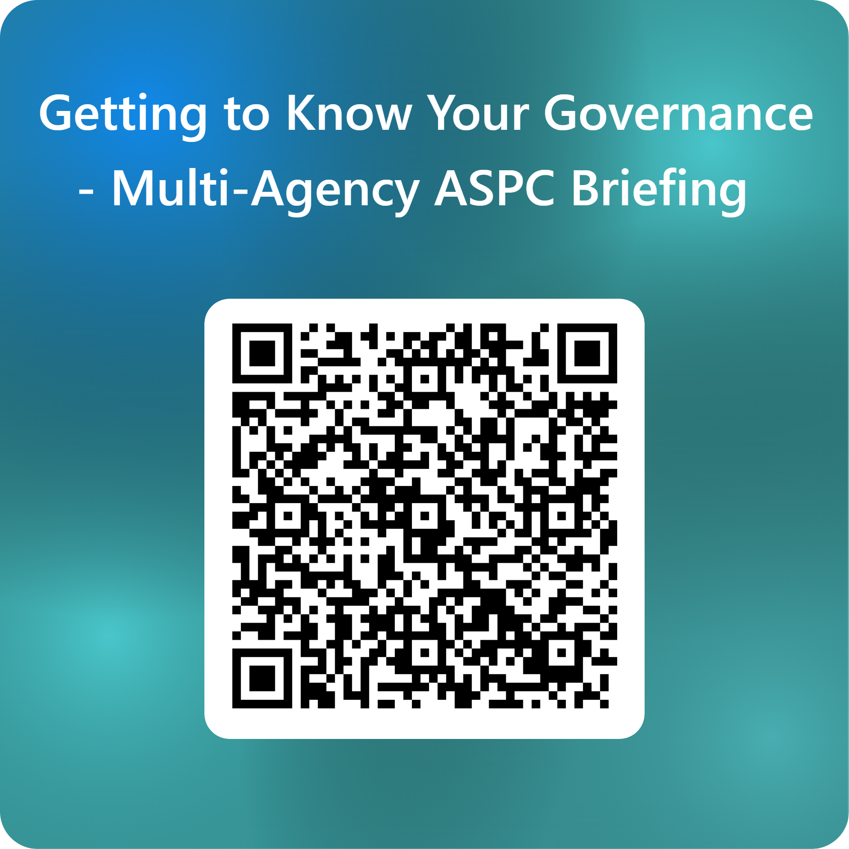
Thank you for your participation!
Visit the ASPC website - https://glasgowadultprotection.org.uk/
Visit the CPC website - https://www.glasgowchildprotection.org.uk/
Contact the Public Protection Committees Team - publicprotectioncommittees@glasgow.gov.uk
Notes:
This brings us to the end of the briefing. Are there any questions?
Slides will be emailed, along with a link to a short evaluation. We would be grateful if you could take a few minutes to complete it.

