Slide 1





Tayside Adult Support and Protection Defensible Decision-Making

Slide 2


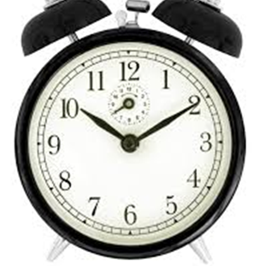


Welcome and Safe Space
Notes:
Whole Group introduction, say who you are, where you work max 3 sentences
Safe space – confidentiality, keeping yourself safe…emotive content? Safe space
Confidentiality
MS Teams functions
Breaks

Slide 3

Ice breaker and Menti
What needs to happen for you to make this learning experience worthwhile for you?
Notes:
What type of decision maker do you think you are…
What matters to you when making decisions?
The most difficult decision you’ve had to make in the last 7 days (which you are willing to share)
Laura

Slide 4
Group discussions
Case examples
Evidence based
Critical reflection

Slide 5
Overview
Session 1
Group introductions
Exploring initial decisions and thresholds
Critical review of the ASP legislation
Session 2
Threshold to risk and vulnerability
Professional curiosity
Different ways of thinking
Session 3
Risk assessment, Bias, thresholds, chronologies and significant events
Learning from SCR’s and ICR’s

Slide 6

Group Discussion
What are the challenges/opportunities in decision making in adult support and protection for :
You?
The adult or potential ‘adult at risk’?
Your organisation?
What is a defensible decision for you now?
Notes:
Feedback – 1 point per heading per group
‘What types of accountability do I experience?’ ‘In what circumstances am I held accountable?’
‘If there are several types of accountability mechanisms in play, do they affect my thinking in similar or different ways?’
‘If you are adapting your decisions – or the presentation of those decisions – to suit the anticipated reactions of particular audiences, what effect is that having on the way in which you analyse information and make judgements?’
Language . The activities that make up defensible decisions may in themselves be neutral but, when we think about them in terms of the battle metaphor, we can see how this underlying concept could steer attitudes and practice in ways that practitioners don’t consciously realise.

Slide 7
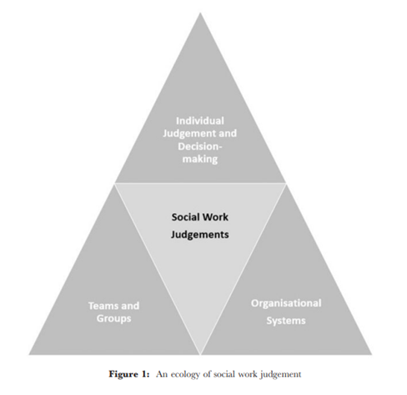
The Professionals' World of Decision Making
(Helm, D. 2017)
Notes:
Richard - The Childs World model
Applying an ecological perspective is a powerful antidote to the pre[1]dominating positivism inherent in technical–rational approaches, as it openly acknowledges the situated and constructed nature of such judgements, thereby supporting more rigorous appraisal of the data. Second, an ecological model provides practitioners with a means of examining their own sense-making activity as part of a larger set of interacting system
There is a small but growing body of empirical literature investigating the dynamics and outcomes of group decision making in social work (Kelly and Milner, 1996, 1999; Harlow, 2004; Harlow and Shardlow, 2006; Prince et al., 2005; Hitzler and Messmer, 2010; Roesch-Marsh, 2011). These studies indicate that groups can be just as prone to errors in judgement as individuals
The success of formal safeguarding decision-making groups is often determined by the quality of chairing (Harlow, 2004; Prince et al., 2005; Harlow and Shardlow, 2006). The chair must be able to surface the rele[1]vant information and analysis from each group member, maintain a clear distinction between fact, observation, allegation and opinion, and be able to help the group maintain its focus on the child and the child’s timescales (Calder, 2003; Prince et al., 2005).
Organisational culture can be described as ‘a psycho-social process which makes a bridge between individuals’ inner worlds and the social institutions in which they live and work’ (Taylor et al., 2008, p. 24). The culture of the organisation, group and/or team and its norms can influ[1]ence how we frame decisions (Helm, 2016), how we construct a narra[1]tive about a service user and partner agency through a process of ‘telling’ the story of the case (White and Stancombe, 2003) A range of authors have also identified that managerialist and target-driven cultures have not led to improvements in practice and have in fact undermined the ethical core of the profession (Webb, 2006; Emond et al., 2013; Featherstone et al., 2014).
Whittaker has argued that ‘rather than viewing practitioners simply as passive victims caught up in an increasing spiral of overly prescriptive guidance and regulation’, we should seek to understand the ‘complex picture of the way in which practitioners make choices... it is only in the careful explication of these everyday processes that a deeper understanding can be gained’ (Whittaker, 2011, p. 492). Pathologising and individualising judgement renders the picture incom[1]plete yet there remains the challenge of mapping the territory between the prescribers/regulators and those professionals tasked with making judgements with the system constructed
Throughout these sessions we will look at each angle of the triangle and what affects our decision making processes

Slide 8
Definition
Defensible decision-making in the context of Adult Support and Protection in Scotland involves making decisions that are well-founded, transparent, and can be justified. Based on evidence, legal principles, and ethical considerations.
  Legal Framework: The Adult Support and Protection (Scotland) Act 2007 provides the legal basis for protecting adults at risk of harm. It outlines the duties and powers of local authorities and other agencies to intervene and support vulnerable adult
  Evidence-Based Decisions: Decisions should be based on thorough assessments and evidence. This includes gathering information from various sources, such as medical reports, social work assessments, and input from other professionals
  Principles of the Act: The Act emphasizes respecting the autonomy and capacity of individuals. Decisions should encourage the exercise of autonomy and legal capacity, even when interventions are necessary
  Transparency and Documentation: All decisions should be clearly documented, detailing the rationale, evidence considered, and the decision-making process. This ensures accountability and allows for scrutiny if needed
  Human Rights Considerations: Decisions must respect the human rights of individuals, including their right to liberty and privacy as outlined in the European Convention on Human Rights (ECHR) and the United Nations Convention on the Rights of Persons with Disabilities (UNCRPD)
  Multi-Disciplinary Approach: Involving various professionals in the decision-making process helps ensure that all aspects of the individual's situation are considered, leading to more balanced and defensible decisions
  (Adult Support and Protection (Scotland) Act 2007, IRISS, Decision Making in Social Work, 2011, Mental Welfare Commission, Good Decision Making Guide, 2022)
Notes:
BRichard
Has appropriate levels of knowledge and skill s
appropriate use of information s risk assessment grounded in evidence s
communication with relevant others s risk management plan linked to risks and risk level s
risk management plan delivered with integrity s
all reasonable steps taken s information collected and thoroughly evaluated s
clear recording.
(From Kemshall 1997)
A degree of autonomy affects role and professionalism is affected
Problems in actually reaching a decision can include taking account of irrelevant information, and feeling overwhelmed by the greater awareness of possible outcomes that comes from having more information and a fear of being wrong. This last point is aptly summarised by Beckett et al. (writing about child protection but it could apply equally well to other settings): ‘To actually come to a conclusion carries the risk of discovering that one’s conclusion is wrong, and this creates an incentive to delay’ (2007, p.62).

Slide 9
Recap on Principles
(S.1 and 2.)
Group Task – How do we show we are working to these principles?
Benefit to the adult (s.1)
Least Restrictive to the adult’s freedom (s.1)
Wishes of Adult (past/present)
Other’s views (relative, carer, POA etc)
Participation of adult (as full as possible)
Support and information
Less Favourably – must not be treated
Abilities, background and characteristics
– must be respected
Notes:
Richard
The Act requires the principles to be applied when deciding which measure will be most suitable for meeting the needs of the individual. Any person or body taking a decision or action under the Act must be able to demonstrate that the principles in sections 1 and 2 have been applied. (so providing information, taking part in decision making forums)
How could we evidence each of these principles in action – where may there be some difficulties? or imbalances?– discuss in groups
Wishes – facilitate communication with which ever methods is appropriate, advanced statements, POA, chronology or case recordings, ACP
Views of others – undue pressure, increased risk, risk aversion,
Participation, advocacy (independent or informal), pre/post meetings prep to ascertain views, recording unmet communication needs, translation (sensory/language), flyers (Kate Fennel 2023 – “you walk in blind” “They all know each other” “ I didn’t know my role”
Support – extending or utilizing existing networks (neighbours, friends) formal supports and signposting
Less Favourable – there is a need to ensure that the adult is not treated, without justification, any less favourably than the way in which a person who is not an ‘adult at risk’ would be treated in a comparable situation. – example of someone using alcohol without or with an LD?
Abilities, background and characteristics - – including the adult’s age, sex, sexual orientation, religious persuasion, racial origin, ethnic group, and cultural and linguistic heritage. So as to more fully assess the abilities, background and characteristics of the adult, users of this Code may find it helpful to consider the wider protected characteristics list and definitions set out in the Equality Act 2010 for the purposes of that Act
Richard

Slide 10
Definition of an Adult at Risk
Adults, aged 16 or over, who:
Are unable to safeguard their own well-being, property, rights or other interests and
Are at risk of harm and
Because they are affected by disability, mental disorder, illness or physical or mental infirmity, are more vulnerable to being harmed than adults who are not so affected.
Notes:
Laura
Most people will be able to safeguard themselves through the ability to take clear and well thought through decisions about matters to do with their health and safety, and as such could not be regarded as adults at risk of harm within the terms of the Act. However, this will not be the case for all people, and when a person is deemed unable to safeguard themselves they will meet the first point of the three-point criteria.
Note: An adult who is considered unwilling to safeguard themselves, rather than unable to safeguard themselves, may not be considered an adult at risk. This distinction requires careful consideration. All adults who have capacity have the right to make their own choices about their lives and these choices should be respected if they are made freely.
However, for many people the effects of trauma and/or adverse childhood experiences may impact upon both their ability to make and action decisions, and the type of choices they appear to make. In this context it is reasonable to envisage situations in which these experiences, and the cumulative impact of them through life, may very well have rendered some people effectively unable, through reliable decision making or action, to safeguard themselves.
Similar considerations apply to coercive control or undue pressure. In such situations the control exercised over a vulnerable person may also effectively render them unable to take or action decisions that would protect them from harm. It is therefore important, as part of the assessment, to understand the person’s decision-making processes. This should include an understanding of any factors which may have impacted upon them with the effect of impinging on, or detracting from, their ability to make and action free and informed decisions to safeguard themselves. This could therefore mean that in these circumstances they should be regarded as unable to safeguard themselves. Other circumstances can impact on the extent to which a person is meaningfully able to safeguard themselves. Refusing to give a random stranger money is, for example, very far removed from the situation where it is the person’s relative who is making such a request, and where the adult is dependent upon that relative for support. For fear of repercussions or removal of support, they may feel afraid of refusing the request. It is also important to bear in mind that an inability to safeguard oneself is not the same as an adult lacking mental capacity.
For example a person may have relevant mental capacity, but also have physical limitations that restrict their ability to implement actions to safeguard themselves.
Capacity applies to both decision making and the implementation of decisions. A person can have the capacity to make a particular decision but through illness or infirmity may not have the physical capacity to implement that decision.
What do you mean by physical or mental infirmity?
Vulnerability is often defined as being at increased risk of harm or having reduced capacity or power to protect one’s
interests’ (Mackenzie 2014)

Slide 11
Breaking down the 3 Point Criteria (test)
“Unable to safeguard” (c.1)
Not formally defined in the Act or guidance
Referenced in COP from Oxford English Dictionary as “lacking the skill, means or opportunity to do something”
Scottish Government Guidance must be considered by LA and health professionals (but not necessarily the Courts)
Notes:
Laura
When thinking about is the person unable, consider do they have the skills to keep themselves safe, do they have the means – do they have supports, monies, resources to keep themselves safe. Do they have opportunity to change things, are they able to make changes based on their current situation. Is resources available to promote opportunity.
How do YOU make that decision?
Inability to Safeguard:
The codes emphasize that an adult may be unable to safeguard their well-being, property, rights, or other interests due to various factors, including physical or mental disabilities, illness, or the effects of substance misuse1
.

Slide 12

“Unable to safeguard” (C.1)
Unable as “lacking the necessary power, ability or authority (to do something); not able”
Unwilling is defined as “unfavourably inclined, reluctant” and may describe someone who is aware but still makes a deliberate choice
(Collins English Dictionary in COP, 2022)
Notes:
Laura
Most people will be able to safeguard themselves through the ability to take clear and well thought through decisions about matters to do with their health and safety, and as such could not be regarded as adults at risk of harm within the terms of the Act. However, this will not be the case for all people, and when a person is deemed unable to safeguard themselves they will meet the first point of the three-point criteria.
Note: An adult who is considered unwilling to safeguard themselves, rather than unable to safeguard themselves, may not be considered an adult at risk. This distinction requires careful consideration. All adults who have capacity have the right to make their own choices about their lives and these choices should be respected if they are made freely.
However, for many people the effects of trauma and/or adverse childhood experiences may impact upon both their ability to make and action decisions, and the type of choices they appear to make. In this context it is reasonable to envisage situations in which these experiences, and the cumulative impact of them through life, may very well have rendered some people effectively unable, through reliable decision making or action, to safeguard themselves.
Similar considerations apply to coercive control or undue pressure. In such situations the control exercised over a vulnerable person may also effectively render them unable to take or action decisions that would protect them from harm. It is therefore important, as part of the assessment, to understand the person’s decision-making processes. This should include an understanding of any factors which may have impacted upon them with the effect of impinging on, or detracting from, their ability to make and action free and informed decisions to safeguard themselves. This could therefore mean that in these circumstances they should be regarded as unable to safeguard themselves. Other circumstances can impact on the extent to which a person is meaningfully able to safeguard themselves. Refusing to give a random stranger money is, for example, very far removed from the situation where it is the person’s relative who is making such a request, and where the adult is dependent upon that relative for support. For fear of repercussions or removal of support, they may feel afraid of refusing the request. It is also important to bear in mind that an inability to safeguard oneself is not the same as an adult lacking mental capacity.
For example a person may have relevant mental capacity, but also have physical limitations that restrict their ability to implement actions to safeguard themselves.
Capacity applies to both decision making and the implementation of decisions. A person can have the capacity to make a particular decision but through illness or infirmity may not have the physical capacity to implement that decision.

Slide 13
Breaking down the "3 point criteria (test)"
At Risk of Harm (c.2)
Adults are deemed to be “at risk of harm” when;
Another person(s) conduct is causing (or is likely to cause) the adult to be harmed
The adult is engaging (or is likely to engage) in conduct, which causes (or is likely to cause) self-harm (s.3 (2))
(s.53) includes all harmful conduct and in particular includes;
Conduct which causes physical harm
Conduct which causes psychological harm (for example causing fear, alarm or distress)
Unlawful conduct which appropriates or adversely affects property, rights or interests (theft, fraud, embezzlement or extortion) and
Conduct which causes self harm
  N.B. “conduct” includes neglect and other failures to act
Notes:
Laura
Ask group what is defined as harm and how this might be evidenced….
Harm:
Harm is defined broadly to include all harmful conduct, whether intentional or unintentional, and can encompass physical, psychological, financial, sexual, or neglectful harm1
.
The codes provide examples of different types of harm and stress the importance of considering the adult's perspective and experiences1

Slide 14

Definition:
Risk of Harm (c.2)
S.3(2) Adults are deemed to be “at risk of harm” if:
Another person(s) conduct is causing (or is likely to cause) the adult to be harmed
The adult is engaging (or is likely to engage) in conduct, which causes (or is likely to cause) self-harm
Notes:
Laura
Adults can be at risk of harm in various settings, be it in their own home, in the wider community, or in a hospital setting. They also may be placed at risk through inappropriate arrangements for their care in a range of social or health care settings. Perpetrators of harm can include families and friends, informal and formal carers, fellow users of residential and day care services, fraudsters and members of the public

Slide 15
Group Discussion
How do you differentiate between harm and significant or serious harm?
Notes:
Laura

Slide 16
3rd Criteria
Because they are affected by disability, mental disorder, illness or physical or mental infirmity, are more vulnerable to being harmed than adults who are not so affected.
Discuss in groups (5 mins)
Notes:
Laura
Physical or mental infirmity are distinct from disability and mental disorder and are not defined in the Act. Infirmity is defined as a “physical or mental weakness”. Infirmity does not, therefore, necessarily rely upon a medical diagnosis in the way that mental disorder or illness do.
To note: It is recognised that “infirmity” is a term that is no longer favoured when describing disability. Having a particular condition or being a disabled person does not automatically mean someone is unable to safeguard their own wellbeing. “Illness” can apply to physical or mental health. The impact of illness on an individual’s ability to safeguard themselves, and the extent to which it makes them more vulnerable to harm, must be considered. Depending upon the nature and trajectory of an illness, the assessment of this criterion of the three-poi
Each of the three criteria must be met to enable intervention under the Act. It should be recognised that an individual’s vulnerabilities, health conditions and abilities can fluctuate and evolve over time. Practitioners should be alert to the need for re-assessment or for re-evaluation of an individual’s circumstances against the three-point criteria. While someone who lacks capacity may be unable to safeguard their own wellbeing, property, rights and other interests, it should never be assumed that an adult who has capacity is able to do so, nor should any decision made, regarding whether an adult is an adult at risk, ever be delayed for an assessment of capacity to be undertaken. Capacity assessments may, however, be of benefit as means of identifying other legislative options available to support the individual.
Further guidance related to capacity in the context of adult support and protection activity can be found in Chapter 7. The three-point criteria should be used to determine whether an adult is at risk of harm, and from this will follow decisions regarding what steps can be taken to protect that adult from harm. The three-point criteria is not, and should not be used as, an eligibility test for access to services. An assessment that intervention under the Act is not necessary or appropriate does not absolve authorities of responsibility to consider intervention under any other legislation, including the general provisions in Section 12 of the Social Work (Scotland) Act 1968 (general social work services of local authorities), or to offer any other services in order to provide care and support. Consideration should be given to support provided by social work, health, independent and third sector providersnt criteria may change over time.
Trauma informed practice is an approach to care provision that considers the impact of trauma exposure on an individual’s biological, psychological and social development. Delivering services in a trauma informed way means understanding that individuals may have a history of traumatic experiences which may impact on their ability to feel safe and develop trusting relationships with services and professionals. Practitioners should be alert to the need to view behaviours that compromise health, wellbeing and safety as adaptations that may have played a useful role in the individual’s life in helping them to survive, and cope with, their experiences of trauma. Examples of such adaptations can include: maintaining contact with an alleged harmer; use of drugs or alcohol; self-harm; hoarding, and avoidance of places and people, including professional relationships and services, which may trigger reminders of prior traumatic experiences. As above, in these circumstances, some people’s ability to take and action decisions about safeguarding themselves may effectively be compromised.

Slide 17
Complexities of the Act
Unwilling or Unable – A Distinction between those who lack the skills, means, opportunity and power and those who choose not to do so
Blurring Concepts – an Inability to safeguard is not the same as lacking capacity
Infirmity –relates to physical or mental infirmity; OED Definition; weakness or want of strength; lack of power to do something, unable
Consent and Capacity Complexities (Fluctuating, Impact of Trauma, Undue Pressure)
Identifying Harm and Vulnerability
Balancing Rights and Protection
Notes:
Laura

Slide 18

Tea Break

Slide 19
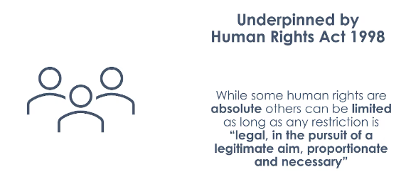
Notes:
Richard

Slide 20
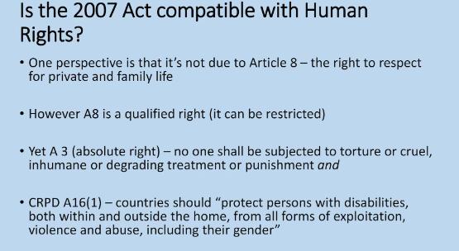
Notes:
Richard

Slide 21
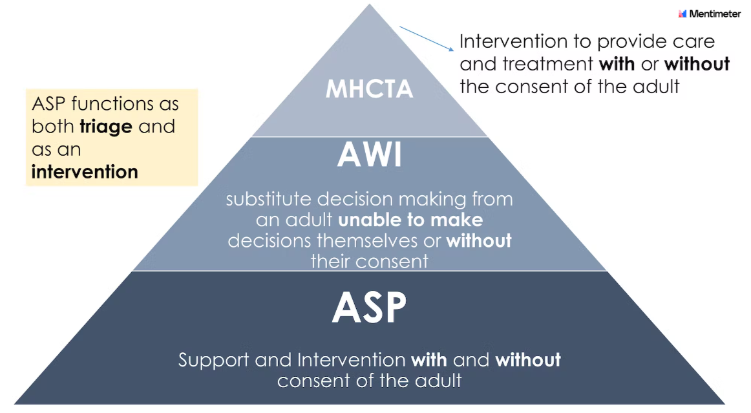
Notes:
Laura
Not clear cut info re transitions etc. And CP overview (adult, cognitive development, decision-making and trauma, what does age mean when looking at capacity and exec)
Link in re iriss
Iain suggested timeline re ages etc. And case examples
Supported decision-making
Consider PP lens (whole family and community i.e. hoarding and housing legislation)

Slide 22
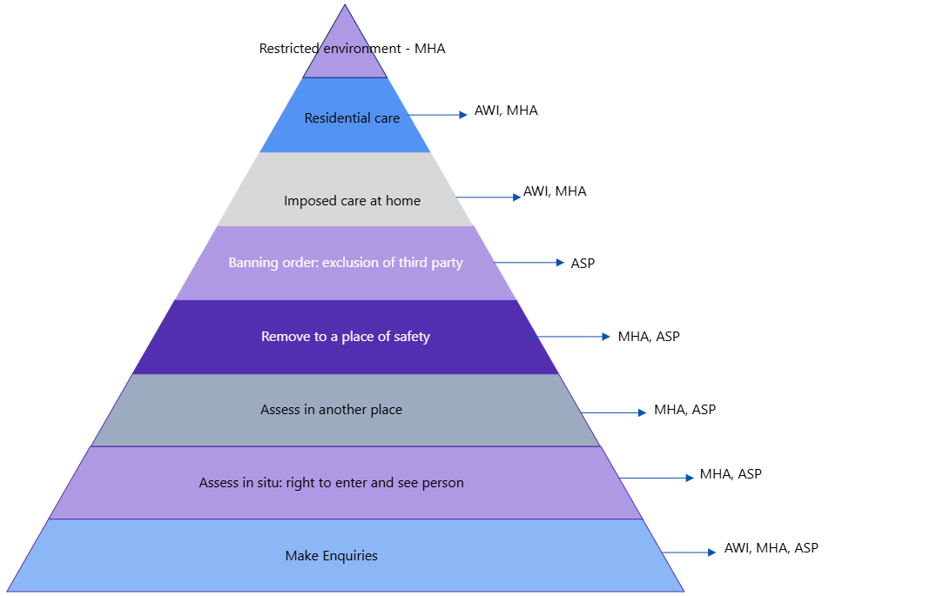
Powers Across the Acts
Notes:
Laura

Slide 23
The Principles across the Acts
ASP | AWI | MHCT
Intervention must Benefit the adult; Be the least restrictive option (s.1) | Intervention must Benefit the adult; Be the least restrictive option (s.1) | Intervention must Benefit the adult; Be the least restrictive option (s.1)
Have regard to the adults wishes and feelings (past and present); (s2) | Take account of adults wishes and feelings (past and present); (s1) | Have regard to the present and past wishes and feelings of the patient; (s1)
Have regard to the views of adults nearest relative primary carer, guardian or attorney and any other person with interest in the adult wellbeing or property (s2) | Take account of views of adults nearest relative, primary carer guardian or attorney, persons identified by sheriff and any other person with interest in adults' welfare or the intervention (s1) | Have regard to the views of the patient's named person; any carer of the patient; any guardian of the patient; and any welfare attorney of the patient (s1)
 | Adults should be encouraged to use existing skills or develop new skills(s1)
Ensure the adult can participate as fully as possible and provide support and information to facilitate this (s2) |  | The importance of the patient participating as fully as possible and the importance of providing such information and support to the patient as it necessary (s1)
That the adult is not treated less favourable than the way in which a person who is not an adult at risk might be treated in a comparable situation (s2) |  | That the patient is not treated in a way that is less favourable than the way in which a person who is not a patient might be treated in a comparable situation (s1)
Take account of the adults' abilities, background and characteristics (s2) |  | Have regard to the range of options available in the patient's case (s1)
 |  | Have regard to the range of options available in the patient's case (s1)
 |  | The needs and circumstances of any carer relevant to the discharge of the function and of which the person is aware; and providing information to any carers as might assist the carer to care for the patient (s1)
No equivalent but see s6 of the act (support and advocacy) |  | The importance of the provision of appropriate services to the person who is, or has been, subject to the certificate or order (s1)
 |  | Under 18 – welfare of the child (s2)

Slide 24

Group Discussion
From your experience consider a case where “someone made a lifestyle choice” and did not appear to meet the criteria for ASP…what are your thoughts on this now?

Slide 25
Consent and the COP
Obtaining Consent: The Code emphasizes the importance of obtaining the adult's consent before taking any action or sharing information. This respects the adult's autonomy and right to make their own decisions
Exceptions to Consent: There are situations where consent may not be required. For example, if the adult is at immediate risk of harm or if obtaining consent would place them at greater risk
Undue Pressure: If it is believed that the adult is under undue pressure to refuse consent, this should be carefully considered. The Act allows for intervention even without consent in such cases
Transparency: It is important to be open and transparent with the adult about the actions being taken and the reasons for them. This helps build trust and ensures the adult is informed
Notes:
Procedures Say
If the person can consent but does not wish any action to be taken then their wishes should be respected unless:-
1. a crime has been committed;
2. there is a risk to other people;
3. there is a Statutory requirement to take action;
4. there are public health concerns;
5. the person is currently in an institutional setting such as a care home or hospital or there is a concern about a registered service;
6. it is considered that the person may be under undue pressure;
7. the allegation concerns a member of staff; 8. the person is pregnant in which case the Unborn Baby Protocol should be followed. You must discuss the suspected harm with your line manager and record appropriately regardless of consent

Slide 26
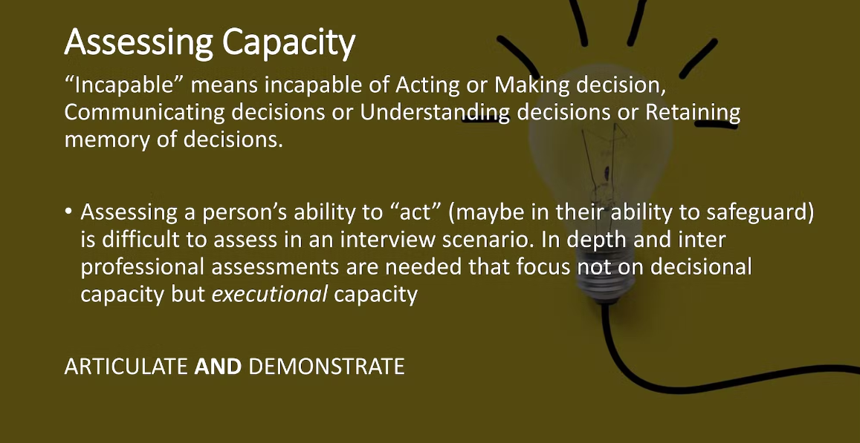

Slide 27
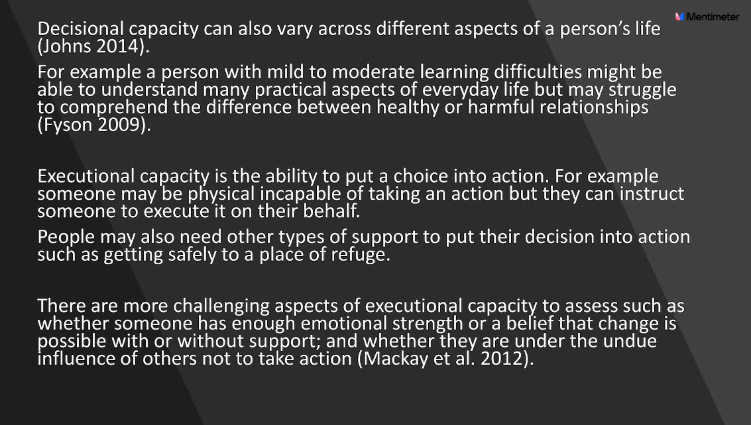

Slide 28
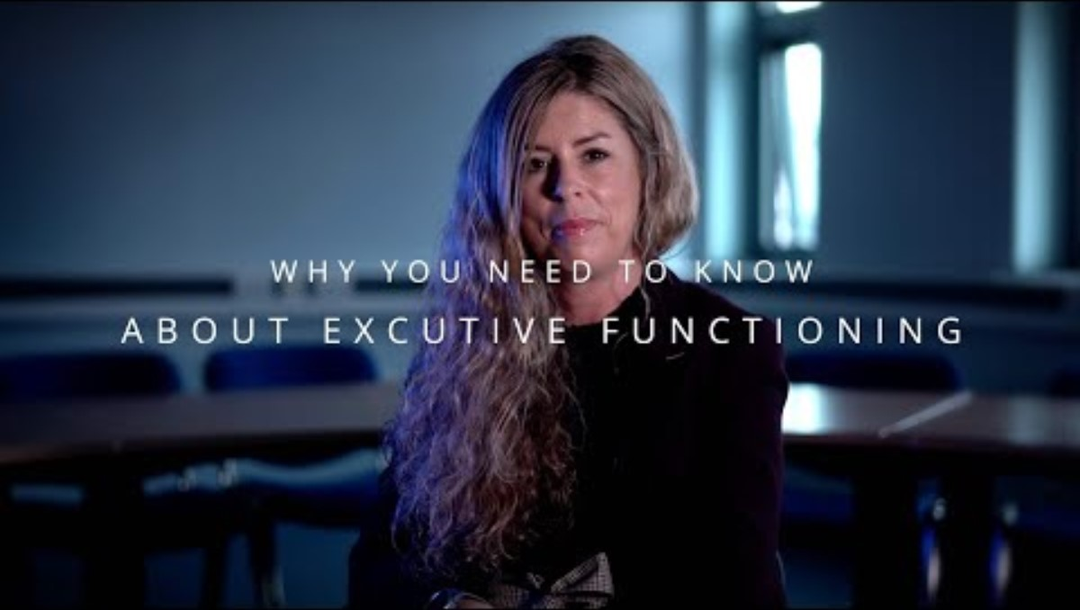
Elie Atkins – Executive Functioning

Slide 29
Reflections…
Capacity is not a black and white issue
Each case requires careful consideration
If someone doesn’t meet the legal definition do we “walk away?”
Is this gatekeeping?
What is the Duty of Care?
Opportunity to use ASP as triage legislation
What else?

Slide 30
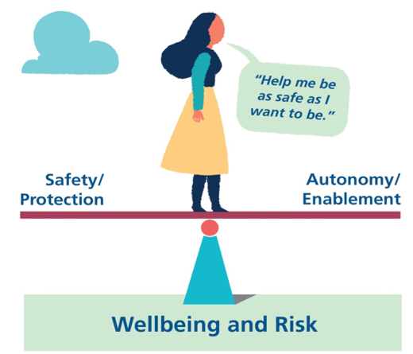
Is the right to “self-determination” favoured over the right to be protected or vice-versa?
Are these “competing” rights
Can intervention be “more restrictive” in the short term to promote autonomy/self-determination in the long term?
Notes:
Richard
When considering the 3 point test- ask yourself these three questions…
Do they have the skill – personal ability?
Means= material wherewithal
Opportunity – surrounding circumstances allow application of these
Families may have hgh levels of worry about their loved ones who have high levels of care and support needs, every family has different dynamics and different attitudes but there is generally a tendency to prioritise safety
When someone has capacity and are acting free from the influence of others, decision making is not impared by impact or trauma and no evidence of serious harm – should we look to be risk enablers?

Slide 31

Mrs Eileen Anderson Referral
Mrs Anderson is an 80 year old woman who has been diagnosed with Alzheimer’s. She lives alone in a 2 story house.
Mrs Anderson was admitted to hospital on an emergency basis under section 36 of the Mental Health (Care and Treatment) Act 2003, compulsory measures were required on admission as she was refusing fluids and medical treatment. Mrs Anderson was diagnosed with a chest infection and UTI, she was described as unkept on admission, confused, constantly wandering and verbally aggressive. She is also doubly incontinent.
Notes:
Richard
Mrs Eileen Anderson Referral
Mrs Anderson is an 80 year old woman who has been diagnosed with Alzheimer’s. She lives alone in a 2 story house.
Mrs Anderson was admitted to hospital on an emergency basis under section 36 of the Mental Health (Care and Treatment) Act 2003, compulsory measures were required on admission as she was refusing fluids and medical treatment. Mrs Anderson was diagnosed with a chest infection and UTI, she was described as unkept on admission, confused, constantly wandering and verbally aggressive. She is also doubly incontinent.

Slide 32

Case Study Introduction
Mrs A referral
Based in the information provided…what is the decision you will come to about next steps?
What further info do you need?
Who will be the key people you have to involve?
What about capacity?
What are your options?
Notes:
Richard
Mrs Eileen Anderson Referral
Mrs Anderson is an 80 year old woman who has been diagnosed with Alzheimer’s. She lives alone in a 2 story house.
Mrs Anderson was admitted to hospital on an emergency basis under section 36 of the Mental Health (Care and Treatment) Act 2003, compulsory measures were required on admission as she was refusing fluids and medical treatment. Mrs Anderson was diagnosed with a chest infection and UTI, she was described as unkept on admission, confused, constantly wandering and verbally aggressive. She is also doubly incontinent.

Slide 33

Tasks for next session
Professional curiosity guidance (7 pages)
Read Mrs A's Case Example and consider the points in Rise Resource
Ask a colleague or manager for feedback about what your strengths are as a decision maker
Notes:
Richard

Slide 34

Menti Checking out
Notes:
Richard

