Slide 1




Tayside Adult Support and Protection Defensible Decision-Making

Slide 2

Checking-in Whole Group Discussion
Notes:
•Read Tayside Protocol - Chronology Guidance, Risk management, consent and capacity (20 mins)
•Apply the “6 hat thinking” to a situation where you need to make a decision – what do you notice?
•Look into / research a learning review and bring some key themes to the group

Slide 3
Session 3 Overview
Thresholds
Risk assessment
Bias
chronologies and significant events
SCRs and Learning Reviews

Slide 4

Break Out Room Discussion
What can impact on your decision making about risk?
What about decision making of the Adult at Risk?
Notes:
What about the decision making of the adult at risk?
Resources…
Bias…
Past experience…etc. etc.

Slide 5

Threshold exercise
Notes:
4 Case Studies (7 minutes)
Group scores
What was affecting my decision making

Slide 6
Assessing Risk
How do you do assess risk now…
What tools do you use?
Can you share what you have found helpful?

Slide 7
Two definitions of Risk
1) “The possibility of beneficial and harmful outcomes and the likelihood of their occurrence in a stated timescale”
2) “Risk as the probability of an adverse or unwanted event, which may arise from known or unknown factors or both. We also acknowledge that positive risk-taking balances-controlled risks and opportunities to sustain or increase independence. ”
Notes:
Autonomy vs Protection tensions and dilemmas

Slide 8
Components of a good Risk Assessment
Collect full information.
Use a chronology- single or multi agency (depending on purpose).
State the risks to the adult, where, when and in what circumstances the harm occurs or may occur.
Make sure you communicate with all relevant parties.
Evaluate (what does information mean for the adult’s safety or wellbeing).
Identify potential/actual outcomes to the adult.
Clear language.
Avoid jargon.
Understanding of the adult.
Ability / awareness of the adult.
Establish a plan.
Clarify individual roles and responsibilities.
Set timescale for reviewing risk and plan.
Notes:
The chronology helps us look back to identify future potentials- we will look at chronology under tools for collating information.

Slide 9
Risk Assessment & Risk Management
What is worrying us?
How worried are we?
What can we do to reduce the worry?

Slide 10

Kemshall (2013) identifies the key components of assessing risk as:
Identification of the risk of what? – the behaviour or event of the concern
Calculation of its likelihood or probability
The conditions, situation(s) or circumstances in which the risk might occur
The likely impact of risk
The consequences of risk and who might be exposed to and harmed by risk
Notes:
Steven Hoskins Inquiry
There was sufficient evidence to justify a likelihood that Steven would come to harm – However a lack of information sharing and analysis of the evidence prevented an assessment of the types of harm, their immindencem their likelihood and the severity of the impact of that harm – i.e. TILS

Slide 11
Risk Assessment as a process
The Risk Assessment process has four distinctive and sequential stages, and practitioners should go through each of them, involving the individual (Clarke et al 2011). it is important to remember that a person’s ability to engage can fluctuate, because of a cognitive impairment or due to physical or emotional difficulties. In such circumstances it could be necessary to arrange conversations at times that are appropriate for them and/or provide additional support if required.
(Stage 1)
Understanding the person’s circumstances
(Stage 2)
Identifying risks & protective factors
Identify risks in the life-context of the individual and their circumstances (and therefore impact on quality of life and individual wellbeing).
Identify risk perspectives from all the people involved.
Identify weighting of risks (imminence, likelihood of occurring/ recurring.
Identify current and past strategies for managing risks.
(Stage 3)
Assessing impact and likelihood of risks (severity of impact - on emotional, social and psychological wellbeing).
(Stage 4)
Managing risks– risk enablement and planning.
Notes:
We will look at each of these stages in coming slides.
Risk assessment process- it is important to remember that a person’s ability to engage can fluctuate either as a result of a cognitive impairment of the mind or brain or due to physical or emotional difficulties. In such circumstances it will be necessary to arrange conversations at times that are appropriate for them and/or provide additional support if required such as:
• Appropriate Person
• Advocacy service.

Slide 12
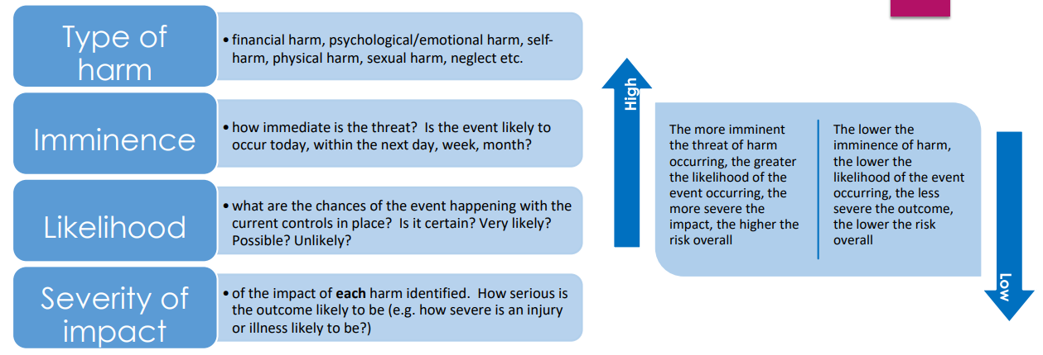
An analytical approach to risk assessment –
TILS (Type of harm, Imminence, Likelihood, Severity of impact)
(Midlothian and East Lothian Councils)
In your groups think about a TILS assessment for Mrs A
Notes:
A helpful approach to assessing risk is to consider the interaction of the following component parts: Each Element of TILS should inform SMART Actions
S – Specific: The goal should be clear and well-defined.
M – Measurable: You should be able to track progress and measure the outcome.
A – Achievable: The goal should be realistic and attainable.
R – Relevant: It should align with broader objectives or values.
T – Time-bound: There should be a deadline or time frame for completion.
TILS can be a form of language or a guideline for recordings, verbal discussion, chronologies, risk assessment, protection plans, contributions at case conference etc
TILS helps you to frame your thinking and analysis and be able to articulate your argument – just like grammar helps us to understand a sentence, think of TILS as your grammar for Risk Assesment
IRISS TILS risk clarification tool with case example (East Lothian and Midlothian) | Iriss
Steven Hoskins Inquiry
There was sufficient evidence to justify a likelihood that Steven would come to harm – However a lack of information sharing and analysis of the evidence prevented an assessment of the types of harm, their immindencem their likelihood and the severity of the impact of that harm – i.e. TILS
Mrs Eileen Anderson
Eileen lives at home alone in a two storey building, she is 80 years old. Her daughter Jane is her main carer. They have no other family.
After a fall, Eileen was admitted to hospital. She had bruising to her legs, was doubly incontinent and appeared confused.
Eileen remained in hospital for three months, during this time she was diagnosed with Alzheimer’s which is exacerbated by frequent UTI’s and having high blood pressure.
She was discharged home, incontinent of urine with a referral being made to the OPCMT. No other supports in place.
When home Eileen failed to attend the first two appointments with the OPCMHT Consultant Psychiatrist, Jane contacted them to state her mum was unable to attend due to poor mobility.
Part 2
OPCMT Consultant Psychiatrist wrote to Eileen’s GP stating she had not attended and referred back to GP.
GP wrote to OPCMHT stating that Eileen was a “little vulnerable”.
CPN from OPCMHT – Home Visit. Home was cold and unkempt, Eileen was alone and refused any support from social services.
4 days after home visit Eileen was admitted to hospital with hypothermia, bruising on both legs and was doubly incontinent.

Slide 13
Mrs A TILS Analysis
What could be some SMART Actions based on this TILS?
TILS Element | Assessment
T – Type of Harm | - Physical harm: Repeated falls, bruising, hypothermia. - Neglect: Lack of adequate heating, hygiene, and continence care. - Psychological harm: Isolation, confusion, and refusal of support.
I – Imminence | - Risk was immediate and escalating: Mrs A was discharged with minimal support, missed psychiatric appointments, and was later found in a cold, unkempt home. - Hospital admission occurred just 4 days after a concerning home visit.
L – Likelihood | - High likelihood of harm due to multiple risk factors: advanced age, Alzheimer’s, incontinence, poor mobility, and refusal of services. - Jane’s role as sole carer with no additional support increased vulnerability.
S – Severity | - Severe: Hospitalisation with hypothermia and physical injuries. - Potential for life-threatening outcomes if risks are not addressed.
Notes:
For TILS to be effective – we need to ensure we manage the difference between descriptive writing and critical or analytical writing
Key Concerns and Recommendations
Lack of coordinated care: Discharge planning did not ensure adequate support.
Missed opportunities: Non-attendance at appointments and GP's note of vulnerability were not escalated effectively.
Environmental risks: Cold, unkempt home environment posed serious health threats.
Need for assertive outreach: Given Eileen’s refusal of services, a more proactive safeguarding approach was warranted.

Slide 14
Descriptive Writing v Critical/Analytical Writing
Descriptive | Critical and Analytical
States what happened | Identifies the significance
States what something is like | Evaluates (judges the value) Strengths and Weaknesses
Gives the story so far | Weighs one piece of information against another
States the order in which things happened | Makes reasoned judgements
Says how to do something | Argues a case according to evidence
Explains what a theory says | Shows why something is relevant or suitable
Explains how something works | Indicates why something will work (best)
Notes the methods used | Indicates whether something is appropriate or suitable
Says when something occurred | Identifies why the timing is important
States the different components | Weighs up the importance of the component parts

Slide 15

Mrs A – The Inquiry
What is your assessment of the risk(s)?
What is the information telling you?
Who else will have information that is relevant?
Professional curiosity – What doesn’t fit?
What will be your decision?
Notes:
Key Concerns and Recommendations
Lack of coordinated care: Discharge planning did not ensure adequate support.
Missed opportunities: Non-attendance at appointments and GP's note of vulnerability were not escalated effectively.
Environmental risks: Cold, unkempt home environment posed serious health threats.
Need for assertive outreach: Given Eileen’s refusal of services, a more proactive safeguarding approach was warranted.

Slide 16

Break

Slide 17
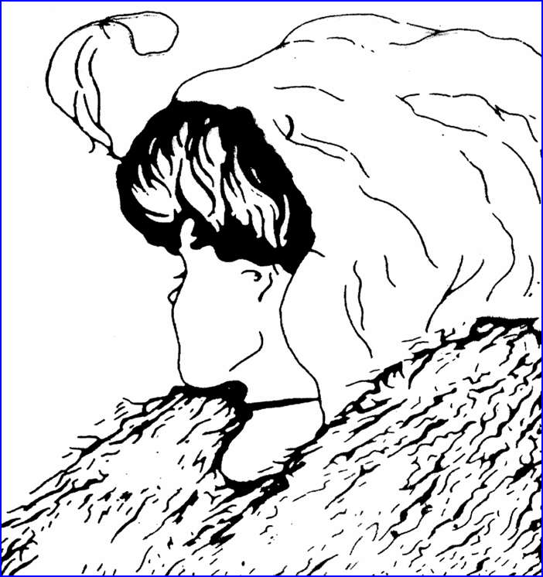
What do you see?
Notes:
Seeing risks in different ways, things like bias, experiences, structures all affect the way we see risk, using tools like we have discussed to evidence our risk assessments can support our assessments and make our decisions defensible

Slide 18
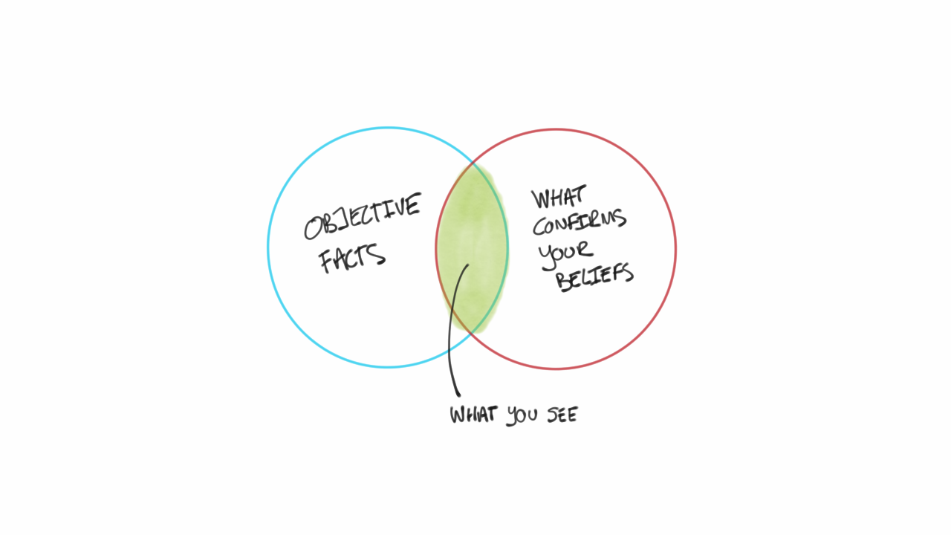
Bias and decision making – Group Discussion…
Notes:
Confirmatory Bias - decisions unduly influenced by initial information. New information processed to support initial judgement
Credibility Bias - we are more inclined to accept a statement or evidence from those we like/ respect/ trust
Recall Bias - recent dramatic cases can result in overestimating the probability of harm
Resource Bias - decisions actively influenced by availability of resources
Anchoring Bias - judgements dictated by our views about what is “normal”
Compression Bias - tendency to overestimate unlikely undesirable events and underestimate likely undesirable events
Optimism Bias - Want to see things in a positive light and this impacts on decision making
Repetition Bias -tendency to attach most weight to most repeated story

Slide 19
Bias in risk assessments
Anchoring Bias - judgements dictated by our views about what is “normal”.
Compression Bias - tendency to overestimate unlikely undesirable events and underestimate likely undesirable events.
Optimism Bias - Want to see things in a positive light and this impacts on decision making.
Repetition Bias -tendency to attach most weight to most repeated story.
Confirmatory Bias - decisions unduly influenced by initial information. New information processed/ sought to support initial judgement.
Credibility Bias - we are more inclined to accept a statement or evidence from those we like/ respect/ trust.
Recall Bias - recent dramatic cases can result in overestimating the probability of harm.
Resource Bias - decisions actively influenced by availability of resources.
Notes:
.In situations of limited time and resource, intuitive reasoning and recourse to a range of subjective biases can easily take place, sowing the seeds of potential error. A wide-ranging field of literature on risk perception has identified a number of sources of error and bias.
As mentioned earlier- structured professional judgement can be suspectable to bias.
Operation Jasmine professional deference or bias as both husband and wife owners were GP's but the are believed to be the cause of 63 peoples deaths and maybe a lot more –Ah well people get old – GP was on TV saying well old people get sores - that’s not true – what do reviews mean

Slide 20
What benchmarks am I using to judge behaviour/ situations?
Which of my previous experiences is influencing my work?
Are there risks in anchoring decisions to these experiences?
Am I unduly influenced by recent or dramatic events?
How can I moderate against inappropriate bias?
How can I learn from life and work experience and avoid bias?
On what am I basing my estimate of the probability of harm (or success)?
Am I giving due weight to all available information?
Am I making sure I am not discriminating on any grounds?
Am I unduly over-confident or optimistic?
What would it take to change my mind about the last assessment point?
11 Thoughts to Help Avoid Bias

Slide 21
Chronologies Reflective Practice
Menti 4713-3404

Slide 22
Chronology Guidance
Recording information which is relevant, necessary, legitimate, appropriate and proportionate
is an essential tool for best practice in assessment, analysis, and decision making
is an aid to effective partnership working and discussion with the adult, carers and families
is factual, accurate and evidence based
supports workers to maintain focus on the adult
is in a neutral language, suitable for practitioners, adult and families to understand
is presented in time and date order starting with the earliest available information
is concise – if every concern, event or milestone and circumstance is recorded then the chronology loses its value and impact
provides an early indication of an emerging pattern of need, concerns, and/or risks
Notes:
Look at chronology tool

Slide 23
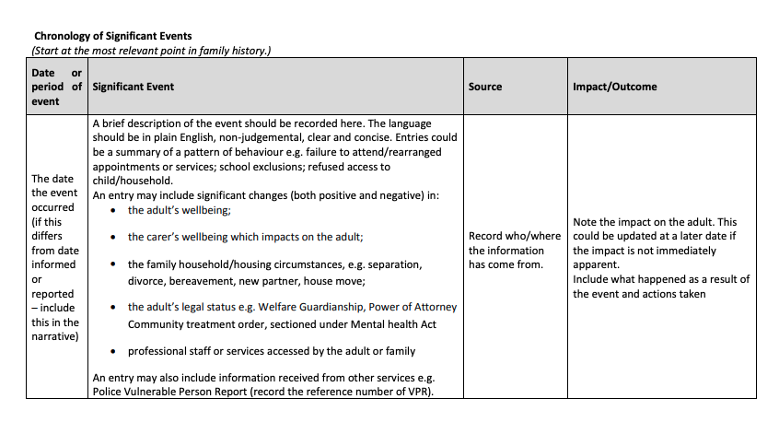
Notes:
Fact – proven or known to be true – how
Opinion – a view of judgement formed about something not necessarily based on fact or knowledge
Judgement – the ability to make considered decision or come to sensible conclusions
A Chronology is an analytical tool – a chronology keeps the focus on the person and allows us to see what bits of information we need to pull apart to see the compotentn parts and how they relate to each other – thinking about the how and why not merely the what as in a case note

Slide 24
√ Do:
To be of value, the chronology should be:
Succinct - if every issue/ contact is recorded the value of the Chronology is diluted.
Simple in format - thus ensuring that information is efficiently merged and sorted.
Informative - assist with the decision making process.
Coherent- use clear, straightforward language that explicitly depicts the issues.
X Don’t:
What should not be in a chronology:
SW visits - these points should be in the assessment or the case notes (although specific issues/disclosures may be relevant);
Analysis.
Wordy Descriptions.
Dialogue unless a verbatim quote re: harm.
Copy of case recording.
Insignificant telephone contacts with person or carers.
*Record every ‘failed’ home/ office visits- separately.
Notes:
*If intention is to evidence either unwillingness / unable to engage, group together e.g. between April–June 2020 there were 23 arranged appointments offered but individual was available/ attended for 10. Indicate whether a plausible reason for missed appointments had been provided e.g. someone with depression might say that they were in a deep depressive state and this is consistent with their illness (indicates plausibility but might not suggest unwillingness to engage but might highlight their MH is affecting their ability to use support available consistently- unable to engage).
Group together contacts with emergency services- e.g. someone who calls police, ambulance and uses GP and A & E very frequently. Record the visits between this date and that date, similar to the home visits. Only record emergency services contacts if there is something significant about them.

Slide 25

Learning Reviews
(Formerly ICR & SCR)
Looking at the timeline of the actual review of Mrs A.
Notes:
During these sessions we have discussed many learning reviews;
Mrs A
AB
Margaret Fleming
P19
Steven Hoskins
Miss X

Slide 26
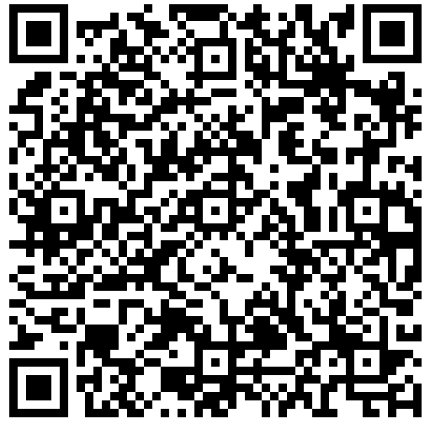
Mrs A – Timeline from Significant Case Review

Slide 27

“key points in the case when there was a lack of what has been described as professional challenge and too often, there was a lack of appropriate rigour in analysing and evaluating information.
Essentially, workers gave too much weight to what Mr Ash and Mrs Ash were telling them, thereby allowing the right to self-determination to override the right to protection. This has particular relevance to statutory responsibilities under Adult Support and Protection legislation and associated mental health legislation.”
Ellen Ash SCR, pg.14

Slide 28
“The SCR team formed the opinion that there was sufficient evidence gathered from the “duty to enquire” to warrant a formal investigation under the ASP legislation. However, such is the complexity of legislation in this area of work that there is often more than one option and the final decision should come down to professional judgement based on a comprehensive risk assessment.”
Significant Case Review undertaken on behalf of Glasgow APC on Mrs Ellen Ash, pgs25-26
Notes:
What the role of PPA supporting PPASC committee in the LR process
commissioning role, shared guidance available for Dundee & Angus.
Your decisions need to be defensible and show the decisions have been well made.
Don't rely on your word against another person.
Always looking at the what we could do better stuff not blaming people – processes and systems more than personal improvements.

Slide 29
Professional Judgement
High-profile decision making can generate considerable anxiety in both practitioners and managers. This anxiety can increase the likelihood of organisational defences and risk of practitioners engaging in defensive practice. (Cooper and Whittaker, 2016)
A key aspect of the interaction between the decision-maker and the environment is the relationship between practitioners and their managers. (Whittaker and Harvard, 2016)
Equally important is the fact that we make many judgements where we recommend a course of action even if we do not make the final decision (Taylor, 2017)
Practitioners should be able, and should expect, to give detailed accounts of how they have reached a decision; that is, they must demonstrate how their analysis meets the criteria of coherence, good reasons, and a sense of ‘fit’ with the available best evidence. (Vibeke and Turney, 2017)
Such accounts will also include an honest appraisal of what is not known, what does not ‘fit’, and any uncertainties about the validity of the reasoning process - and this will not be possible in a culture of fear, compliance or blame. (Vibeke and Turney, 2017)
Notes:
Nobel Prize-winning decision researcher Herbert Simon argued that in order to understand human decision-making, it is necessary to examine both the individual decision-maker and their decision environment.
High-profile decision making can generate considerable anxiety in both practitioners and managers. This anxiety can increase the likelihood of organisational defences (Cooper and Whittaker, 2016) and risk of practitioners engaging in defensive practice (wittaker and Harvard, 2016)A key aspect of the interaction is between practitioners and managers. A key aspect of the interaction between the decision-maker and the environment is the relationship between practitioners and their managers.
Equally important is the fact that we make many judgements where we recommend a course of action even if we do not make the final decision (Taylor, 2017a Taylor, B. J. (2017a). Decision making, assessment and risk in social work (3rd ed.). London: Sage. [Google Scholar]).
GPJ tries to address this complexity through epistemically responsible processes of critical thinking and reflection on an individual level. Practitioners should be able, and should expect, to give detailed accounts of how they have reached a decision; that is, they must demonstrate epistemic responsibility by showing how their analysis meets the criteria of coherence, good reasons, and a sense of ‘fit’ with the available best evidence. Such accounts will also include an honest appraisal of what is not known, what does not ‘fit’, and any uncertainties about the validity of the reasoning process - and this will not be possible in a culture of fear, compliance or blame.
Vi b e k e , S . , & Turney, D. (2017). The role of professional judgement in social work assessment: a comparison between Norway and England. European Journal of Social Work, 20(1), 112-124. https://doi.org/10.1080/13691457.2016.1185701

Slide 30
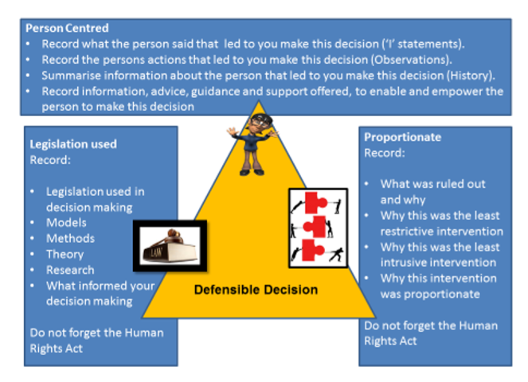
Defensible decision making always follows the word ‘because’ and is the justification for the level, extent and course of action taken. I chose this action because……….. I ruled this out because……
Notes:
Diagram source: Care Knowledge. Safeguarding adults in decision making. Defensible decisions are also constructive decisions when they are based on clear reasoning.
Ensure decisions are grounded in the evidence.
Structured professional assessment.
Collect, verify and thoroughly evaluate information.
Record and account for your decision making- see next slide.
Communicate with relevant others, seek information you do not have.
Stay within agency policies and procedures.
Take all reasonable steps.
Match risk management interventions to risk factors- in keeping with Human Rights and principles of legislation used.
Maintain contact with person set within agency guidelines.
Respond to escalating risk, deteriorating behaviour/ circumstances; and non/ disguised compliance.

Slide 31
A defensible decision has been defined as a decision that will withstand ‘hindsight scrutiny’ should the case ‘go wrong’ and negative outcomes have occurred” Carson, D. (1996)
“A decision is defensible if, in spite of a negative outcome, it can be demonstrated that all reasonable steps had been taken in its assessment and management. This is particularly important for those agencies that carry out risk assessment in the public eye, and where risk assessment and management failures can be very costly for victims, and to organisational credibility”
Kemshall, H and Pritchard, J (1998)

Slide 32
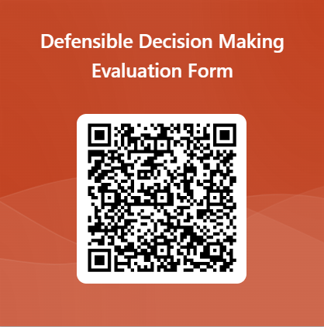
Evaluation

