Slide 1


REFLECTIVE PRACTICE SESSIONS
Chronologies - Strengthening Insight and Impact
Notes:
These sessions have been created to support Line Managers to have reflective discussions with teams around chronologies, their current use, identifying gaps and sharing best practice in a short 1-2 hour team reflective session

Slide 2

REFLECTIVE SESSION OUTCOMES AND CONTRACTING
Understand the purpose and value of chronologies in social work (what did we learn from the E-learning?)
Reflect on current practice and identify areas for improvement
Explore how chronologies support assessment, planning, and protection
Strengthen skills in compiling, analysing, and using chronologies meaningfully
1.5-2 hour Session
Safe and Brave Space – there is no wrong answers, however, we respect each others' opinions and ask questions to understand each others perspectives
Anything Else?
Notes:
As per the session guidelines, for this session to work in a short session – it would be best if participants had already completed the Elearning on Chronologies prior to this session
The session will provide an initial overview of purpose and value of chronologies and current learning tools available to us
Where is the evidence?? What do we know about the purpose and effectiveness of chronologies
Finally from understanding all of the outcomes – what goals can we set as a team around our chronology practice.
And allowing us to delve deeper into our teams and our own practice
Contracting is important – we want everyone to feel able to share their opinions and options we have some standard contracting included, safe and brave space, respect each others opinions and promote asking to understand perspectives.
What else – are there other things your team would find helpful – maybe mobiles off or laptops away may be an option for example?

Slide 3



WHAT DO YOU FEEL ABOUT CHRONOLOGIES PRACTICE JUST NOW?
Five-minute table discussion and feedback to the wider group.
How often are they completed?
Why are they not completed – What gets in the way
We could spend a lot of time discussing the difficulties or challenges; however, chronologies are an important part of our practice – we must do them – let us use this session to impact our practice, focus on the good and change what we can, for the better.
What do you think the current figures are like in Dundee for Chronologies across Adult and Children Services?
Notes:
Feedback to group – that the things that they have probably mentioned are not isolated to their team or even to Dundee – as much of these issues are recognised nationally
computer systems not matching up or complicated,
only seems to be social work responsibility,
where do you start from
What do you include
What does a good chronology look like
Process and Procedures Get in the way
Don’t have enough time to complete one
You find them more in protection work especially in child protection work – however, they can be tick box rather than analytical
Stats from Local Organisations - here

Slide 4
DEFINITION
A chronology is a succinct, sequential record of significant events in a person’s life, compiled to support understanding, assessment, and decision-making. It is not a case record but a summary timeline that helps practitioners identify patterns, risks, and changes over time.
Chronologies:
Organise key events in date order to provide a clear picture of a person’s circumstances
Support analysis by highlighting trends, gaps, and turning points
Aid communication across agencies and with individuals and families
Promote engagement and reflection, especially when used in a trauma-informed way
Can be single-agency or multi-agency, depending on the context and involvement
They are dynamic tools that require regular review and updating, and their quality depends on professional judgement about what events are truly significant
(adapted from IRISS 2024)
Group discussion: “What makes a good chronology?” (5 Mins)

Slide 5
We could turn chronologies on its head, and perhaps see chronologies as the start of our assessments – the basis for our understanding of the person we are working with – some practitioners identify the values of chronology work;
Avoids person being re-traumatized having to re-tell their story
Avoid risks and strengths being misunderstood or not being recognised at all
Supports participation and can get a deeper understanding of events from the persons perspective
It's an analytical tool
Can highlight protective factors
Can show trends or patterns
Can show what has been tried already and avoids bias
Can help manage power imbalances and understand perspectives between the person and professionals
Can save time by understanding what has worked in the past and why
Can enable people by them being fully involved in the process and the solutions
THE VALUE OF THE CHRONOLOGIES
(FROM THE PRACTITIONER LENS)

Slide 6

“Sharing and exploring chronologies can support people to understand what has happened in their lives, to appreciate and validate the family’s position and what the family think might help. …... Co-producing chronologies with family members can also build their self-efficacy and promote their position as experts in their own lives”.
Research in Practice, 2022)
Learning from Research:
Notes:
Learning from Research note – examples of this in practice in Dundee can be shown from DDARs work when chronology helped the adult and the worker have a conversation about significant events and patterns in their lives, they together were able to identify why this pattern was occurring (prison release of a family member) and the person could see why people were concerned and seen the escalating risks rather than the incidents happening in isolation.
Have you had experiences you would like to share – be great if we can capture these experiences

Slide 7
WHAT A CHRONOLOGY IS AND WHAT IT ISN’T – A RECAP
What it isn’t
A copy of a case note
Contain judgement, bias or hearsay – it is based on facts and their impact
Just to be used in protection work
Long detailed accounts of each visit or interaction
A professional's document containing jargon and professional language
An assessment – it's an analytical tool to aid assessment
What it is
Factual
Provides a shared understanding of risks or strengths between family/adult/child and the professionals
Provides a clear reference to significant events across a person's life-course
Tool to be used alongside the people we are working with
Can show escalating risks and can provide preventative practice rather than a reactive one
Helps us to be professionally curious – what else do we need to know? Where or who can help us understand the impact of a significant event?
A tool to help us reflect on our own practice and avoid the rule of optimism, confirmation bias, start again syndrome
It is a live document, which will adapt and change as more is known about impacts of events

Slide 8
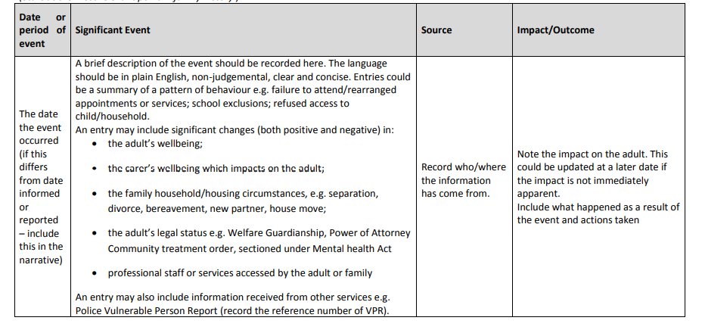
Learning from Research – What should be included in a Chronology
Notes:
An Example of what a chronology should contain and what type of information may appear in each section.
This is based on the IRISS, Research in Practice, Care Inspectorate Models and Tayside Chronology Guidance and is reflected in the Mosaic model we use online

Slide 9
“Professional judgement is key for determining what is (or is not) a significant event for an individual. Any events, which are considered to have a significant impact on a person, whether the event is positive or negative, or a strength or a weakness, should be considered for inclusion in a Chronology”
Tayside Practitioner's Guidance: Chronologies
Learning from Guidance:
Group discussion: “What is a Significant Event (5 Mins)
Notes:
Possible Feedback;
Bereavement
Divorce
Health Changes
Care Package Changes
Starting or leaving school or college
ASP/CP – if we have received multiple referrals about same incident they are put together under one event with appropriate reference to the detail held in the appropriate case file section (same as all detailed incidents)
Change in household
Change in worker or team

Slide 10
CASE STUDY EXERCISE (25 MINS)
Review
Review a case chronology – Margaret Fleming – Don’t Forget my Name
Identify
Identify strengths, gaps, and areas for improvement
Discuss
Discuss how the chronology informs decision-making and planning – what did you notice?
Notes:
Using the word printed templates and the “chronology” of Margaret Fleming – What do you notice, what would you change – what would you include and how would you record
Create a mini chronology in the short space of time that you have

Slide 11
DATE OR PERIOD OF EVENT | SIGNIFICANT EVENT | SOURCE | IMPACT/OUTCOME
1 November 1980 | Margaret is born Rankin Hospital in Greenock and lives in Port Glasgow with both her parents. She is an only child. | NHS Records
1981-1986 | Contradictions and discussions with professionals involved in health and education discuss a possible learning disability or chromosomal abnormality but no official diagnosis | Significant Learning Review | No diagnosis meant no appropriate supports in place
1993 | Parents’ divorce and Margaret stays with her father alongside her paternal grandparents | Significant Learning Review
1993 | Father met EC and AJ – through AJ’s business, a hotel which runs music nights. |  | EC and AJ become involved in family life and assume caring role
1995 | Father receives terminal diagnosis and appoints Eddie Cairney and Avril Jones as executors of his will. |  | Professionals assumed that EC and AJ were carers for Margaret
1995-1997 | Margaret is living with her mother – which is “tense and tumultuous”, with some stays (respite?) with EC and AJ which are described as breaks for Margarets mother | EC and AJ | EC and AJ have a bigger role in Margarets life and are given a significant voice in decision making
1997 | Margaret is living permanently with AC and AJ |  | Margaret starts to withdraw from protective factors of community and social events
December 1999 | Last known sighting of Margaret – family gathering, concerns from those that sighted Margaret – she was referred to as “wee slave”, guttering tubes on arms to stop "self harming", significant weight loss |  | Evidence of psychological and emotional abuse and neglect. It is then “presumed” that Margaret was murdered at 19 years old
2017 | Margaret was invisible until 2011 when she was discovered as “missing” | DWP | Investigations
Notes:
There are gaps - Lots of unknowns, no contact details for sources of information if a professional wanted to go back and discuss further – We have the luxury of hindsight
When we think of when to start a chronology sometimes the decision of where to start can be overwhelming, some people just start completing the chronology and then go back to historical chronologies at a later date or request the chronology from previous professionals or teams.

Slide 12

CHRONOLOGIES IN LEARNING REVIEWS
P19 - ‘Whilst chronologies and risk assessments were in place, these were not reflective of all the relevant information from all agencies and were not up to date". (p19, Significant Case Review, 2021)
The chronology in place "offered little value as an assessment or decision-making tool".
(O18, Significant Case Review, 2020)
….”little recorded discussion of the concept of undue influence or pressure, a lack of use of chronologies, and inconsistent protection plans and decision-making.
AB, Significant Case Review, 2023
Notes:
All adult case reviews, however, there are similar in child significant case reviews

Slide 13




WHAT ARE YOUR NEXT STEPS? (RECORD AND SHARE)
Personal Reflection (s) and Goal
- One thing I am going to do differently and what steps will I need to take to start the journey
Team Reflection (s) and Goal (s)
- What things are we going to improve together and what steps do we need to take to start the journey
How will we measure the change
What agreements can we make now to check-in on our personal and team goals?
Use the QR Code to Record your Individual and Team Goals
Notes:
Share your next steps - using the QR code, promoting individual and group accountability. Make sure that any goals are realistic and achievable
Laura will be in touch in 6-8 weeks to discuss any reflections or changes that you and your team may have noticed to record and share your hard work as a team

Slide 14
RESOURCES
Angus Council, (2021) Significant Care Review P19 – can be found here
Angus Council (2020) Significant Case Review O18 – can be found here
Care Inspectorate (2010) Practice Guide to Chronologies – can be found here
Chronologies E-learning (Tayside Tool) – Available on E-learning Platform
IRISS (2023) Moving from Current to best – can be found Chronologies in Adult Support and Protection: moving from current to best | Iriss
IRISS (2024) Leading Chronology Improvement: Reflection and Self Assessment Too – can be found here
IRISS Chronologies Conversations Podcast –- can be found here
Mental Welfare Commission, Investigation into the Death of AB (2020) can be found here
Research in practice (2022) Completing Social Work Chronologies Practice Tool –- can be found here
Notes:
As a leader working through the Reflection and Self Assessment Tool can be really helpful and can be used in future sessions that you may run with your team

